Slide 1
我们的目标
理解数据链路层服务背后的原理:
错误检测与纠正
共享一个广播频道:多路访问
链路层编址
可靠的数据传输，流程控制: 完成!
各种链路层技术的实例化和实现
以太网: 广播频道
点对点通道
Notes:
In the previous chapter we learned that the network layer provides a communication service between any two network hosts.
Between the two hosts, datagrams travel over a series of communication links, some wired and some wireless, starting at the source host, passing through a series of packet switches (switches and routers) and ending at the destination host.
As we continue down the protocol stack, from the network layer to the link layer, we naturally wonder how packets are sent across the individual links that make up the end-to-end communication path.
How are the network-layer datagrams encapsulated in the link-layer frames for transmission over a single link?
Are different link-layer protocols used in the different links along the communication path?
How are transmission conflicts in broadcast links resolved?
Is there addressing at the link layer and, if so, how does the link-layer addressing operate with the network-layer addressing we learned about in Chapter 4? [ARP]
And what exactly is the difference between a switch and a router?
We’ll answer these and other important questions in this chapter.
In discussing the link layer, we’ll see that there are two fundamentally different types of link-layer channels.
The first type are broadcast channels, which connect multiple hosts in wireless LANs, satellite networks, and hybrid fiber-coaxial cable (HFC) access networks.
Since many hosts are connected to the same broadcast communication channel, a so-called medium access protocol is needed to coordinate frame transmission. [MAC]
In some cases, a central controller may be used to coordinate transmissions; in other cases, the hosts themselves coordinate transmissions.
The second type of link-layer channel is the point-to-point communication link, such as that often found between two routers connected by a long-distance link, or between a user’s office computer and the nearby Ethernet switch to which it is connected.
Coordinating access to a point-to-point link is simpler; the reference material on this book’s web site has a detailed discussion of the Point-to-Point Protocol (PPP), which is used in settings ranging from dial-up service over a telephone line to high-speed point-to-point frame transport over fiber-optic links.
We’ll explore several important link-layer concepts and technologies in this chapter.
We’ll dive deeper into error detection and correction, a topic we touched on briefly in Chapter 3.
We’ll consider multiple access networks and switched LANs, including Ethernet — by far the most prevalent wired LAN technology.
We’ll also look at virtual LANs, and data center networks.
Although WiFi, and more generally wireless LANs, are link-layer topics, we’ll postpone our study of these important topics until Chapter 7.

Slide 2
application process
application process
AP4
AP₂
AP3
AP₁
application data (presentation formatting and compression)
message = specific headers + manipulated data
5
4
3
2
1
port/socket/endpoint
port
5
4
3
2
1
message segment or user datagram
运输层为相互通信的应用进程提供了逻辑通信
IP 层
Host A
Host B
Router 1
Router 2
AP₁
AP₃
LAN₁
WAN
LAN₂
AP₂
AP₄
Notes:
传输层协议为运行在不同Host上的进程提供了一种逻辑通信机制，之所以叫做逻辑通信，是因为两个进程之间的通信就像所在的两个Host存在直接链接一样。
其实，两个Host可能相距很远，两者的物理连接可能经过了多个交换机/路由器，传输路径可能由不同类型的物理链路组成。
利用这种逻辑通信机制，两个进程可以不用考虑两者之间的物理连接方式而实现发送/接收报文。
传输层协议在Host中实现，交换机/路由器中没有传输层。
发送方：将应用递交的报文分成一个或多个的Segment，并向下传给网络层。
接收方：将接收到的segment组装成报文，并向上交给应用层。

Slide 3
第 6 章 链路层和局域网
6.1 链路层概述
链路层提供的服务
链路层在何处实现
6.2 差错检测和纠正技术
奇偶校验
校验和方法
循环冗余检测
6.3 多路访问链路和协议
信道划分协议
随机接入协议
轮流协议
DOCSIS: 用于电缆互联网接入的链路层协议
6.4 交换局域网
链路层寻址和 ARP
以太网
链路层交换机
虚拟局域网 (VLANs)
6.5 链路虚拟化：网络作为链路层
多协议标签交换 (MPLS)
6.6 数据中心网络
6.7 回顾：Web页面请求的历程
准备：DHCP、UDP、IP和以太网
仍在准备：DNS 和 ARP
仍在准备：域内路由选择到DNS服务器
Web 客户 — 服务器交互：TCP 和 HTTP
6.8 小结

Slide 4
IP Suite: End Hosts vs. Routers
host
host
HTTP message
HTTP
HTTP
TCP segment
TCP
TCP
router
router
IP
IP packet
IP packet
IP packet
IP
IP
IP
Ethernet
interface
Ethernet
interface
SONET
interface
SONET
interface
Ethernet
interface
Ethernet
interface

Slide 5
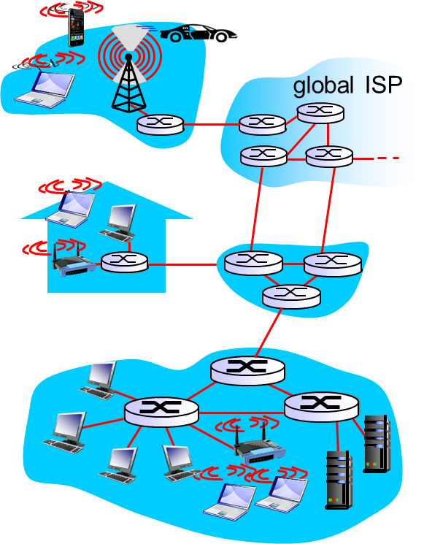
5.1 链路层概述
术语
节点：主机和路由器
链路：沿着通信路径连接相邻节点的通信信道
有线链路
无线链路
帧：数据链路层的分组单元
数据链路层负责将数据报通过链路从一个节点传输到物理上相邻的下一个节点。
Notes:
6.1 Introduction to the Link Layer
Let’s begin with some important terminology.
We’ll find it convenient in this chapter to refer to any device that runs a link-layer (i.e., layer 2) protocol as a node.
Nodes include hosts, routers, switches, and WiFi access points (discussed in Chapter 7).
We will also refer to the communication channels that connect adjacent nodes along the communication path as links.
In order for a datagram to be transferred from source host to destination host, it must be moved over each of the individual links in the end-to-end path.
As an example, in the company network shown at the bottom of Figure 6.1, consider sending a datagram from one of the wireless hosts to one of the servers.
This datagram will actually pass through six links: a WiFi link between sending host and WiFi access point, an Ethernet link between the access point and a link-layer switch; a link between the link-layer switch and the router, a link between the two routers; an Ethernet link between the router and a link-layer switch; and finally an Ethernet link between the switch and the server.
Over a given link, a transmitting node encapsulates the datagram in a link-layer frame and transmits the frame into the link.

Slide 6
数据链路层传送的是帧
结点 A
结点 B
网络层
IP 数据报
IP 数据报
数据
链路层
装入
取出
帧
帧
取出
物理层
1010… …0110
1010… …0110
链路
(a) 三层简化模型
结点 A
结点 B
数据
链路层
发送
接收
帧
帧
链路
(b) 只考虑数据链路层

Slide 7
数据链路和帧
链路(link)是从一个结点到相邻结点的一段物理线路wire(有线wired或无线wireless)，而中间没有任何其他的交换结点。
一条链路只是一条路径path(或者说通路)的组成部分。
数据链路(data link) 除了物理线路外，还必须有通信协议来控制这些数据的传输。若把实现这些协议的硬件和软件加到 (或者作用于) 链路上，就构成了数据链路。
现在最常用的方法是使用网络适配器 (既有硬件，也包括软件) 来实现这些协议。
一般的适配器都包括了数据链路层和物理层这两层的功能。
也有人采用另外的术语。这就是把链路分为物理链路和逻辑链路。

Slide 8
Link layer: context
Datagram transferred by different link protocols over different links:
e.g., Ethernet on first link, frame relay on intermediate links, 802.11 on last link
Each link protocol provides different services
e.g., may or may not provide rdt (reliable data transfer) over a link.
transportation analogy
trip from Princeton, New Jersey to Lausanne, Switzerland
limo: Princeton to JFK
plane: JFK to Geneva
train: Geneva to Lausanne
tourist = datagram
transportation segment = communication link
transportation mode = link layer protocol
travel agent = routing algorithm
Notes:
In order to gain further insight into the link layer and how it relates to the network layer, let’s consider a transportation analogy.
Consider a travel agent who is planning a trip for a tourist traveling from Princeton, New Jersey, to Lausanne, Switzerland.
The travel agent decides that it is most convenient for the tourist to take a limousine from Princeton to JFK airport, then a plane from JFK airport to Geneva’s airport, and finally a train from Geneva’s airport to Lausanne’s train station.
Once the travel agent makes the three reservations, it is the responsibility of the Princeton limousine company to get the tourist from Princeton to JFK; it is the responsibility of the airline company to get the tourist from JFK to Geneva; and it is the responsibility of the Swiss train service to get the tourist from Geneva to Lausanne.
Each of the three segments of the trip is “direct” between two “adjacent” locations.
Note that the three transportation segments are managed by different companies and use entirely different transportation modes (limousine, plane, and train).
Although the transportation modes are different, they each provide the basic service of moving passengers from one location to an adjacent location.
In this transportation analogy, the tourist is a datagram, each transportation segment is a link, the transportation mode is a link-layer protocol, and the travel agent is a routing protocol.

Slide 9
5.1 链路层概述
几点特别说明
数据报在不同链路上可能由不同的链路层协议进行处理
例如：第一段链路上由PPP处理，最后一段链路上由以太网处理，中间链路上由广域链路层协议处理
不同的链路层协议可能提供不同的服务
例如：可靠传递、不可靠传递

Slide 10
第 6 章 链路层和局域网
6.1 链路层概述
链路层提供的服务
链路层在何处实现
6.2 差错检测和纠正技术
奇偶校验
校验和方法
循环冗余检测
6.3 多路访问链路和协议
信道划分协议
随机接入协议
轮流协议
DOCSIS: 用于电缆互联网接入的链路层协议
6.4 交换局域网
链路层寻址和 ARP
以太网
链路层交换机
虚拟局域网 (VLANs)
6.5 链路虚拟化：网络作为链路层
多协议标签交换 (MPLS)
6.6 数据中心网络
6.7 回顾：Web页面请求的历程
准备：DHCP、UDP、IP和以太网
仍在准备：DNS 和 ARP
仍在准备：域内路由选择到DNS服务器
Web 客户 — 服务器交互：TCP 和 HTTP
6.8 小结

Slide 11
链路层可能提供的服务
成帧(framing), 链路接入:
将数据报封装成帧，增加首部和或尾部
如果共享媒体，则进行媒体访问控制MAC (Medium Access Control) 协调多个节点的帧传输
在帧首部中使用“MAC” 地址标识源和目的节点。
MAC地址不同于IP地址!
相邻节点之间可靠交付
我们已经学会了怎么做(第3章) !
很少用于低比特错误链路(光纤，某些双绞线)
无线链路: 高差错率
Q: why both link-level and end-end reliability?
Notes:
Although the basic service of any link layer is to move a datagram from one node to an adjacent node over a single communication link, the details of the provided service can vary from one link-layer protocol to the next.
Possible services that can be offered by a link-layer protocol include:
• Framing.
Almost all link-layer protocols encapsulate each network-layer datagram within a link-layer frame before transmission over the link.
A frame consists of a data field, in which the network-layer datagram is inserted, and a number of header fields.
The structure of the frame is specified by the link-layer protocol.
We’ll see several different frame formats when we examine specific link-layer protocols in the second half of this chapter.
• Link access.
A medium access control (MAC) protocol specifies the rules by which a frame is transmitted onto the link.
For point-to-point links that have a single sender at one end of the link and a single receiver at the other end of the link, the MAC protocol is simple (or nonexistent) — the sender can send a frame whenever the link is idle.
The more interesting case is when multiple nodes share a single broadcast link — the so-called multiple access problem.
Here, the MAC protocol serves to coordinate the frame transmissions of the many nodes.
• Reliable delivery.
When a link-layer protocol provides reliable delivery service, it guarantees to move each network-layer datagram across the link without error.
Recall that certain transport-layer protocols (such as TCP) also provide a reliable delivery service.
Similar to a transport-layer reliable delivery service, a link-layer reliable delivery service can be achieved with acknowledgments and retransmissions (see Section 3.4).
A link-layer reliable delivery service is often used for links that are prone to high error rates, such as a wireless link, with the goal of correcting an error locally — on the link where the error occurs — rather than forcing an end-to-end retransmission of the data by a transport- or application-layer protocol.
However, link-layer reliable delivery can be considered an unnecessary overhead for low bit-error links, including fiber, coax, and many twisted-pair copper links.
For this reason, many wired link-layer protocols do not provide a reliable delivery service.

Slide 12
链路层可能提供的服务
差错检测
信号衰减和电磁干扰噪声导致出错
接收方检测到错误存在：
给发送方发送信号要求重传
丢弃该数据帧
差错纠正
接收方检测和纠正帧中错误，不用重传
半双工和全双工
半双工时，链路两端的节点都能传输分组，但不能同时传输
Notes:
• Error detection and correction.
The link-layer hardware in a receiving node can incorrectly decide that a bit in a frame is zero when it was transmitted as a one, and vice versa.
Such bit errors are introduced by signal attenuation and electromagnetic noise.
Because there is no need to forward a datagram that has an error, many link-layer protocols provide a mechanism to detect such bit errors.
This is done by having the transmitting node include error-detection bits in the frame, and having the receiving node perform an error check.
Recall from Chapters 3 and 4 that the Internet’s transport layer and network layer also provide a limited
form of error detection — the Internet checksum.
Error detection in the link layer is usually more sophisticated and is implemented in hardware.
Error correction is similar to error detection, except that a receiver not only detects when bit errors have occurred in the frame but also determines exactly where in the frame the errors have occurred (and then corrects these errors).

Slide 13
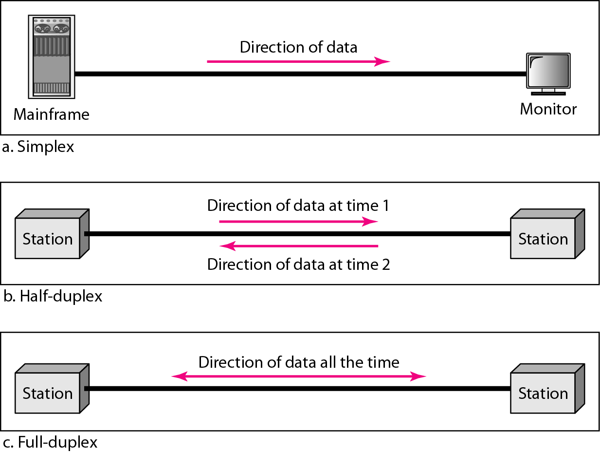
链路层可能提供的服务
Notes:
c

Slide 14
第 6 章 链路层和局域网
6.1 链路层概述
链路层提供的服务
链路层在何处实现
6.2 差错检测和纠正技术
奇偶校验
校验和方法
循环冗余检测
6.3 多路访问链路和协议
信道划分协议
随机接入协议
轮流协议
DOCSIS: 用于电缆互联网接入的链路层协议
6.4 交换局域网
链路层寻址和 ARP
以太网
链路层交换机
虚拟局域网 (VLANs)
6.5 链路虚拟化：网络作为链路层
多协议标签交换 (MPLS)
6.6 数据中心网络
6.7 回顾：Web页面请求的历程
准备：DHCP、UDP、IP和以太网
仍在准备：DNS 和 ARP
仍在准备：域内路由选择到DNS服务器
Web 客户 — 服务器交互：TCP 和 HTTP
6.8 小结

Slide 15
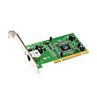
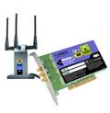

链路层在何处实现
链路层的实现
在每一台设备上(主机、交换机、路由器)
链路层在“适配器”(网卡NIC)或者芯片上实现
以太网卡、802.11卡和以太网芯片
实现链路层和物理层
直接与主机的系统总线相连
是硬件、软件和固件的结合体
应用层
传输层
网络层
数据链路层
CPU
内存
数据链路层
物理层
主机总线(如：PCI)
控制器
物理
传输接口
网卡
Notes:
Before diving into our detailed study of the link layer, let’s conclude this introduction by considering the question of where the link layer is implemented.
We’ll focus here on an end system, since we learned in Chapter 4 that the link layer is implemented in a router’s line card.
Is a host’s link layer implemented in hardware or software?
Is it implemented on a separate card or chip, and how does it interface with the rest of a host’s hardware and operating system components?
Figure 6.2 shows a typical host architecture.
For the most part, the link layer is implemented in a network adapter, also sometimes known as a network interface card (NIC).
At the heart of the network adapter is the link-layer controller, usually a single, special-purpose chip that implements many of the link-layer services (framing, link access, error detection, and so on).
Thus, much of a link-layer controller’s functionality is implemented in hardware.
For example, Intel’s 710 adapter [Intel 2016] implements the Ethernet protocols we’ll study in Section 6.5; the Atheros AR5006 [Atheros 2016] controller implements the 802.11 WiFi protocols we’ll study in Chapter 7.
Until the late 1990s, most network adapters were physically separate cards (such as a PCMCIA card or a plug-in card fitting into a PC’s PCI card slot) but increasingly, network adapters are being integrated onto the host’s motherboard — a so-called LAN-on-motherboard configuration.

Slide 16
适配器通信
link-layer software
link-layer software
datagram
datagram
controller
controller
发送主机
接收主机
datagram
frame
发送方:
在一个帧内封装数据报
增加差错检测位，可靠交付，流量检测等
接收方
查找错误,可靠交付, 流量控制等
取出数据报，交给网络层
Notes:
On the sending side, the controller takes a datagram that has been created and stored in host memory by the higher layers of the protocol stack, encapsulates the datagram in a link-layer frame (filling in the frame’s various fields), and then transmits the frame into the communication link, following the link-access protocol.
On the receiving side, a controller receives the entire frame, and extracts the network-layer datagram.
If the link layer performs error detection, then it is the sending controller that sets the error-detection bits in the frame header and it is the receiving controller that performs error detection.
Figure 6.2 shows a network adapter attaching to a host’s bus (e.g., a PCI or PCI-X bus), where it looks much like any other I/O device to the other host components. (如显示卡)
Figure 6.2 also shows that while most of the link layer is implemented in hardware, part of the link layer is implemented in software that runs on the host’s CPU.
The software components of the link layer implement higher-level link layer functionality such as assembling link-layer addressing information and activating the controller hardware.
On the receiving side, link-layer software responds to controller interrupts (e.g., due to the receipt of one or more frames), handling error conditions and passing a datagram up to the network layer.
Thus, the link layer is a combination of hardware and software — the place in the protocol stack where software meets hardware.
[Intel 2016] provides a readable overview (as well as a detailed description) of the XL710 controller from a software-programming point of view.

Slide 17
适配器通信
适配器是半自治单元
帧的接收和发送、检错、丢弃均是自主进行
向上提交数据时，需要节点干预
最终受控于节点

Slide 18
适配器通信
Notes:
Attachment Unit Interface 连接单元接口

Slide 19
第 6 章 链路层和局域网
6.1 链路层概述
链路层提供的服务
链路层在何处实现
6.2 差错检测和纠正技术
奇偶校验
校验和方法
循环冗余检测
6.3 多路访问链路和协议
信道划分协议
随机接入协议
轮流协议
DOCSIS: 用于电缆互联网接入的链路层协议
6.4 交换局域网
链路层寻址和 ARP
以太网
链路层交换机
虚拟局域网 (VLANs)
6.5 链路虚拟化：网络作为链路层
多协议标签交换 (MPLS)
6.6 数据中心网络
6.7 回顾：Web页面请求的历程
准备：DHCP、UDP、IP和以太网
仍在准备：DNS 和 ARP
仍在准备：域内路由选择到DNS服务器
Web 客户 — 服务器交互：TCP 和 HTTP
6.8 小结

Slide 20
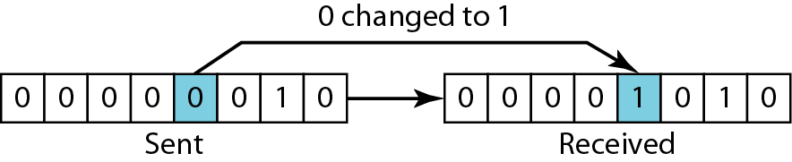
单比特差错

Slide 21
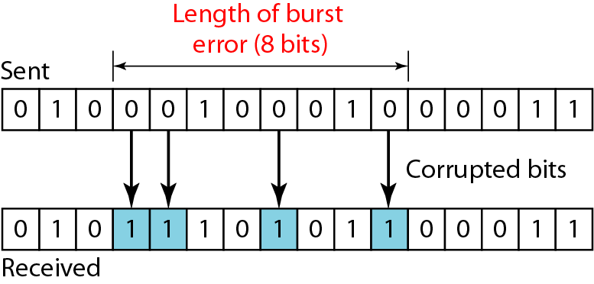
突发错误长度

Slide 22
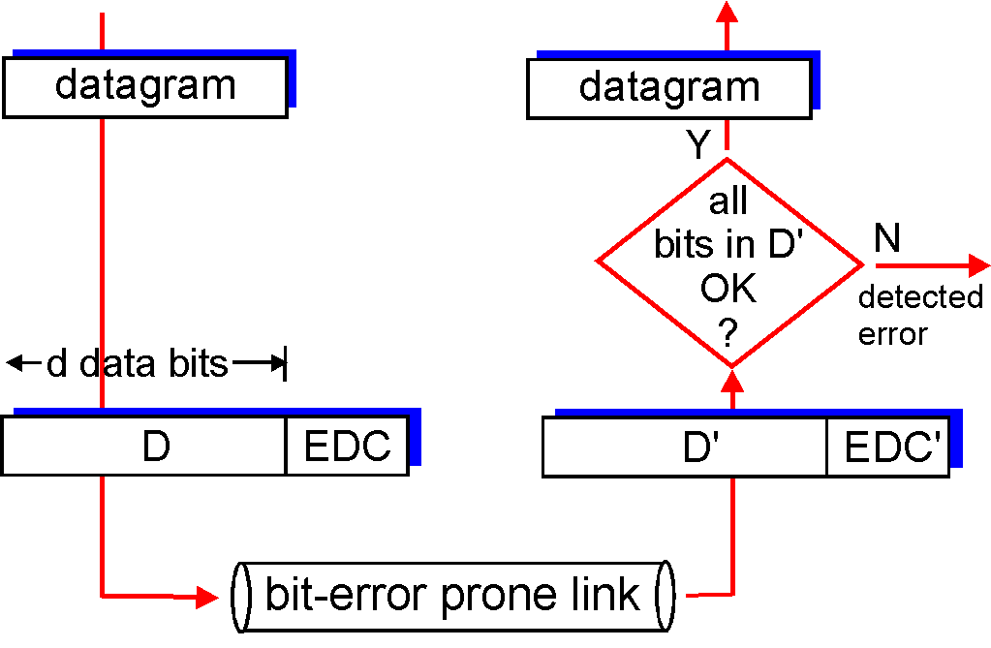
6.2 差错检测和纠正技术
差错检测模型
EDC= Error Detection and Correction bits 差错检测和纠错比特
D = Data 差错检测位保护的数据，可包括首部
差错检测不是100%可靠的，EDC越长，出错不能检测到的概率越低！
数据报
数据报
在D’中的所有比特正确吗？
检测到差错
d数据比特
易出现比特差错的链路
Notes:
In the previous section, we noted that bit-level error detection and correction — detecting and correcting the corruption of bits in a link-layer frame sent from one node to another physically connected neighboring node — are two services often provided by the link layer.
We saw in Chapter 3 that error-detection and –correction services are also often offered at the transport layer as well.
In this section, we’ll examine a few of the simplest techniques that can be used to detect and, in some cases, correct such bit errors.
A full treatment of the theory and implementation of this topic is itself the topic of many textbooks (for example, [Schwartz 1980] or [Bertsekas 1991]), and our treatment here is necessarily brief.
Our goal here is to develop an intuitive feel for the capabilities that error-detection and –correction techniques provide, and to see how a few simple techniques work and are used in practice in the link layer.
Figure 6.3 illustrates the setting for our study.
At the sending node, data, D, to be protected against bit errors is augmented with error-detection and -correction bits (EDC).
Typically, the data to be protected includes not only the datagram passed down from the network layer for transmission across the link, but also link-level addressing information, sequence numbers, and other fields in the link frame header.
Both D and EDC are sent to the receiving node in a link-level frame.
At the receiving node, a sequence of bits, D’ and EDC’ is received.
Note that D’ and EDC’ may differ from the original D and EDC as a result of in-transit bit flips.
The receiver’s challenge is to determine whether or not D’ is the same as the original D, given that it has only received D’ and EDC’.
The exact wording of the receiver’s decision in Figure 6.3 (we ask whether an error is detected, not whether an error has occurred!) is important.
Error-detection and -correction techniques allow the receiver to sometimes, but not always, detect that bit errors have occurred.
Even with the use of error-detection bits there still may be undetected bit errors; that is, the receiver may be unaware that the received information contains bit errors.
As a consequence, the receiver might deliver a corrupted datagram to the network layer, or be unaware that the contents of a field in the frame’s header has been corrupted.
We thus want to choose an error-detection scheme that keeps the probability of such occurrences small.
Generally, more sophisticated error-detection and-correction techniques (that is, those that have a smaller probability of allowing undetected bit errors) incur a larger overhead — more computation is needed to compute and transmit a larger number of error-detection and -correction bits.
Let’s now examine three techniques for detecting errors in the transmitted data — parity checks (to illustrate the basic ideas behind error detection and correction), checksumming methods (which are more typically used in the transport layer), and cyclic redundancy checks (which are more typically used in the link layer in an adapter).

Slide 23
第 6 章 链路层和局域网
6.1 链路层概述
链路层提供的服务
链路层在何处实现
6.2 差错检测和纠正技术
奇偶校验
校验和方法
循环冗余检测
6.3 多路访问链路和协议
信道划分协议
随机接入协议
轮流协议
DOCSIS: 用于电缆互联网接入的链路层协议
6.4 交换局域网
链路层寻址和 ARP
以太网
链路层交换机
虚拟局域网 (VLANs)
6.5 链路虚拟化：网络作为链路层
多协议标签交换 (MPLS)
6.6 数据中心网络
6.7 回顾：Web页面请求的历程
准备：DHCP、UDP、IP和以太网
仍在准备：DNS 和 ARP
仍在准备：域内路由选择到DNS服务器
Web 客户 — 服务器交互：TCP 和 HTTP
6.8 小结

Slide 24
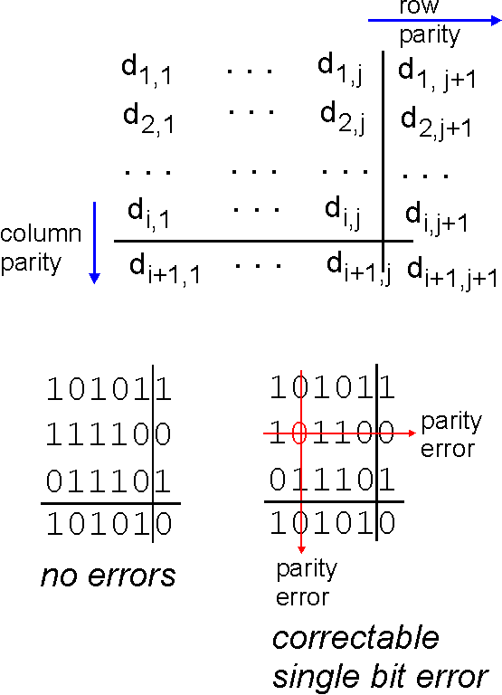
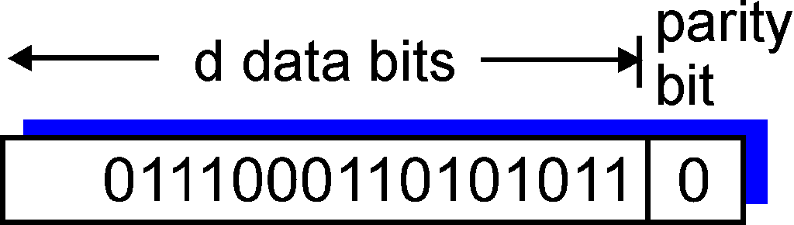
奇偶校验
单比特奇偶校验:
检测单个比特错误
二维奇偶校验:
检测和纠正单个比特错误
校验位
行校验
d个数据比特
列校验
校验错
0
0
无差错
校验错
可纠正单比特差错
Notes:
Perhaps the simplest form of error detection is the use of a single parity bit.
Suppose that the information to be sent, D in Figure 6.4, has d bits.
In an even parity scheme, the sender simply includes one additional bit and chooses its value such that the total number of 1s in the d + 1 bits (the original information plus a parity bit) is even.
For odd parity schemes, the parity bit value is chosen such that there is an odd number of 1s.
Figure 6.4 illustrates an even parity scheme, with the single parity bit being stored in a separate field.
Receiver operation is also simple with a single parity bit.
The receiver need only count the number of 1s in the received d + 1 bits.
If an odd number of 1-valued bits are found with an even parity scheme, the receiver knows that at least one bit error has occurred.
More precisely, it knows that some odd number of bit errors have occurred.
But what happens if an even number of bit errors occur?
You should convince yourself that this would result in an undetected error.
If the probability of bit errors is small and errors can be assumed to occur independently from one bit to the next, the probability of multiple bit errors in a packet would be extremely small.
In this case, a single parity bit might suffice.
However, measurements have shown that, rather than occurring independently, errors are often clustered together in “bursts.”
Under burst error conditions, the probability of undetected errors in a frame protected by single-bit parity can approach 50 percent [Spragins 1991].
Clearly, a more robust error-detection scheme is needed (and, fortunately, is used in practice!).
But before examining error-detection schemes that are used in practice, let’s consider a simple generalization of one-bit parity that will provide us with insight into error-correction techniques.
Figure 6.5 shows a two-dimensional generalization of the single-bit parity scheme.
Here, the d bits in D are divided into i rows and j columns.
A parity value is computed for each row and for each column.
The resulting i + j + 1 parity bits comprise the link-layer frame’s error-detection bits.
Suppose now that a single bit error occurs in the original d bits of information.
With this two-dimensional parity scheme, the parity of both the column and the row containing the flipped bit will be in error.
The receiver can thus not only detect the fact that a single bit error has occurred, but can use the column and row indices of the column and row with parity errors to actually identify the bit that was corrupted and correct that error!
Figure 6.5 shows an example in which the 1-valued bit in position (2,2) is corrupted and switched to a 0 — an error that is both detectable and correctable at the receiver.
Although our discussion has focused on the original d bits of information, a single error in the parity bits themselves is also detectable and correctable.
Two-dimensional parity can also detect (but not correct!) any combination of two errors in a packet.
Other properties of the two-dimensional parity scheme are explored in the problems at the end of the chapter.
The ability of the receiver to both detect and correct errors is known as forward error correction (FEC).
These techniques are commonly used in audio storage and playback devices such as audio CDs.
In a network setting, FEC techniques can be used by themselves, or in conjunction with link-layer ARQ techniques similar to those we examined in Chapter 3.
FEC techniques are valuable because they can decrease the number of sender retransmissions required.
Perhaps more important, they allow for immediate correction of errors at the receiver.
This avoids having to wait for the round-trip propagation delay needed for the sender to receive a NAK packet and for the retransmitted packet to propagate back to the receiver — a potentially important advantage for real-time network applications [Rubenstein 1998] or links (such as deep-space links) with long propagation delays.
Research examining the use of FEC in error-control protocols includes [Biersack 1992; Nonnenmacher 1998; Byers 1998; Shacham 1990].

Slide 25
校验和方法 (review)
发送方
将数据段的内容作为16比特的整数序列
校验和: 累加求和，计算和的1的补码
发送方将得到的校验和值放入协议数据单元PDU校验和字段
接收方
计算收到的数据段的校验和
检查计算出的校验和与校验和字段中的值是否相同:
NO – 检测到错误
YES – 没有错误
特别注意：仅用于TCP、UDP和IPv4协议中
Notes:
In checksumming techniques, the d bits of data in Figure 6.4 are treated as a sequence of k-bit integers.
One simple checksumming method is to simply sum these k-bit integers and use the resulting sum as the error-detection bits.
The Internet checksum is based on this approach — bytes of data are treated as 16-bit integers and summed.
The 1s complement of this sum then forms the Internet checksum that is carried in the segment header.
As discussed in Section 3.3, the receiver checks the checksum by taking the 1s complement of the sum of the received data (including the checksum) and checking whether the result is all 1 bits.
If any of the bits are 0, an error is indicated.
RFC 1071 discusses the Internet checksum algorithm and its implementation in detail.
In the TCP and UDP protocols, the Internet checksum is computed over all fields (header and data fields included).
In IP the checksum is computed over the IP header (since the UDP or TCP segment has its own checksum).
In other protocols, for example, XTP [Strayer 1992], one checksum is computed over the header and another checksum is computed over the entire packet.
Checksumming methods require relatively little packet overhead.
For example, the checksums in TCP and UDP use only 16 bits.
However, they provide relatively weak protection against errors as compared with cyclic redundancy check, which is discussed below and which is often used in the link layer.
A natural question at this point is, Why is checksumming used at the transport layer and cyclic redundancy check used at the link layer?
Recall that the transport layer is typically implemented in software in a host as part of the host’s operating system.
Because transport-layer error detection is implemented in software, it is important to have a simple and fast error-detection scheme such as checksumming.
On the other hand, error detection at the link layer is implemented in dedicated hardware in adapters, which can rapidly perform the more complex CRC operations.
Feldmeier [Feldmeier 1995] presents fast software implementation techniques for not only weighted checksum codes, but CRC (see below) and other codes as well.

Slide 26
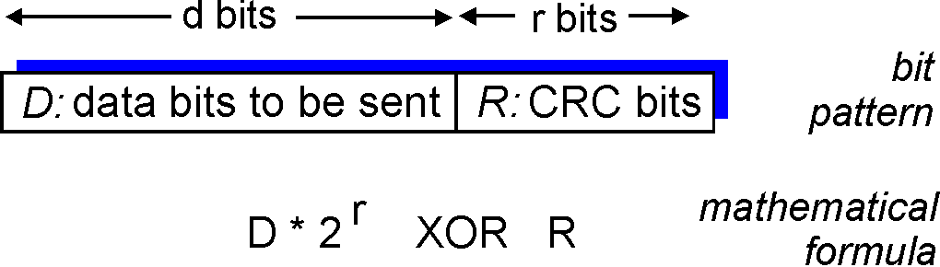
循环冗余校验码
较强大的错误检测编码
d比特的数据，D
选择r＋1比特模式(生成多项式)，表示为G
目标：选择r个CRC比特，R，以便
<D, R> 恰好能被G整除 (模2计算)
接收方已知G，用G去除<D, R> ，若余数非0，则检测到错误
能检测到所有少于r+1比特的错误
在实践中被广泛应用 (Ethernet, 802.11 WiFi, ATM)
d比特
r比特
比特模式
D:被发送的数据比特
R:CRC比特
数学公式
Notes:
An error-detection technique used widely in today’s computer networks is based on cyclic redundancy check (CRC) codes.
CRC codes are also known as polynomial codes, since it is possible to view the bit string to be sent as a polynomial whose coefficients are the 0 and 1 values in the bit string, with operations on the bit string interpreted as polynomial arithmetic.
CRC codes operate as follows.
Consider the d-bit piece of data, D, that the sending node wants to send to the receiving node.
The sender and receiver must first agree on an r + 1 bit pattern, known as a generator, which we will denote as G.
We will require that the most significant (leftmost) bit of G be a 1.
The key idea behind CRC codes is shown in Figure 6.6.
For a given piece of data, D, the sender will choose r additional bits, R, and append them to D such that the resulting d + r bit pattern (interpreted as a binary number) is exactly divisible by G (i.e., has no
remainder) using modulo-2 arithmetic.
The process of error checking with CRCs is thus simple: The receiver divides the d + r received bits by G.
If the remainder is nonzero, the receiver knows that an error has occurred; otherwise the data is accepted as being correct.
All CRC calculations are done in modulo-2 arithmetic without carries in addition or borrows in subtraction.
This means that addition and subtraction are identical, and both are equivalent to the bitwise exclusive-or (XOR) of the operands.
Thus, for example,
1011 XOR 0101 = 1110
1001 XOR 1101 = 0100
Also, we similarly have
1011 – 0101 = 1110
1001 – 1101 = 0100
Multiplication and division are the same as in base-2 arithmetic, except that any required addition or subtraction is done without carries or borrows.
As in regular binary arithmetic, multiplication by 2^{k} left shifts a bit pattern by k places.
Thus, given D and R, the quantity D.2^{r} XOR R yields the d + r bit pattern shown in Figure 6.6.
We’ll use this algebraic characterization of the d + r bit pattern from Figure 6.6 in our discussion below.

Slide 27
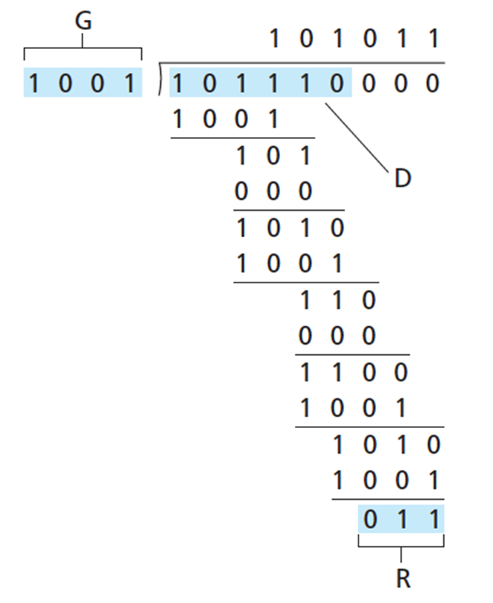
5.2 差错检测和纠正技术
如果要:
D*2^{r} XOR R = n.G
两边都异或R，得到:
D*2^{r} = n.G XOR R
即:
D*2^{r} 除以G，得到余数 R
D.2^{r}
G
R = remainder[ ]
CRC-32(国际标准)
G_{CRC-32} =100000100110000010001110110110111 (33bits)
Notes:
Let us now turn to the crucial question of how the sender computes R.
Recall that we want to find R such that there is an n such that
D.2^{r} XOR R = nG
That is, we want to choose R such that G divides into D.2^{r} XOR R without remainder.
If we XOR (that is, add modulo-2, without carry) R to both sides of the above equation, we get
D.2^{r} = nG XOR R
This equation tells us that if we divide D.2^{r} by G, the value of the remainder is precisely R.
In other words, we can calculate R as
R = remainder[D.2^{r}/G]
Figure 6.7 illustrates this calculation for the case of D = 101110, d = 6, G = 1001, and r =3.
The 9 bits transmitted in this case are 101110 011.
You should check these calculations for yourself and also check that indeed D . 2^{r} = 101011.G XOR R.
International standards have been defined for 8-, 12-, 16-, and 32-bit generators, G.
The CRC-32 32-bit standard, which has been adopted in a number of link level IEEE protocols, uses a generator of
G_{CRC-32} =100000100110000010001110110110111 (33 bits)
Each of the CRC standards can detect burst errors of fewer than r + 1 bits.
(This means that all consecutive bit errors of r bits or fewer will be detected.)
Furthermore, under appropriate assumptions, a burst of length greater than r + 1 bits is detected with probability 1 – 0.5^{r}.
Also, each of the CRC standards can detect any odd number of bit errors.
See [Williams 1993] for a discussion of implementing CRC checks.
The theory behind CRC codes and even more powerful codes is beyond the scope of this text.
The text [Schwartz 1980] provides an excellent introduction to this topic.

Slide 28
第 6 章 链路层和局域网
6.1 链路层概述
链路层提供的服务
链路层在何处实现
6.2 差错检测和纠正技术
奇偶校验
校验和方法
循环冗余检测
6.3 多路访问链路和协议
信道划分协议
随机接入协议
轮流协议
DOCSIS: 用于电缆互联网接入的链路层协议
6.4 交换局域网
链路层寻址和 ARP
以太网
链路层交换机
虚拟局域网 (VLANs)
6.5 链路虚拟化：网络作为链路层
多协议标签交换 (MPLS)
6.6 数据中心网络
6.7 回顾：Web页面请求的历程
准备：DHCP、UDP、IP和以太网
仍在准备：DNS 和 ARP
仍在准备：域内路由选择到DNS服务器
Web 客户 — 服务器交互：TCP 和 HTTP
6.8 小结

Slide 29





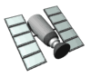
5.3 多路访问链路和协议
两种链路
点到点链路(point-to-point)
用于拨号接入PPP
以太网交换机和主机之间的点到点链路
广播链路(共享线路或介质)
传统以太网 /802.11无线LAN /upstream HFC
shared wire (e.g.,
cabled Ethernet)
shared RF
(e.g., 802.11 WiFi)
shared RF
(satellite)
humans at a
cocktail party
(shared air, acoustical)
Notes:
In the introduction to this chapter, we noted that there are two types of network links: point-to-point links and broadcast links.
A point-to-point link consists of a single sender at one end of the link and a single receiver at the other end of the link.
Many link-layer protocols have been designed for point-to-point links; the point-to-point protocol (PPP) and high-level data link control (HDLC) are two such protocols.
The second type of link, a broadcast link, can have multiple sending and receiving nodes all connected to the same, single, shared broadcast channel.
The term broadcast is used here because when any one node transmits a frame, the channel broadcasts the frame and each of the other nodes receives a copy.
Ethernet and wireless LANs are examples of broadcast link-layer technologies.
In this section we’ll take a step back from specific link-layer protocols and first examine a problem of central importance to the link layer: how to coordinate the access of multiple sending and receiving nodes to a shared broadcast channel — the multiple access problem.
Broadcast channels are often used in LANs, networks that are geographically concentrated in a single building (or on a corporate or university campus).
Thus, we’ll also look at how multiple access channels are used in LANs at the end of this section.
We are all familiar with the notion of broadcasting — television has been using it since its invention.
But traditional television is a one-way broadcast (that is, one fixed node transmitting to many receiving nodes), while nodes on a computer network broadcast channel can both send and receive.
Perhaps a more apt human analogy for a broadcast channel is a cocktail party, where many people gather in a large room (the air providing the broadcast medium) to talk and listen.
A second good analogy is something many readers will be familiar with — a classroom — where teacher(s) and student(s) similarly share the same, single, broadcast medium.
A central problem in both scenarios is that of determining who gets to talk (that is, transmit into the channel), and when.
As humans, we’ve evolved an elaborate set of protocols for sharing the broadcast channel:
“Give everyone a chance to speak.”
“Don’t speak until you are spoken to.”
“Don’t monopolize the conversation.”
“Raise your hand if you have a question.”
“Don’t interrupt when someone is speaking.”
“Don’t fall asleep when someone is talking.”

Slide 30
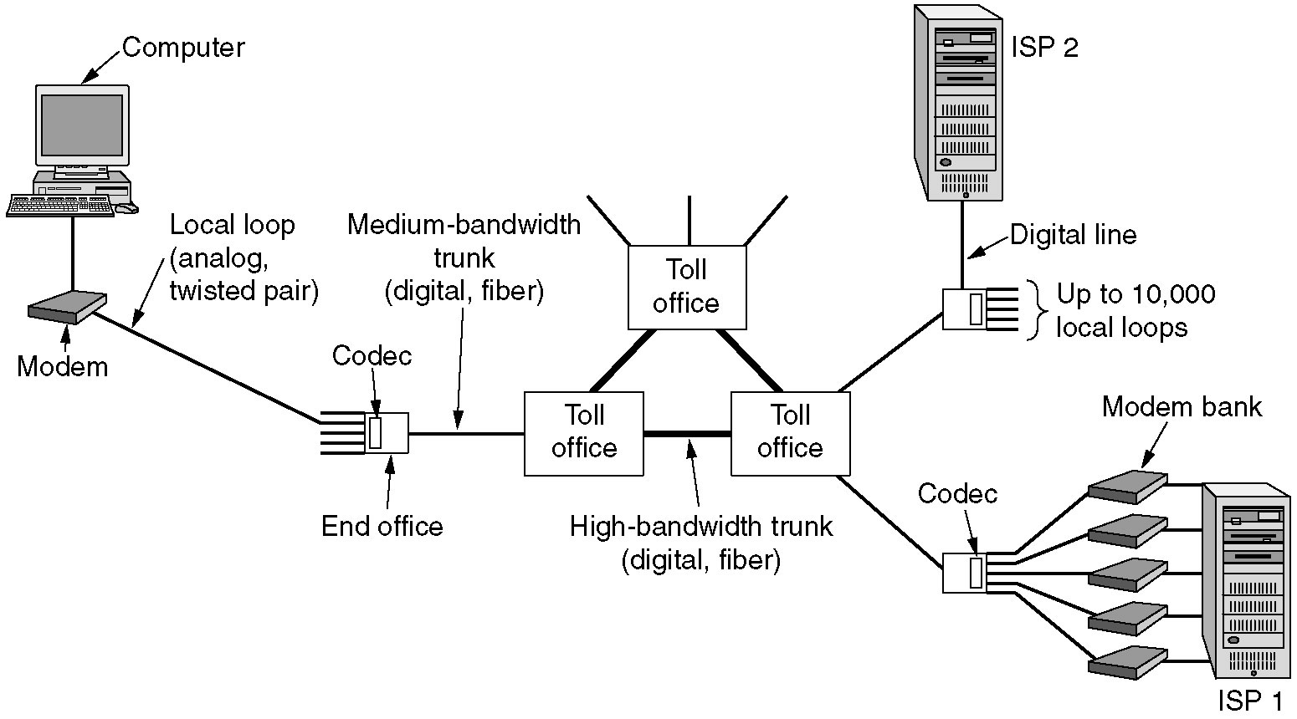
PPP for dial-up access
The use of both analog and digital transmissions for a computer to computer call.
Conversion is done by the modems and codecs.

Slide 31
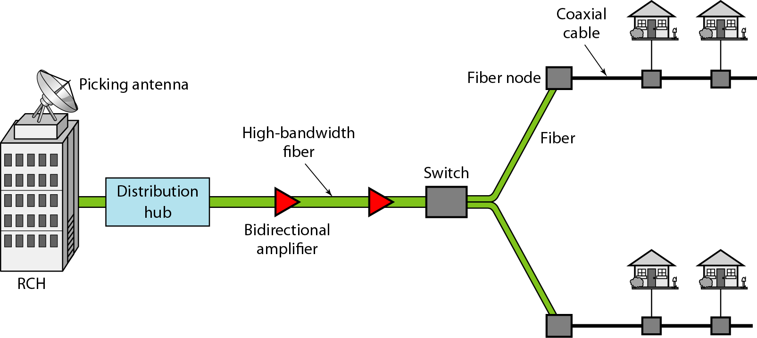
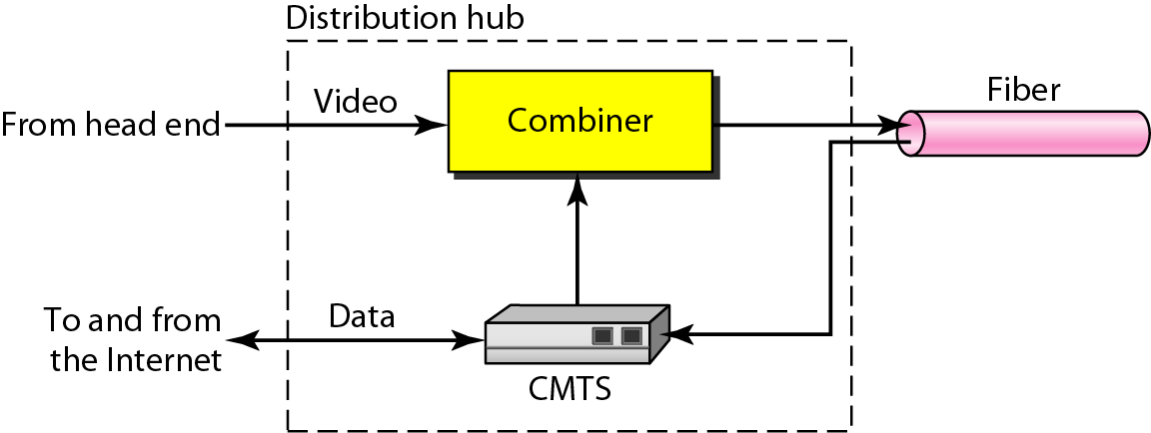
Hybrid fiber-coaxial (HFC) network
inside
Notes:
Cable Modem Termination System 电缆调制解调器终端系统(=CMTS)

Slide 32
6.3 多路访问链路和协议
广播链路的特点
单个共享广播信道
两个或多个节点同时传输：相互干扰
碰撞：一个节点同时收到两个或多个信号
多址访问协议
分布式算法决定节点如何共享信道，节点何时可以传输数据。
特别注意：有关共享信道的通信(协商)需使用信道本身
没有额外的信道来进行协调。
Notes:
Computer networks similarly have protocols — so-called multiple access protocols — by which nodes regulate their transmission into the shared broadcast channel.
As shown in Figure 6.8, multiple access protocols are needed in a wide variety of network settings, including both wired and wireless access networks, and satellite networks.
Although technically each node accesses the broadcast channel through its adapter, in this section we will refer to the node as the sending and receiving device.
In practice, hundreds or even thousands of nodes can directly communicate over a broadcast channel.
Because all nodes are capable of transmitting frames, more than two nodes can transmit frames at the same time.
When this happens, all of the nodes receive multiple frames at the same time; that is, the transmitted frames collide at all of the receivers.
Typically, when there is a collision, none of the receiving nodes can make any sense of any of the frames that were transmitted; in a sense, the signals of the colliding frames become inextricably tangled together.
Thus, all the frames involved in the collision are lost, and the broadcast channel is wasted during the collision interval.
Clearly, if many nodes want to transmit frames frequently, many transmissions will result in collisions, and much of the bandwidth of the broadcast channel will be wasted.
In order to ensure that the broadcast channel performs useful work when multiple nodes are active, it is necessary to somehow coordinate the transmissions of the active nodes.
This coordination job is the responsibility of the multiple access protocol.
Over the past 40 years, thousands of papers and hundreds of PhD dissertations have been written on multiple access protocols; a comprehensive survey of the first 20 years of this body of work is [Rom 1990].
Furthermore, active research in multiple access protocols continues due to the continued emergence of new types of links, particularly new wireless links.

Slide 33
6.3 多路访问链路和协议
理想的多路访问协议需满足：
假定：信道为速率为R b/s的广播信道
当只有一个节点有数据发送时，该节点的吞吐量为R
当M个节点有数据发送时，每个节点吞吐量为R/M
分散
没有特定节点用于调整传输
没有时钟同步
简单，实现不昂贵。
Notes:
Let’s conclude this overview by noting that, ideally, a multiple access protocol for a broadcast channel of rate R bits per second should have the following desirable characteristics:
1. When only one node has data to send, that node has a throughput of R bps.
2. When M nodes have data to send, each of these nodes has a throughput of R/M bps.
This need not necessarily imply that each of the M nodes always has an instantaneous rate of R/M, but rather that each node should have an average transmission rate of R/M over some suitably defined interval of time.
3. The protocol is decentralized; that is, there is no master node that represents a single point of failure for the network.
4. The protocol is simple, so that it is inexpensive to implement.

Slide 34
5.3 多路访问链路和协议
多址访问协议分类
信道划分协议
将信道划分成小的“片”(时隙、频段、编码)
将“片”分配给节点使用
随机接入协议
信道没有被分割，允许碰撞
碰撞恢复
轮流协议
节点轮流传送，但数据量大的节点轮流更长时间
Notes:
Over the years, dozens of multiple access protocols have been implemented in a variety of link-layer technologies.
Nevertheless, we can classify just about any multiple access protocol as belonging to one of three categories: channel partitioning protocols, random access protocols, and taking-turns protocols.
We’ll cover these categories of multiple access protocols in the following three subsections.

Slide 35
第 6 章 链路层和局域网
6.1 链路层概述
链路层提供的服务
链路层在何处实现
6.2 差错检测和纠正技术
奇偶校验
校验和方法
循环冗余检测
6.3 多路访问链路和协议
信道划分协议
随机接入协议
轮流协议
DOCSIS: 用于电缆互联网接入的链路层协议
6.4 交换局域网
链路层寻址和 ARP
以太网
链路层交换机
虚拟局域网 (VLANs)
6.5 链路虚拟化：网络作为链路层
多协议标签交换 (MPLS)
6.6 数据中心网络
6.7 回顾：Web页面请求的历程
准备：DHCP、UDP、IP和以太网
仍在准备：DNS 和 ARP
仍在准备：域内路由选择到DNS服务器
Web 客户 — 服务器交互：TCP 和 HTTP
6.8 小结

Slide 36
信道划分协议
TDMA(Time Division Multiple Access)
循环访问信道
每个节点在每次循环中得到固定长度的时隙(时隙长度＝传输单个分组时间)
没有数据发送的时隙空闲
例如：6-节点 LAN, 时隙1, 3, 4 有数据发送; 2,5,6 的时隙空闲
6-slot
frame
6-slot
frame
1
3
4
1
3
4
Notes:
Recall from our early discussion back in Section 1.3 that time-division multiplexing (TDM) and frequency-division multiplexing (FDM) are two techniques that can be used to partition a broadcast channel’s bandwidth among all nodes sharing that channel.
As an example, suppose the channel supports N nodes and that the transmission rate of the channel is R bps.
TDM divides time into time frames and further divides each time frame into N time slots.
(The TDM time frame should not be confused with the link-layer unit of data exchanged between sending and receiving adapters, which is also called a frame.
In order to reduce confusion, in this subsection we’ll refer to the link-layer unit of data exchanged as a packet.)
Each time a slot is then assigned to one of the N nodes.
Whenever a node has a packet to send, it transmits the packet’s bits during its assigned time slot in the revolving TDM frame.
Typically, slot sizes are chosen so that a single packet can be transmitted during a slot time.
Figure 6.9 shows a simple four-node TDM example.
Returning to our cocktail party analogy, a TDM-regulated cocktail party would allow one partygoer to speak for a fixed period of time, then allow another partygoer to speak for the same amount of time, and so on.
Once everyone had had a chance to talk, the pattern would repeat.
TDM is appealing because it eliminates collisions and is perfectly fair: Each node gets a dedicated transmission rate of R/N bps during each frame time.
However, it has two major drawbacks.
First, a node is limited to an average rate of R/N bps even when it is the only node with packets to send.
A second drawback is that a node must always wait for its turn in the transmission sequence — again, even when it is the only node with a frame to send.
Imagine the partygoer who is the only one with anything to say (and imagine that this is the even rarer circumstance where everyone wants to hear what one person has to say).
Clearly, TDM would be a poor choice for a multiple access protocol for this particular party.

Slide 37
信道划分协议
FDMA (Frequency Division Multiple Access)
信道按频谱分成若干频段
每个节点分配固定频段
在频段不用时该部分信道被闲置和浪费
time
frequency bands
FDM cable
Notes:
While TDM shares the broadcast channel in time, FDM divides the R bps channel into different frequencies (each with a bandwidth of R/N) and assigns each frequency [band] to one of the N nodes.
FDM thus creates N smaller channels of R/N bps out of the single, larger R bps channel.
FDM shares both the advantages and drawbacks of TDM.
It avoids collisions and divides the bandwidth fairly among the N nodes.
However, FDM also shares a principal disadvantage with TDM — a node is limited to a bandwidth of R/N, even when it is the only node with packets to send.
A third channel partitioning protocol is code division multiple access (CDMA).
While TDM and FDM assign time slots and frequencies, respectively, to the nodes, CDMA assigns a different code to each node.
Each node then uses its unique code to encode the data bits it sends.
If the codes are chosen carefully, CDMA networks have the wonderful property that different nodes can transmit simultaneously and yet have their respective receivers correctly receive a sender’s encoded data bits (assuming the receiver knows the sender’s code) in spite of interfering transmissions by other nodes.
CDMA has been used in military systems for some time (due to its anti-jamming properties) and now has widespread civilian use, particularly in cellular telephony.
Because CDMA’s use is so tightly tied to wireless channels, we’ll save our discussion of the technical details of CDMA until Chapter 6.
For now, it will suffice to know that CDMA codes, like time slots in TDM and frequencies in FDM, can be allocated to the multiple access channel users.

Slide 38
TDM versus TDMA
我们需要强调的是，虽然时分多路接入(TDMA)和时分多路复用(TDM)在概念上看起来是相似的，但它们之间还是有区别的。
时分多路复用(TDM)是允许多个连接共享一个链路的高带宽的数字过程(a digital process)。
时分多路复用TDM是一种数字多路复用技术，用于将几个低速率信道组合成一个高速率信道。
该过程使用一个物理多路复用器，从每个信道交叉复用数据单元。
Notes:
From Data Communications and Networking
We need to emphasize that although TDMA and TDM conceptually seem similar, there are differences between them.
Time-division multiplexing (TDM) is a digital process that allows several connections to share the high bandwidth of a link.
TDM is a digital multiplexing technique for combining several low-rate channels into one high-rate one.
The process uses a physical multiplexer that interleaves data units from each channel.
TDMA, on the other hand, is an access method in the data link layer.
The data link layer in each node tells its physical layer to use the allocated time slot.
There is no physical multiplexer at the data link layer.

Slide 39
TDM versus TDMA
另一方面，TDMA是数据链路层的一种访问或接入(access)方法。
每个节点中的数据链路层告诉它的物理层使用分配的时隙。
在数据链路层没有物理多路复用器。
Notes:
From Data Communications and Networking
We need to emphasize that although TDMA and TDM conceptually seem similar, there are differences between them.
Time-division multiplexing (TDM) is a digital process that allows several connections to share the high bandwidth of a link.
TDM is a digital multiplexing technique for combining several low-rate channels into one high-rate one.
The process uses a physical multiplexer that interleaves data units from each channel.
TDMA, on the other hand, is an access method in the data link layer.
The data link layer in each node tells its physical layer to use the allocated time slot.
There is no physical multiplexer at the data link layer.

Slide 40
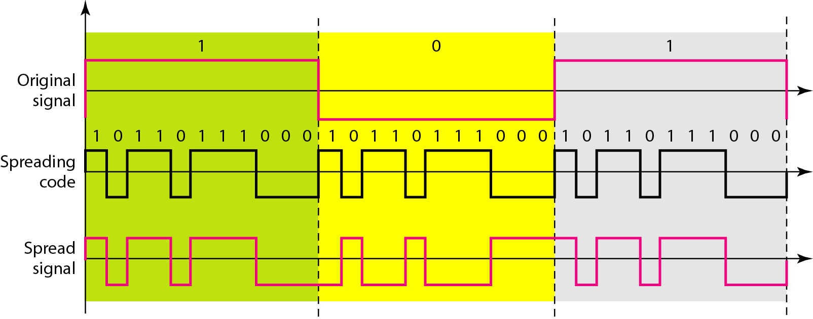
码分多址CDMA
NRZL
Spread signal = Original signal * Spreading code
Notes:
A third channel partitioning protocol is code division multiple access (CDMA).
While TDM and FDM assign time slots and frequencies, respectively, to the nodes, CDMA assigns a different code to each node.
Each node then uses its unique code to encode the data bits it sends.
If the codes are chosen carefully, CDMA networks have the wonderful property that different nodes can transmit simultaneously and yet have their respective receivers correctly receive a sender’s encoded data bits (assuming the receiver knows the sender’s code) in spite of interfering transmissions by other nodes.
CDMA has been used in military systems for some time (due to its anti-jamming properties) and now has widespread civilian use, particularly in cellular telephony.
Because CDMA’s use is so tightly tied to wireless channels, we’ll save our discussion of the technical details of CDMA until Chapter 6.
For now, it will suffice to know that CDMA codes, like time slots in TDM and frequencies in FDM, can be allocated to the multiple access channel users.

Slide 41
第 6 章 链路层和局域网
6.1 链路层概述
链路层提供的服务
链路层在何处实现
6.2 差错检测和纠正技术
奇偶校验
校验和方法
循环冗余检测
6.3 多路访问链路和协议
信道划分协议
随机接入协议
轮流协议
DOCSIS: 用于电缆互联网接入的链路层协议
6.4 交换局域网
链路层寻址和 ARP
以太网
链路层交换机
虚拟局域网 (VLANs)
6.5 链路虚拟化：网络作为链路层
多协议标签交换 (MPLS)
6.6 数据中心网络
6.7 回顾：Web页面请求的历程
准备：DHCP、UDP、IP和以太网
仍在准备：DNS 和 ARP
仍在准备：域内路由选择到DNS服务器
Web 客户 — 服务器交互：TCP 和 HTTP
6.8 小结

Slide 42
随机接入协议
当节点有数据发送时
以信道全部速率R传输
没有主节点起协调作用
两个或多个节点传送时 —— 碰撞或冲突collision
随机接入协议解决
如何检测碰撞
如何从碰撞中恢复(如：每个涉及到碰撞的节点选择独立的随机延时后重传)
随机接入协议举例：
ALOHA、时隙ALOHA
CSMA, CSMA/CD, CSMA/CA
Notes:
The second broad class of multiple access protocols are random access protocols.
In a random access protocol, a transmitting node always transmits at the full rate of the channel, namely, R bps.
When there is a collision, each node involved in the collision repeatedly retransmits its frame (that is, packet) until its frame gets through without a collision.
But when a node experiences a collision, it doesn’t necessarily retransmit the frame right away.
Instead it waits a random delay before retransmitting the frame.
Each node involved in a collision chooses independent random delays.
Because the random delays are independently chosen, it is possible that one of the nodes will pick a delay that is sufficiently less than the delays of the other colliding nodes and will therefore be able to sneak its frame into the channel without a collision.
There are dozens if not hundreds of random access protocols described in the literature [Rom 1990; Bertsekas 1991].
In this section we’ll describe a few of the most commonly used random access protocols — the ALOHA protocols [Abramson 1970; Abramson 1985; Abramson 2009] and the carrier sense multiple access (CSMA) protocols [Kleinrock 1975b].
Ethernet [Metcalfe 1976] is a popular and widely deployed CSMA protocol.

Slide 43
1. ALOHA
ALOHA的由来
ALOHA是Additive Link On-Line HAwaii system简写，ALOHA恰好还是夏威夷方言的“你好”。
ALOHA网是计算机网络早期发展中一个著名的网络，也是第一个无线计算机网络，现仍在运行之中。
ALOHA网的特征
因群岛位置的散布，网络拓扑采用了星型结构；
为节省费用和易于组网，网络中各站点的通信采用了无线传输介质。
由于采用无线电信道，考虑到无法申请更多的频率点，因而所有站点都使用统一的频率通过主机交换信息。

Slide 44
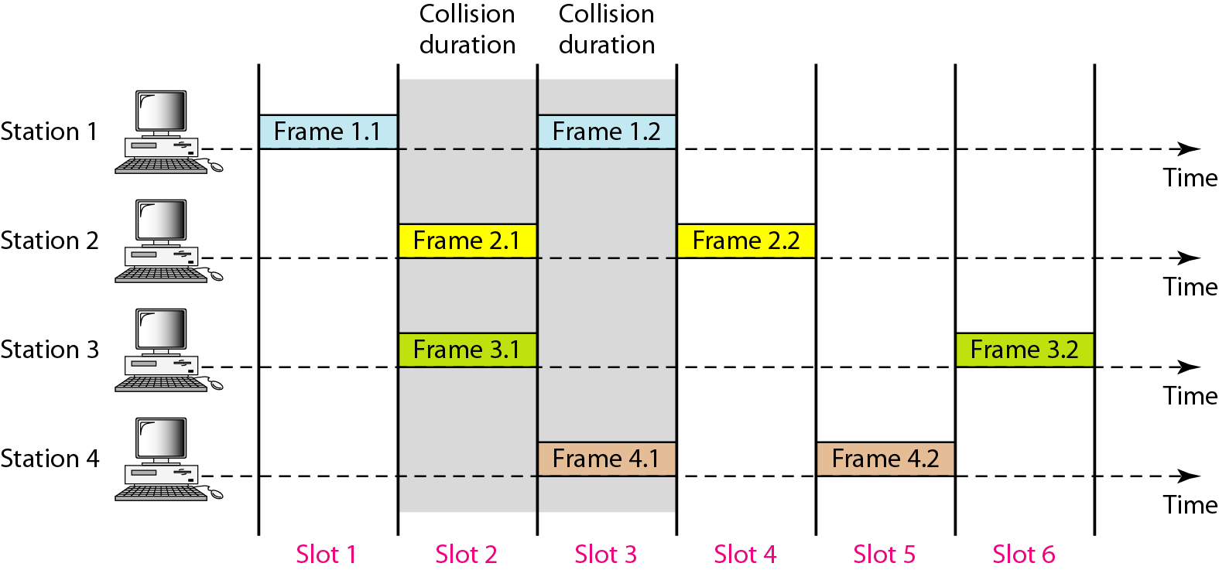
时隙ALOHA

Slide 45
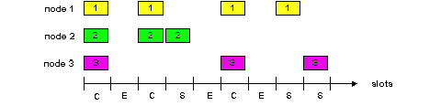
时隙ALOHA
successful slot
Pros
a single active node can continuously transmit at full rate of channel
highly decentralized: only slots in the nodes need to be in synchronization
an extremely simple protocol
Cons
collisions, wasting slots
idle slots
nodes may be able to detect collision in less than time to transmit packet
clock synchronization
Notes:
Slotted ALOHA
Let’s begin our study of random access protocols with one of the simplest random access protocols, the slotted ALOHA protocol.
In our description of slotted ALOHA, we assume the following:
• All frames consist of exactly L bits.
• Time is divided into slots of size L/R seconds (that is, a slot equals the time to transmit one frame).
• Nodes start to transmit frames only at the beginnings of slots.
• The nodes are synchronized so that each node knows when the slots begin.
• If two or more frames collide in a slot, then all the nodes detect the collision event before the slot ends.
Let p be a probability, that is, a number between 0 and 1.
The operation of slotted ALOHA in each node is simple:
• When the node has a fresh frame to send, it waits until the beginning of the next slot and transmits the entire frame in the slot.
• If there isn’t a collision, the node has successfully transmitted its frame and thus need not consider retransmitting the frame.
(The node can prepare a new frame for transmission, if it has one.)
• If there is a collision, the node detects the collision before the end of the slot.
The node retransmits its frame in each subsequent slot with probability p until the frame is transmitted without a collision.
By retransmitting with probability p, we mean that the node effectively tosses a biased coin; the event heads (adj. 正面朝上的) corresponds to “retransmit,” which occurs with probability p.
The event tails corresponds to “skip the slot and toss the coin again in the next slot”; this occurs with probability (1 – p).
All nodes involved in the collision toss their coins independently.
Slotted ALOHA would appear to have many advantages.
Unlike channel partitioning, slotted ALOHA allows a node to transmit continuously at the full rate, R, when that node is the only active node.
(A node is said to be active if it has frames to send.)
Slotted ALOHA is also highly decentralized, because each node detects collisions and independently decides when to retransmit.
(Slotted ALOHA does, however, require the slots to be synchronized in the nodes; shortly we’ll discuss an unslotted version of the ALOHA protocol, as well as CSMA protocols, none of which require such synchronization.)
Slotted ALOHA is also an extremely simple protocol.

Slide 46
时隙ALOHA的效率
效率：当有许多活动节点，每个节点有许多帧要发送时，在长期运行中成功时隙的份额。
For maximum efficiency with N nodes, find p* that maximizes Np(1-p)^{N-1}.
For many nodes, take limit of Np*(1-p*)^{N-1} as N goes to infinity, gives 1/e = 0.37
Suppose N nodes with many frames to send, each transmits in slot with probability p
probability that a given node has success in a slot = p(1-p)^{N-1}
probability that any node has a success = Np(1-p)^{N-1}
最多：信道用于有用的传输的时间为37%!
Notes:
Slotted ALOHA works well when there is only one active node, but how efficient is it when there are multiple active nodes?
There are two possible efficiency concerns here.
First, as shown in Figure 6.10, when there are multiple active nodes, a certain fraction of the slots will have collisions and will therefore be “wasted.”
The second concern is that another fraction of the slots will be empty because all active nodes refrain from transmitting as a result of the probabilistic transmission policy.
The only “unwasted” slots will be those in which exactly one node transmits.
A slot in which exactly one node transmits is said to be a successful slot.
The efficiency of a slotted multiple access protocol is defined to be the long-run fraction of successful slots in the case when there are a large number of active nodes, each always having a large number of frames to send.
Note that if no form of access control were used, and each node were to immediately retransmit after each collision, the efficiency would be zero.
Slotted ALOHA clearly increases the efficiency beyond zero, but by how much?
We now proceed to outline the derivation of the maximum efficiency of slotted ALOHA.
To keep this derivation simple, let’s modify the protocol a little and assume that each node attempts to transmit a frame in each slot with probability p.
(That is, we assume that each node always has a frame to send and that the node transmits with probability p for a fresh frame as well as for a frame that has already suffered a collision.)
Suppose there are N nodes.
Then the probability that a given slot is a successful slot is the probability that one of the nodes transmits and that the remaining N – 1 nodes do not transmit.
The probability that a given node transmits is p; the probability that the remaining nodes do not transmit is (1 – p)^{N-1}.
Therefore the probability a given node has a success is p(1 – p)^{N-1}.
Because there are N nodes, the probability that any one of the N nodes has a success is Np(1 – p)^{N-1}.
Thus, when there are N active nodes, the efficiency of slotted ALOHA is Np(1 – p)^{N-1}.
To obtain the maximum efficiency for N active nodes, we have to find the p* that maximizes this expression.
(See the homework problems for a general outline of this derivation.)
And to obtain the maximum efficiency for a large number of active nodes, we take the limit of Np*(1 – p*)^{N-1} as N approaches infinity.
(Again, see the homework problems.)
After performing these calculations, we’ll find that the maximum efficiency of the protocol is given by 1/e = 0.37.
That is, when a large number of nodes have many frames to transmit, then (at best) only 37 percent of the slots do useful work.
Thus the effective transmission rate of the channel is not R bps but only 0.37 R bps!
A similar analysis also shows that 37 percent of the slots go empty and 26 percent of slots have collisions.
Imagine the poor network administrator who has purchased a 100-Mbps slotted ALOHA system, expecting to be able to use the network to transmit data among a large number of users at an aggregate rate of, say, 80 Mbps!
Although the channel is capable of transmitting a given frame at the full channel rate of 100 Mbps, in the long run, the successful throughput of this channel will be less than 37 Mbps.

Slide 47
时隙ALOHA的效率
假设：
N nodes
Each node attempts to transmit a frame in each slot with probability p any frame.

Slide 48
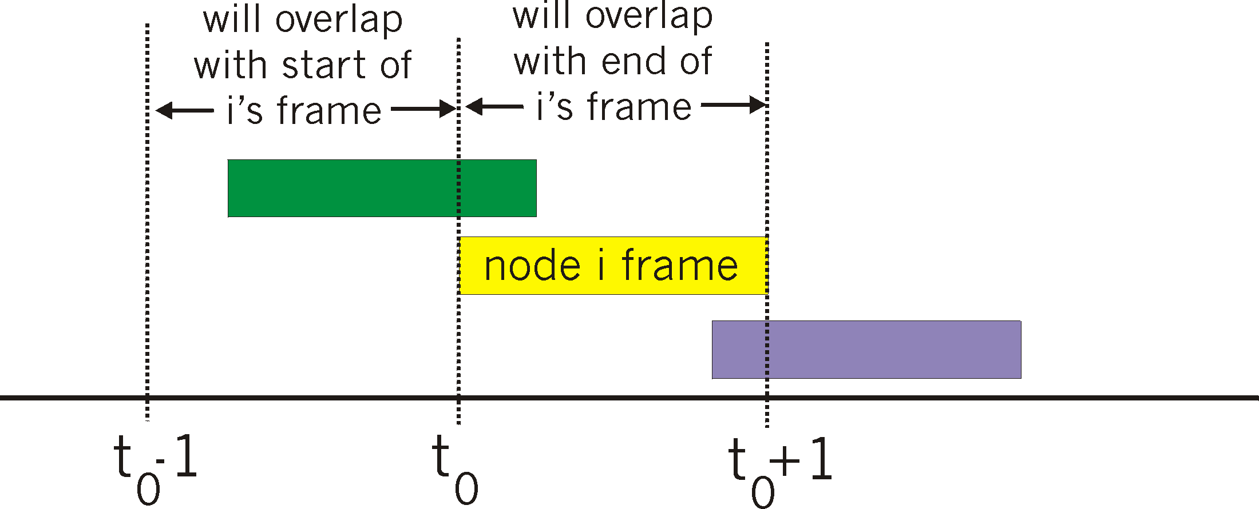
纯(无时隙) ALOHA
纯 ALOHA：更简单，没有同步
当一个帧首次到达时
立即将该帧完整地传输到广播信道
冲突概率增加:
t₀发送的帧与其他在[t₀-1, t₀+1]时发送的帧发生冲突
Notes:
The slotted ALOHA protocol required that all nodes synchronize their transmissions to start at the beginning of a slot.
The first ALOHA protocol [Abramson 1970] was actually an unslotted, fully decentralized protocol.
In pure ALOHA, when a frame first arrives (that is, a network-layer datagram is passed down from the network layer at the sending node), the node immediately transmits the frame in its entirety into the broadcast channel.
If a transmitted frame experiences a collision with one or more other transmissions, the node will then immediately (after completely transmitting its collided frame) retransmit the frame with probability p.
Otherwise, the node waits for a frame transmission time.
After this wait, it then transmits the frame with probability p, or waits (remaining idle) for another frame time with probability 1 – p.
To determine the maximum efficiency of pure ALOHA, we focus on an individual node.
We’ll make the same assumptions as in our slotted ALOHA analysis and take the frame transmission time to be the unit of time.
At any given time, the probability that a node is transmitting a frame is p.
Suppose this frame begins transmission at time t₀ .
As shown in Figure 6.11, in order for this frame to be successfully transmitted, no other nodes can begin their transmission in the interval of time [t₀ – 1, t₀].
Such a transmission would overlap with the beginning of the transmission of node i’s frame.
The probability that all other nodes do not begin a transmission in this interval is (1 – p)^{N-1}.
Similarly, no other node can begin a transmission while node i is transmitting, as such a transmission would overlap with the latter part of node i’s transmission.
The probability that all other nodes do not begin a transmission in this interval is also (1 – p)^{N-1}.
Thus, the probability that a given node has a successful transmission is p(1 – p)^{2(N-1)} .
By taking limits as in the slotted ALOHA case, we find that the maximum efficiency of the pure ALOHA protocol is
only 1/(2e) — exactly half that of slotted ALOHA.
This then is the price to be paid for a fully decentralized ALOHA protocol.

Slide 49
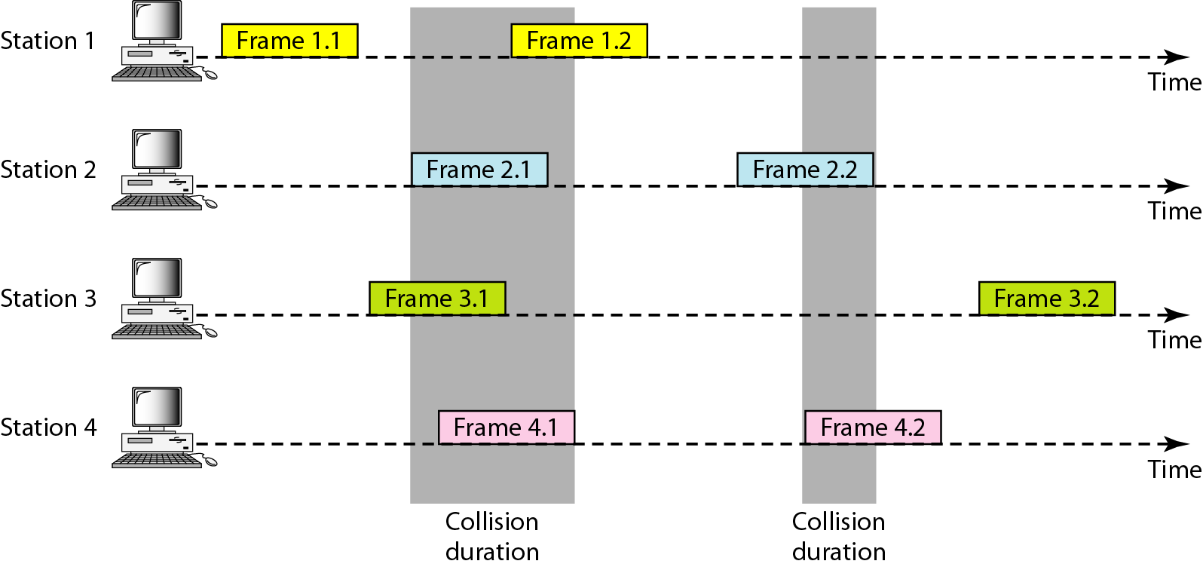
纯(无时隙) ALOHA

Slide 50
纯ALOHA效率
P (success by given node) =
P (node transmits) . P (no other node transmits in [t₀-1, t₀]). P (no other node transmits in [t₀, t₀+1])
= p . (1-p)^{N-1 .} (1-p)^{N-1} = p . (1-p)^{2(N-1)}
even worse than slotted Aloha!

Slide 51
载波侦听多路访问 (Carrier Sense Multiple Access)
传输前监听
如果信道空闲，传送整个帧
如果信道忙，推迟传送
为人处事的规则之一: 不要打断别人的发言!
Listen before speaking. (carrier sensing)
If someone else begins talking at the same time, stop talking. (collision detection)
Notes:
In both slotted and pure ALOHA, a node’s decision to transmit is made independently of the activity of the other nodes attached to the broadcast channel.
In particular, a node neither pays attention to whether another node happens to be transmitting when it begins to transmit, nor stops transmitting if another node begins to interfere with its transmission.
In our cocktail party analogy, ALOHA protocols are quite like a boorish partygoer who continues to chatter away regardless of whether other people are talking.
As humans, we have human protocols that allow us not only to behave with more civility, but also to decrease the amount of time spent “colliding” with each other in conversation and, consequently, to increase the amount of data we exchange in our conversations.
Specifically, there are two important rules for polite human conversation:
• Listen before speaking.
If someone else is speaking, wait until they are finished.
In the networking world, this is called carrier sensing — a node listens to the channel before transmitting.
If a frame from another node is currently being transmitted into the channel, a node then waits until it detects no transmissions for a short amount of time and then begins transmission.
• If someone else begins talking at the same time, stop talking.
In the networking world, this is called collision detection — a transmitting node listens to the channel while it is transmitting.
If it detects that another node is transmitting an interfering frame, it stops transmitting and waits a random amount of time before repeating the sense-and-transmit-when-idle cycle.
These two rules are embodied in the family of carrier sense multiple access (CSMA) and CSMA with collision detection (CSMA/CD) protocols [Kleinrock 1975b; Metcalfe 1976; Lam 1980; Rom 1990].
Many variations on CSMA and CSMA/CD have been proposed.
Here, we’ll consider a few of the most important, and fundamental, characteristics of CSMA and CSMA/CD.

Slide 52
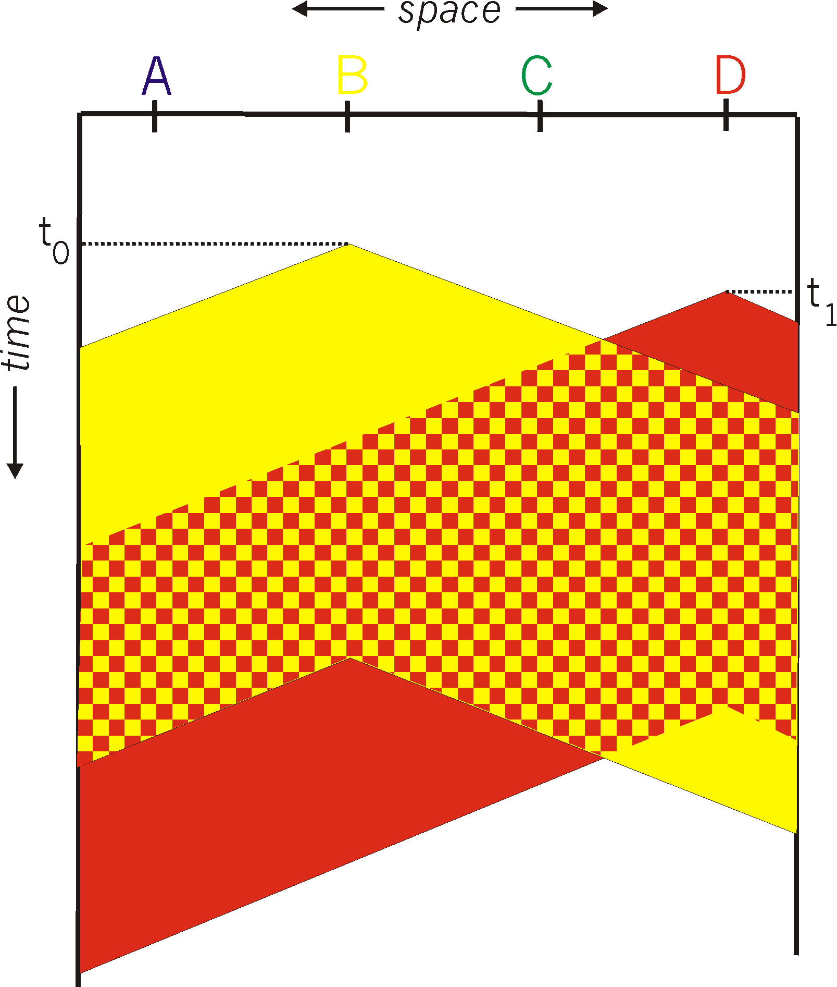
CSMA碰撞
节点空间布局
冲突仍然会发生: 传播延迟意味着两个节点可能听不到彼此的传输
冲突: 整个数据包传输时间的浪费
距离和传播延迟在确定碰撞概率中起作用
A B C D
Notes:
The first question that you might ask about CSMA is why, if all nodes perform carrier sensing, do collisions occur in the first place?
After all, a node will refrain from transmitting whenever it senses that another node is transmitting.
The answer to the question can best be illustrated using space-time diagrams [Molle 1987].
Figure 6.12 shows a space-time diagram of four nodes (A, B, C, D) attached to a linear broadcast bus.
The horizontal axis shows the position of each node in space; the vertical axis represents time.
At time t₀, node B senses the channel is idle, as no other nodes are currently transmitting.
Node B thus begins transmitting, with its bits propagating in both directions along the broadcast medium.
The downward propagation of B’s bits in Figure 6.12 with increasing time indicates that a nonzero amount of time is needed for B’s bits actually to propagate (albeit at near the speed of light) along the broadcast medium.
At time t₁ (t₁ > t₀), node D has a frame to send.
Although node B is currently transmitting at time t1, the bits being transmitted by B have yet to reach D, and thus D senses the channel idle at t₁.
In accordance with the CSMA protocol, D thus begins transmitting its frame.
A short time later, B’s transmission begins to interfere with D’s transmission at D.
From Figure 6.12, it is evident that the end-to-end channel propagation delay of a broadcast channel — the time it takes for a signal to propagate from one of the nodes to another — will play a crucial role in determining its performance.
The longer this propagation delay, the larger the chance that a carrier-sensing node is not yet able to sense a transmission that has already begun at another node in the network.

Slide 53
CSMA分类
非坚持(nonpersistent) CSMA
一旦监听到信道忙(即发现有其他站在发送数据)，就不再坚持听下去，而是根据协议的算法延迟一个随机的时间后重新再监听。
若进行载波监听时发现信道空闲，则将准备好的帧发送出去。
时隙非坚持CSMA
采用划分时隙的随机接入CSMA协议，协议规定只能在每个时隙开始时才能发送帧。

Slide 54
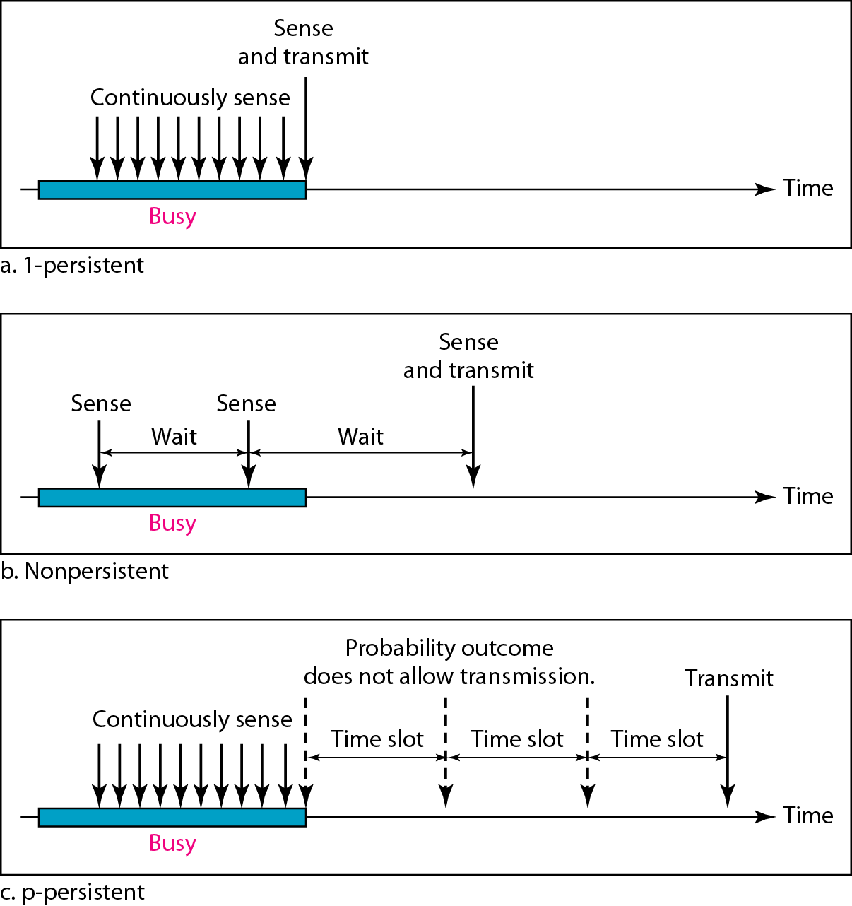
Three persistent methods in CSMA
CSMA/CD采用
Once the medium is found idle, the node transmits its data immediately.
If the medium is busy, the node performs a backoff operation, that is, it waits for a certain amount of time before attempting to transmit again.
backoff
Notes:
In non-persistent CSMA, a wireless node is allowed to immediately transmit data once it finds the medium idle.
If the medium is busy, the node performs a backoff operation, that is, it waits for a certain amount of time before attempting to transmit again.
In contrast, in 1-persistent CSMA, a node wishing to transmit data continuously senses the medium for activity.
Once the medium is found idle, the node transmits its data immediately.
If a collision occurs, the node waits for a random period of time before attempting to transmit again.
In p-persistent CSMA, the node also continuously senses the medium, but transmits data with a probability p once the medium becomes idle and delays transmission with a probability 1-p.
Random backoff values are either continuous values in the case of unslotted CSMA or multiples of a fixed slot size in slotted CSMA.

Slide 55
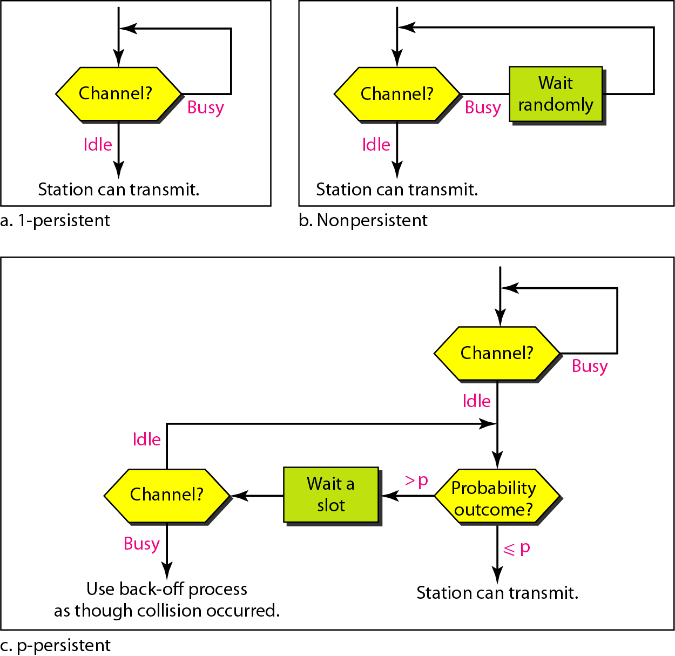
Flow diagram for three persistence methods

Slide 56
CSMA分类
1坚持CSMA
当一个站点要传送数据时，首先侦听信道，看是否有其他站点正在传送。
如果信道正忙，它就持续等待直到它侦听到信道空闲时，便将数据送出。
若发生冲突，站点就等待一个随机长的时间，然后重新开始。

Slide 57
CSMA分类
P坚持CSMA
当一个站点要传送数据时，首先侦听信道，看是否有其他站点正在传送。
如果信道正忙，它就持续等待直到它侦听到信道空闲时，以概率P发送数据，而以概率(1－P)延迟一段时间T(网络中最远的端到端的传播时延)，重新监听信道。
若发生冲突，站点就等待一个随机长的时间，然后重新开始。

Slide 58
CSMA比较
非坚持：不能充分利用信道刚刚转入空闲期的这段时间。
1坚持：容易在上述这段时间产生冲突。
P坚持：可以在一定程度上克服这些缺点，但却很难选择一个能用于各种通信量强度的P值。所以在实际网络中常选择1坚持。

Slide 59
具有碰撞检测的载波侦听多路访问(CSMA/CD)
CSMA/CD (collision detection)
carrier sensing, deferral as in CSMA
在短时间内碰撞被检测
碰撞后停止传输，减少信道浪费
碰撞检测 (collision detection)
在有线LANs中比较容易: 测量信号强度，比较接收和发送的信号。
在无线LANs中比较困难: 接收信号强度被本地传输强度所淹没。
Notes:
In Figure 6.12, nodes do not perform collision detection; both B and D continue to transmit their frames in their entirety even though a collision has occurred.
When a node performs collision detection, it ceases transmission as soon as it detects a collision.
Figure 6.13 shows the same scenario as in Figure 6.12, except that the two nodes each abort their transmission a short time after detecting a collision.
Clearly, adding collision detection to a multiple access protocol will help protocol performance by not transmitting a useless, damaged (by interference with a frame from another node) frame in its entirety.

Slide 60
1 km
A
B
t = 0
B 发送数据
碰撞
A 检测到发生碰撞
t = τ − δ
t
t = τ
单程端到端
传播时延记为τ
t = 2τ − δ
B 检测到发生碰撞

Slide 61
1 km
A
B
t = 0
B 发送数据
碰撞
A 检测到发生碰撞
t = τ − δ
t
t = τ
单程端到端
传播时延记为τ
t = 2τ − δ
B 检测到发生碰撞
t = 0
A 检测到
信道空闲
发送数据
A
B
t = τ − δ
B 检测到信道空闲
发送数据
A
B
A
B
t = τ − δ / 2
发生碰撞
t = τ
B 检测到发生碰撞
停止发送
A
B
STOP
t = 2τ − δ
A 检测到
发生碰撞
STOP
A
B

Slide 62
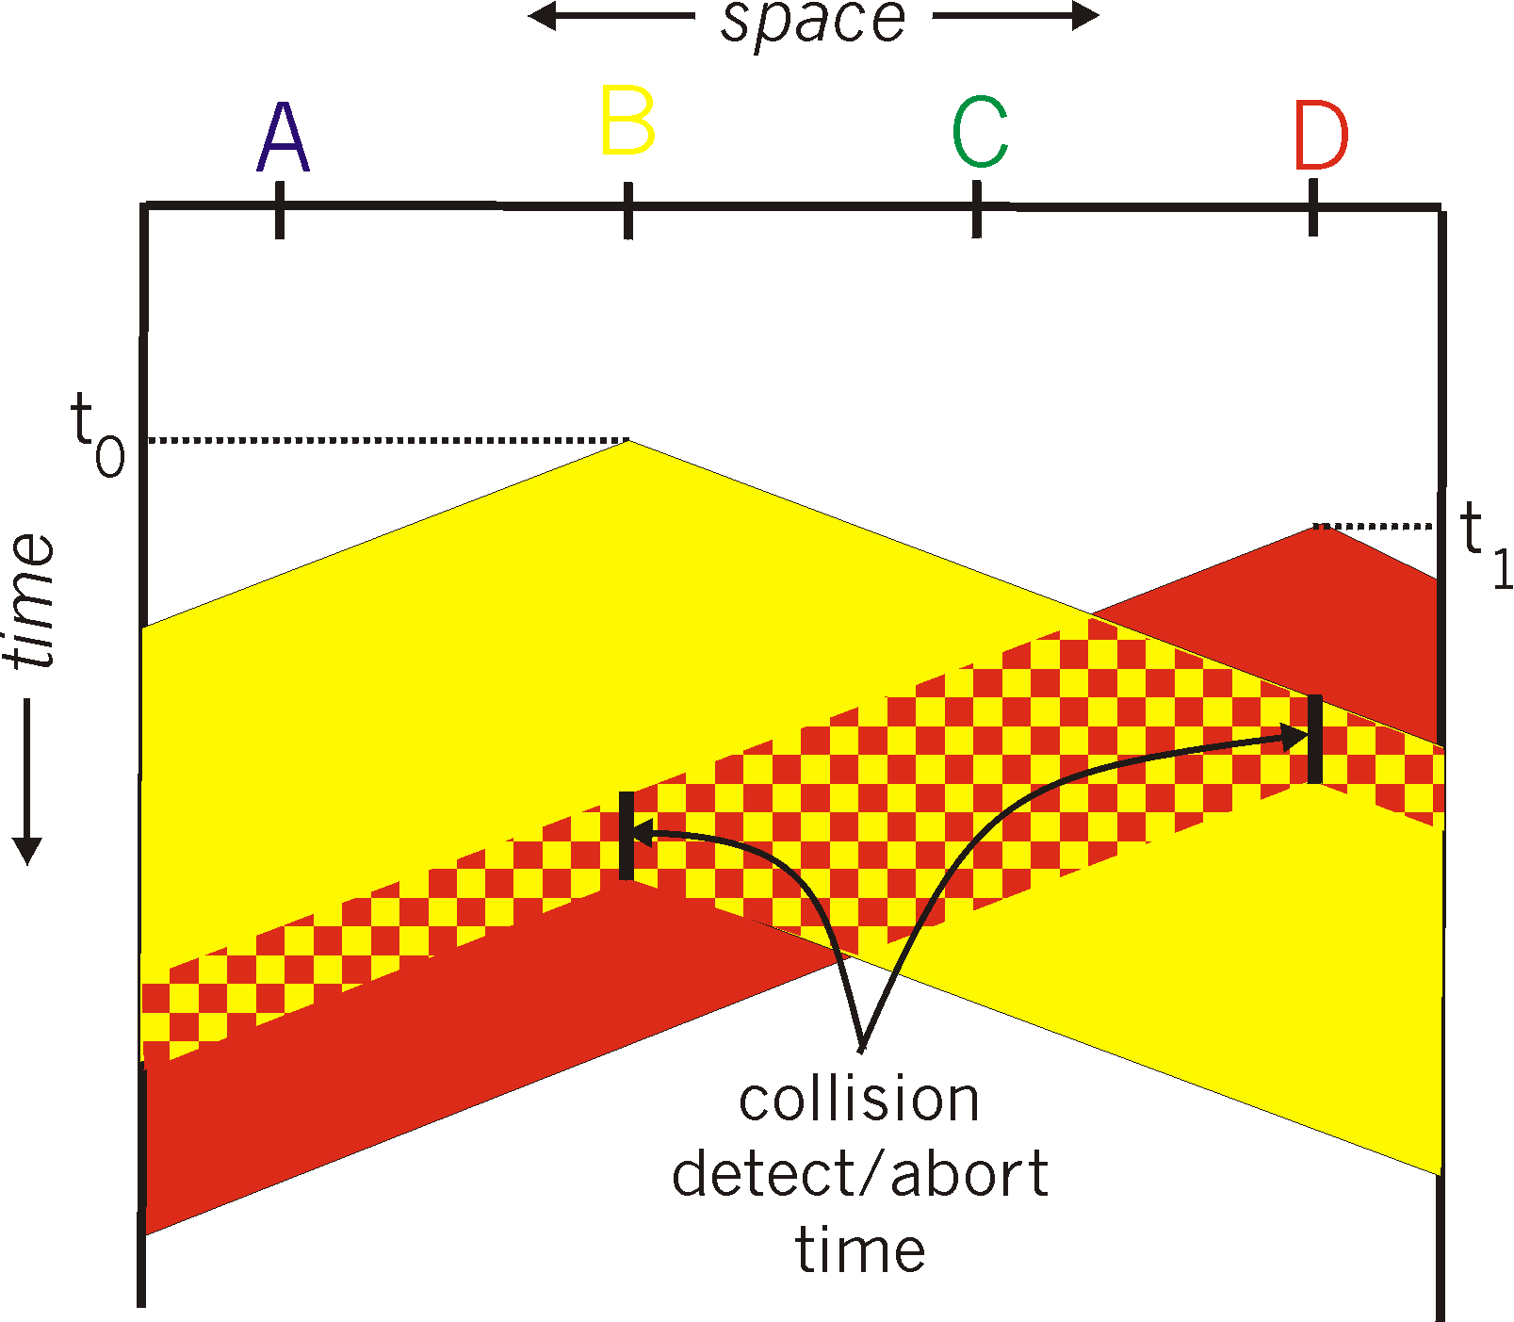
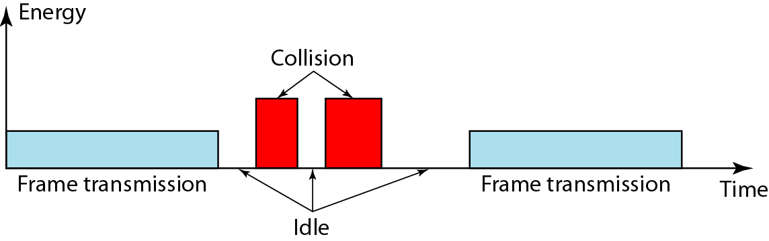
CSMA/CD (collision detection)
spatial layout of nodes
A B C D

Slide 63
具有碰撞检测的载波侦听多路访问(CSMA/CD)
强化碰撞
当发送数据的站一旦发现发生了碰撞时，除了立即停止发送数据外，
还要再继续发送若干比特的人为干扰信号(jamming signal)，
以便让所有用户都知道现在已经发生了碰撞。

Slide 64
A 发送数据
B 发送数据
A
开始冲突
B
τ
T_{B}
信
道
占
用
时
间
A 检测
到冲突
数据帧
T_{J}
干扰信号
t
τ
B 也能够检测到冲突，并立即停止发送数据帧，接着就发送干扰信号。这里为了简单起见，只画出 A 发送干扰信号的情况。

Slide 65
CSMA/CD
争用期
最先发送数据帧的站，在发送数据帧后至多经过时间 2τ （两倍的端到端往返时延）就可知道发送的数据帧是否遭受了碰撞。
以太网的端到端往返时延 2τ 称为争用期，或碰撞窗口。
经过争用期这段时间还没有检测到碰撞，才能肯定这次发送不会发生碰撞。
这时，就可以放心把这一帧数据顺利发送完毕。

Slide 66
以太网CSMA/CD算法
1. NIC从网络层接收数据报，创建帧。
2. 如果NIC感知信道空闲，开始帧传输。如果NIC感觉信道忙，等待信道空闲，然后传输。
3. 如果网卡传输了整个帧而没有检测到另一个传输，网卡就完成了帧的传输！
4.如果NIC在传输时检测到另一个传输，中止并发送阻塞信号。
5.中止后，NIC进入二进制(指数)退避:
第m次碰撞后，NIC从{0, 1, 2，…，2^{m}-1}中随机选择K。网卡等待K·512比特时间，返回步骤2 。
碰撞更多，后退间隔更长
Notes:
Before analyzing the CSMA/CD protocol, let us now summarize its operation from the perspective of an adapter (in a node) attached to a broadcast channel:
1. The adapter obtains a datagram from the network layer, prepares a link-layer frame, and puts the frame adapter buffer.
2. If the adapter senses that the channel is idle (that is, there is no signal energy entering the adapter from the channel), it starts to transmit the frame. If, on the other hand, the adapter senses that the channel is busy, it waits until it senses no signal energy and then starts to transmit the frame.
3. While transmitting, the adapter monitors for the presence of signal energy coming from other adapters using the broadcast channel.
4. If the adapter transmits the entire frame without detecting signal energy from other adapters, the adapter is finished with the frame. If, on the other hand, the adapter detects signal energy from other adapters while transmitting, it aborts the transmission (that is, it stops transmitting its frame).
5. After aborting, the adapter waits a random amount of time and then returns to step 2.
The need to wait a random (rather than fixed) amount of time is hopefully clear — if two nodes transmitted frames at the same time and then both waited the same fixed amount of time, they’d continue colliding forever.
But what is a good interval of time from which to choose the random backoff time?
If the interval is large and the number of colliding nodes is small, nodes are likely to wait a large amount of time (with the channel remaining idle) before repeating the sense-and-transmit-when-idle step.
On the other hand, if the interval is small and the number of colliding nodes is large, it’s likely that the chosen random values will be nearly the same, and transmitting nodes will again collide.
What we’d like is an interval that is short when the number of colliding nodes is small, and long when the number of colliding nodes is large.
The binary exponential backoff algorithm, used in Ethernet as well as in DOCSIS cable network multiple access protocols [DOCSIS 2011], elegantly solves this problem.
Specifically, when transmitting a frame that has already experienced n collisions, a node chooses the value of K at random from {0, 1, 2, . . . . 2^{n-1}}.
Thus, the more collisions experienced by a frame, the larger the interval from which K is chosen.
For Ethernet, the actual amount of time a node waits is K .512 bit times (i.e., K times the amount of time needed to send 512 bits into the Ethernet) and the maximum value that n can take is capped at 10.
Let’s look at an example.
Suppose that a node attempts to transmit a frame for the first time and while transmitting it detects a collision.
The node then chooses K= 0 with probability 0.5 or chooses K= 1 with probability 0.5.
If the node chooses K=0, then it immediately begins sensing the channel.
If the node chooses K = 1, it waits 512 bit times (e.g., 0.01 microseconds for a 100 Mbps Ethernet) before beginning
the sense-and-transmit-when-idle cycle.
After a second collision, K is chosen with equal probability from {0, 1, 2, 3}.
After three collisions, K is chosen with equal probability from {0, 1, 2, 3, 4, 5, 6, 7}.
After 10 or more collisions, K is chosen with equal probability from {0, 1, 2, . . . , 1023}.
Thus, the size of the sets from which K is chosen grows exponentially with the number of collisions; for this reason this algorithm is referred to as binary exponential backoff.
We also note here that each time a node prepares a new frame for transmission, it runs the CSMA/CD algorithm, not taking into account any collisions that may have occurred in the recent past.
So it is possible that a node with a new frame will immediately be able to sneak in a successful transmission while several other nodes are in the exponential backoff state.

Slide 67
以太网使用截断二进制指数类型退避算法 (truncated binary exponential backoff)
发生碰撞的站在停止发送数据后，要推迟(退避)一个随机时间才能再发送数据。
(1) 确定基本退避时间，一般是取为争用期2τ。
(2) 从整数集合[0, 1, …, (2^{k} −1)]中随机地取出一个数，记为 r。重传所需的时延就是 r 倍的基本退避时间。
(3) 参数 k 按下面的公式计算：k = Min[重传次数，10]
当 k ≤ 10 时，参数 k 等于重传次数。
(4) 当重传达 16 次仍不能成功时即丢弃该帧，并向高层报告。

Slide 68
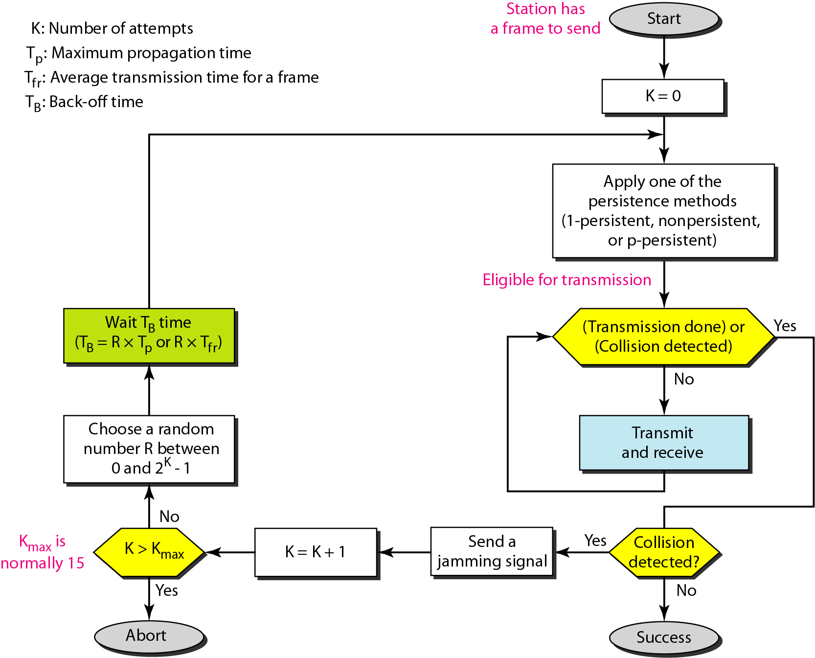
Flow diagram for the CSMA/CD
省略信道idle时还需检测96比特时间。
Notes:
以太网还规定了最小帧间间隔为9.6us ，相当于96比特时间。
这样做的好处是为了使刚刚收到数据帧的站的接受缓存来得及清理，做好接受下一帧的准备。
CSMA/CD协议的要点
(1) 准备发送：适配器从网络层获得一个分组，加上以太网的首部和尾部，组成以太网帧，放入到适配器的缓存中。
(2) 检测信道：若检测到信道忙，则不停地检测，一直等待信道转为空闲。若检测到信道空闲[在没有退避或退避后是空闲的]，并在96比特时间内信道保持空闲 (保证了帧间最小间隔)，就发送这个帧。
(3) 在发送过程中仍不停地检测信道，即网络适配器要边发送边监听。
(4) 若发送成功，然后回到 (1)；若发送失败，适配器就执行指数退避算法，等待r倍512比特时间后，返回到步骤 (2) 。

Slide 69
CSMA/CD efficiency
T_{prop} = max prop delay between 2 nodes in LAN
t_{trans} = time to transmit max-size frame
efficiency goes to 1
as t_{prop} goes to 0
as t_{trans} goes to infinity
better performance than ALOHA: and simple, cheap, decentralized!
Notes:
When only one node has a frame to send, the node can transmit at the full channel rate (e.g., for Ethernet typical rates are 10 Mbps, 100 Mbps, or 1 Gbps).
However, if many nodes have frames to transmit, the effective transmission rate of the channel can be much less.
We define the efficiency of CSMA/CD to be the long-run fraction of time during which frames are being transmitted on the channel without collisions when there is a large number of active nodes, with each node having a large number of frames to send.
In order to present a closed-form approximation of the efficiency of Ethernet, let d_{prop} denote the maximum time it takes signal energy to propagate between any two adapters.
Let d_{trans} be the time to transmit a maximum-size frame (approximately 1.2 msecs for a 10 Mbps Ethernet).
A derivation of the efficiency of CSMA/CD is beyond the scope of this book (see [Lam 1980] and [Bertsekas 1991]).
Here we simply state the following approximation:
We see from this formula that as d_{prop} approaches 0, the efficiency approaches 1. This matches our intuition that if the propagation delay is zero, colliding nodes will abort immediately without wasting the channel.
Also, as d_{trans} becomes very large, efficiency approaches 1.
This is also intuitive because when a frame grabs the channel, it will hold on to the channel for a very long time; thus, the channel will be doing productive work most of the time.

Slide 70
第 6 章 链路层和局域网
6.1 链路层概述
链路层提供的服务
链路层在何处实现
6.2 差错检测和纠正技术
奇偶校验
校验和方法
循环冗余检测
6.3 多路访问链路和协议
信道划分协议
随机接入协议
轮流协议
DOCSIS: 用于电缆互联网接入的链路层协议
6.4 交换局域网
链路层寻址和 ARP
以太网
链路层交换机
虚拟局域网 (VLANs)
6.5 链路虚拟化：网络作为链路层
多协议标签交换 (MPLS)
6.6 数据中心网络
6.7 回顾：Web页面请求的历程
准备：DHCP、UDP、IP和以太网
仍在准备：DNS 和 ARP
仍在准备：域内路由选择到DNS服务器
Web 客户 — 服务器交互：TCP 和 HTTP
6.8 小结

Slide 71
轮流MAC协议
问题的背景
信道划分协议
在重负荷时，共享信道有效、公平
在轻负荷时效率低：信道访问延时，即使只有一个活动节点，也只能分配到1/N的带宽
随机访问协议
轻负荷时效率高：只有一个节点时，能充分利用信道
在重负荷下: 碰撞的开销
轮流协议
在两个方面寻求最佳的解决方案!
Notes:
Recall that two desirable properties of a multiple access protocol are (1) when only one node is active, the active node has a throughput of R bps, and (2) when M nodes are active, then each active node has a throughput of nearly R/M bps.
The ALOHA and CSMA protocols have this first property but not the second.
This has motivated researchers to create another class of protocols — the taking-turns protocols.
As with random access protocols, there are dozens of taking-turns protocols, and each one of these protocols has many variations.
We’ll discuss two of the more important protocols here.

Slide 72
1. 轮询协议
轮询协议
主节点邀请从节点轮流传输
typically used with “dumb” slave devices
轮询协议有一些缺点
轮询开销
等待时间(latency)
单点失效(主节点)
其中两个协议:
802.15 和 蓝牙协议
data
询问
主节点
data
从节点
Notes:
The first one is the polling protocol.
The polling protocol requires one of the nodes to be designated as a master node.
The master node polls each of the nodes in a round-robin fashion.
In particular, the master node first sends a message to node 1, saying that it (node 1) can transmit up to some maximum number of frames.
After node 1 transmits some frames, the master node tells node 2 it (node 2) can transmit up to the maximum number of frames.
(The master node can determine when a node has finished sending its frames by observing the lack of a signal on the channel.)
The procedure continues in this manner, with the master node polling each of the nodes in a cyclic manner.
The polling protocol eliminates the collisions and empty slots that plague random access protocols.
This allows polling to achieve a much higher efficiency.
But it also has a few drawbacks.
The first drawback is that the protocol introduces a polling delay — the amount of time required to notify a node that it can transmit.
If, for example, only one node is active, then the node will transmit at a rate less than R bps, as the master node must poll each of the inactive nodes in turn each time the active node has sent its maximum number of frames.
The second drawback, which is potentially more serious, is that if the master node fails, the entire channel
becomes inoperative.
The 802.15 protocol and the Bluetooth protocol we will study in Section 6.3 are examples of polling protocols.

Slide 73
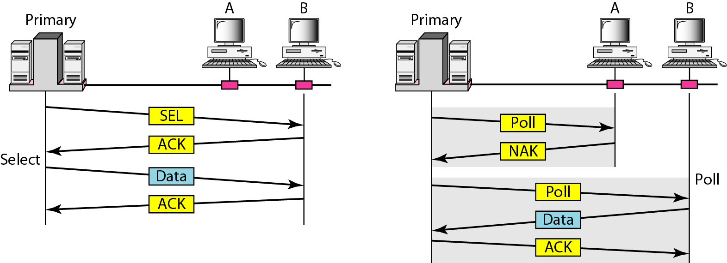
1. 轮询协议
Figure. Select and poll functions in polling access method

Slide 74
2. 令牌传递协议
令牌: 小型的、专用的帧
控制令牌从一个节点按顺序传递到下一个节点。
令牌传递是分散的、高效的。
关注问题：
令牌的开销
等待时间
单点失效(token)
其中两个协议:
FDDI and IEEE 802.5 (Token Ring)
T
(没有数据可发送)
T
data
Notes:
The second taking-turns protocol is the token-passing protocol.
In this protocol there is no master node.
A small, special-purpose frame known as a token is exchanged among the nodes in some fixed order.
For example, node 1 might always send the token to node 2, node 2 might always send the token to node 3, and node N might always send the token to node 1.
When a node receives a token, it holds onto the token only if it has some frames to transmit; otherwise, it immediately forwards the token to the next node.
If a node does have frames to transmit when it receives the token, it sends up to a maximum number of frames and then forwards the token to the next node.
Token passing is decentralized and highly efficient.
But it has its problems as well.
For example, the failure of one node can crash the entire channel.
Or if a node accidentally neglects to release the token, then some recovery procedure must be invoked to get the token back in circulation.
Over the years many token-passing protocols have been developed, including the fiber distributed data interface (FDDI) protocol [Jain 1994] and the IEEE 802.5 token ring protocol [IEEE 802.5 2012], and each one had to address these as well as other sticky issues.

Slide 75
第 6 章 链路层和局域网
6.1 链路层概述
链路层提供的服务
链路层在何处实现
6.2 差错检测和纠正技术
奇偶校验
校验和方法
循环冗余检测
6.3 多路访问链路和协议
信道划分协议
随机接入协议
轮流协议
DOCSIS: 用于电缆互联网接入的链路层协议
6.4 交换局域网
链路层寻址和 ARP
以太网
链路层交换机
虚拟局域网 (VLANs)
6.5 链路虚拟化：网络作为链路层
多协议标签交换 (MPLS)
6.6 数据中心网络
6.7 回顾：Web页面请求的历程
准备：DHCP、UDP、IP和以太网
仍在准备：DNS 和 ARP
仍在准备：域内路由选择到DNS服务器
Web 客户 — 服务器交互：TCP 和 HTTP
6.8 小结

Slide 76
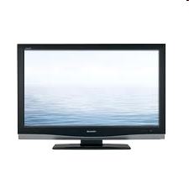
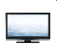

电缆接入网
Internet frames, TV channels, control transmitted
downstream at different frequencies (FDM)
cable headend
…
CMTS
…
splitter
cable
modem
cable modem
termination system
ISP
upstream Internet frames, TV control, transmitted
upstream at different frequencies in time slots (TDM)
多个40Mbps的下行(广播)信道
single CMTS transmits into channels
多个30Mbps的上行信道
多路访问: all users contend for certain upstream channel time slots (others assigned)
Notes:
In the previous three subsections, we’ve learned about three broad classes of multiple access protocols: channel partitioning protocols, random access protocols, and taking turns protocols.
A cable access network will make for an excellent case study here, as we’ll find aspects of each of these three classes of multiple access protocols with the cable access network!
Recall from Section 1.2.1, that a cable access network typically connects several thousand residential cable modems to a cable modem termination system (CMTS) at the cable network headend.
The Data-Over-Cable Service Interface Specifications (DOCSIS) [DOCSIS 2011] specifies the cable data network architecture and its protocols.
DOCSIS uses FDM to divide the downstream (CMTS to modem) and upstream (modem to CMTS) network segments into multiple frequency channels.
Each downstream channel is 6 MHz wide, with a maximum throughput of approximately 40 Mbps per channel (although this data rate is seldom seen at a cable modem in practice); each upstream channel has a maximum channel width of 6.4 MHz, and a maximum upstream throughput of approximately 30 Mbps.
Each upstream and downstream channel is a broadcast channel.
Frames transmitted on the downstream channel by the CMTS are received by all cable modems receiving that channel; since there is just a single CMTS transmitting into the downstream channel, however, there is no multiple access problem.
The upstream direction, however, is more interesting and technically challenging, since multiple cable modems share the same upstream channel (frequency) to the CMTS, and thus collisions can potentially occur.

Slide 77
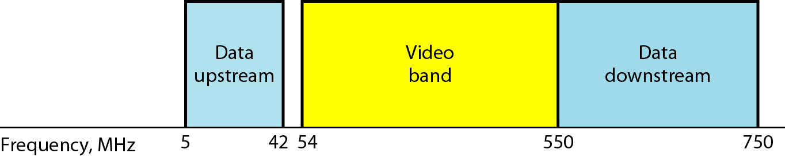
Division of coaxial cable band by CATV

Slide 78
电缆接入网
电缆头端
MAP frame for
Interval [t1, t2]
CMTS
下行信道i
上行信道j
t₁
t₂
具有电缆调制解调器的住宅
包含微时隙请求帧的微时隙
分配的包含电缆调制解调器上行数据帧的微时隙
DOCSIS: Data Over Cable Service Interface Specifications
FDM在上行和下行的频率信道
TDM上行: 一些时隙被分配，一些时隙被竞争
下行介质访问协议MAP帧: 分配上行的时隙
微时隙请求帧以随机访问方式传输，因此可能会彼此冲突。
当推断出一次碰撞，电缆调制解调器使用二进制指数退避将其微时隙请求帧延缓到以后的时隙重新发送。
Notes:
As illustrated in Figure 6.14, each upstream channel is divided into intervals of time (TDM-like), each containing a sequence of mini-slots during which cable modems can transmit to the CMTS.
The CMTS explicitly grants permission to individual cable modems to transmit during specific mini-slots.
The CMTS accomplishes this by sending a control message known as a MAP (media access protocol) message on a downstream channel to specify which cable modem (with data to send) can transmit during which (adj. 哪一个) mini-slot for the interval of time specified in the control message.
Since mini-slots are explicitly allocated to cable modems, the CMTS can ensure there are no colliding transmissions during a mini-slot.
But how does the CMTS know which cable modems have data to send in the first place?
This is accomplished by having cable modems send mini-slot-request frames to the CMTS during a special set of interval mini-slots that are dedicated for this purpose, as shown in Figure 6.14.
These mini-slot-request frames are transmitted in a random access manner and so may collide with each other.
A cable modem can neither sense whether the upstream channel is busy nor detect collisions.
Instead, the cable modem infers that its mini-slot-request frame experienced a collision if it does not receive a response to the requested allocation in the next downstream control message.
When a collision is inferred, a cable modem uses binary exponential backoff to defer the retransmission of its mini-slot-request frame to a future time slot.
When there is little traffic on the upstream channel, a cable modem may actually transmit data frames during slots nominally assigned for mini-slot-request frames (and thus avoid having to wait for a mini-slot
assignment).
A cable access network thus serves as a terrific example of multiple access protocols in action — FDM, TDM, random access, and centrally allocated time slots all within one network!

Slide 79
对于共享介质能做什么?
信道划分，基于时间、频率、编码
时分，频分
随机划分 (动态),
ALOHA, S-ALOHA, CSMA, CSMA/CD
载波侦听:有线“易行”、无线“困难”
CSMA/CD 用于以太网
CSMA/CA 用于 802.11
轮流
主节点轮询，令牌传递
蓝牙、令牌环、 FDDI (Fiber Distributed Data Interface)

Slide 80
第 6 章 链路层和局域网
6.1 链路层概述
链路层提供的服务
链路层在何处实现
6.2 差错检测和纠正技术
奇偶校验
校验和方法
循环冗余检测
6.3 多路访问链路和协议
信道划分协议
随机接入协议
轮流协议
DOCSIS: 用于电缆互联网接入的链路层协议
6.4 交换局域网
链路层寻址和 ARP
以太网
链路层交换机
虚拟局域网 (VLANs)
6.5 链路虚拟化：网络作为链路层
多协议标签交换 (MPLS)
6.6 数据中心网络
6.7 回顾：Web页面请求的历程
准备：DHCP、UDP、IP和以太网
仍在准备：DNS 和 ARP
仍在准备：域内路由选择到DNS服务器
Web 客户 — 服务器交互：TCP 和 HTTP
6.8 小结

Slide 81
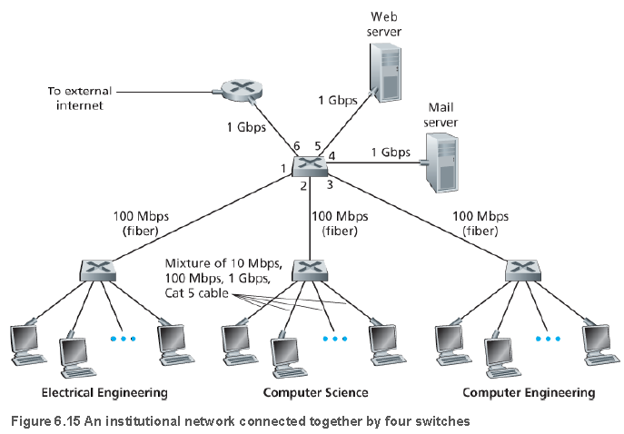
6.4 交换局域网
Notes:
Having covered broadcast networks and multiple access protocols in the previous section, let’s turn our attention next to switched local networks.
Figure 6.15 shows a switched local network connecting three departments, two servers and a router with four switches.
Because these switches operate at the link layer, they switch link-layer frames (rather than network-layer datagrams), don’t recognize network-layer addresses, and don’t use routing algorithms like RIP or OSPF to determine paths through the network of layer-2 switches.
Instead of using IP addresses, we will soon see that they use link-layer addresses to forward link-layer frames through the network of switches.
We’ll begin our study of switched LANs by first covering link-layer addressing (Section 6.4.1).
We then examine the celebrated Ethernet protocol (Section 6.5.2).
After examining link-layer addressing and Ethernet, we’ll look at how link-layer switches operate (Section 6.4.3), and then see (Section 6.4.4) how these switches are often used to build large-scale LANs.

Slide 82
链路层寻址和ARP
主机和路由器有链路层地址。
为什么我们需要在网络和链接层都有地址?
除了描述链路层地址的语法和功能之外，在本节中，我们希望阐明为什么这两层地址是有用的，而且实际上是必不可少的。
我们还将介绍地址解析协议(ARP)，它提供了一种将IP地址转换为链接层地址的机制。
Notes:
Hosts and routers have link-layer addresses.
Now you might find this surprising, recalling from Chapter 4 that hosts and routers have network-layer addresses as well.
You might be asking, why in the world do we need to have addresses at both the network and link layers?
In addition to describing the syntax and function of the link-layer addresses, in this section we hope to shed some light on why the two layers of addresses are useful and, in fact, indispensable.
We’ll also cover the Address Resolution Protocol (ARP), which provides a mechanism to translate IP addresses to link-layer addresses.

Slide 83
1. MAC 地址
MAC (or LAN or physical or Ethernet)地址
作用
在数据链路层标识每块网络适配器，使得能够在广播信道上寻址目标节点
组成
48bit（e.g.: 1A-2F-BB-76-09-AD）
前24bit由IEEE分配管理—— OUI号
后24bit由厂商自行分配
特别注意：MAC地址烧入网络适配器的ROM中，不可更改
Notes:
In truth, it is not hosts and routers that have link-layer addresses but rather their adapters (that is, network interfaces) that have link-layer addresses.
A host or router with multiple network interfaces will thus have multiple link-layer addresses associated with it, just as it would also have multiple IP addresses associated with it.
It's important to note, however, that link-layer switches do not have link-layer addresses associated with their interfaces that connect to hosts and routers.
This is because the job of the link-layer switch is to carry datagrams between hosts and routers; a switch does this job transparently, that is, without the host or router having to explicitly address the frame to the intervening switch.

Slide 84
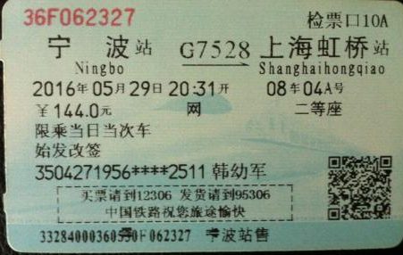
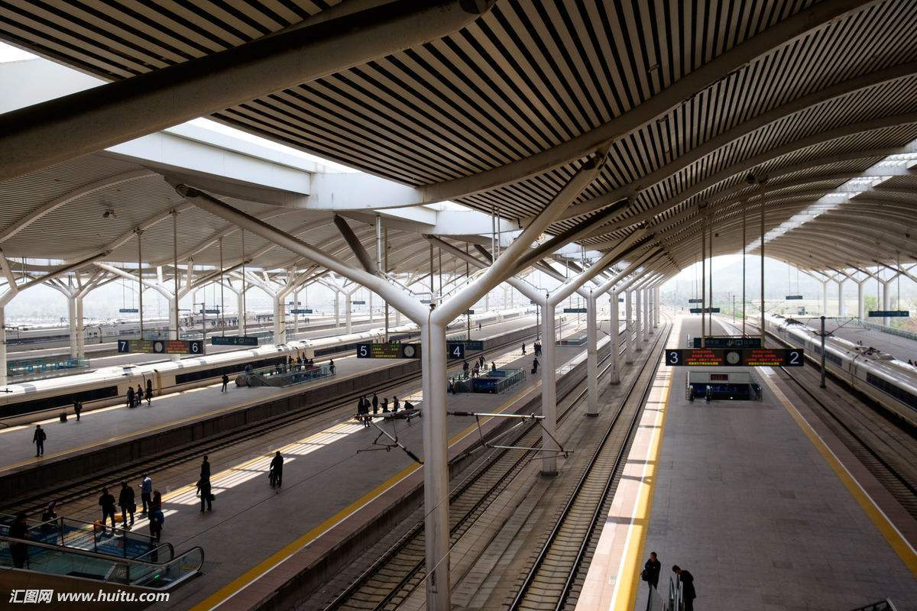
车票(IP地址)与轨道站台(MAC地址)

Slide 85
1. MAC 地址
LAN上的每个适配器都有唯一的LAN地址
广播地址 =
FF-FF-FF-FF-FF-FF
1A-2F-BB-76-09-AD
LAN
(wired or
wireless)
71-65-F7-2B-08-53
适配器
58-23-D7-FA-20-B0
0C-C4-11-6F-E3-98
Notes:
This is illustrated in Figure 6.16.
A link-layer address is variously called a LAN address, a physical address, or a MAC address.
Because MAC address seems to be the most popular term, we’ll henceforth refer to link-layer addresses as MAC addresses.
For most LANs (including Ethernet and 802.11 wireless LANs), the MAC address is 6 bytes long, giving 2⁴⁸ possible MAC addresses.
As shown in Figure 6.16, these 6-byte addresses are typically expressed in hexadecimal notation, with each byte of the address expressed as a pair of hexadecimal numbers.
Although MAC addresses were designed to be permanent, it is now possible to change an adapter’s MAC address via software.
For the rest of this section, however, we’ll assume that an adapter’s MAC address is fixed.

Slide 86
1. MAC 地址
与IP地址的比较
MAC地址是平面地址，类似于身份证号
IP地址是层次地址，类似于邮政通信地址
MAC地址在不同的网络间迁移时，不会改变
IP地址在不同的网络间迁移时，需要改变以适应新的网络配置
特别注意：无线网络中进行漫游时，如果在不同的网络间切换时，改变网络设置，会导致连接中断，为维持连接正常工作，第七章将介绍无线移动管理
Notes:
One interesting property of MAC addresses is that no two adapters have the same address.
This might seem surprising given that adapters are manufactured in many countries by many companies.
How does a company manufacturing adapters in Taiwan make sure that it is using different addresses from a company manufacturing adapters in Belgium?
The answer is that the IEEE manages the MAC address space.
In particular, when a company wants to manufacture adapters, it purchases a chunk of the address space consisting of 2²⁴ addresses for a nominal fee.
IEEE allocates the chunk of 2²⁴ addresses by fixing the first 24 bits of a MAC address and letting the company create unique combinations of the last 24 bits for each adapter.
An adapter’s MAC address has a flat structure (as opposed to a hierarchical structure) and doesn’t change no matter where the adapter goes.
A laptop with an Ethernet interface always has the same MAC address, no matter where the computer goes.
A smartphone with an 802.11 interface always has the same MAC address, no matter where the smartphone goes.
Recall that, in contrast, IP addresses have a hierarchical structure (that is, a network part and a host part), and a host’s IP addresses needs to be changed when the host moves, i.e, changes the network to which it is attached.
An adapter’s MAC address is analogous to a person’s social security number, which also has a flat addressing structure and which doesn’t change no matter where the person goes.
An IP address is analogous to a person’s postal address, which is hierarchical and which must be changed whenever a person moves.
Just as a person may find it useful to have both a postal address and a social security number, it is useful for a host and router interfaces to have both a network-layer address and a MAC address.
When an adapter wants to send a frame to some destination adapter, the sending adapter inserts the destination adapter’s MAC address into the frame and then sends the frame into the LAN.
As we will soon see, a switch occasionally broadcasts an incoming frame onto all of its interfaces.
We’ll see in Chapter 6 that 802.11 also broadcasts frames.
Thus, an adapter may receive a frame that isn’t addressed to it.
Thus, when an adapter receives a frame, it will check to see whether the destination MAC address in the frame matches its own MAC address.
If there is a match, the adapter extracts the enclosed datagram and passes the datagram up the protocol stack.
If there isn’t a match, the adapter discards the frame, without passing the network-layer datagram up.
Thus, the destination only will be interrupted when the frame is received.
However, sometimes a sending adapter does want all the other adapters on the LAN to receive and process the frame it is about to send.
In this case, the sending adapter inserts a special MAC broadcast address into the destination address field of the frame.
For LANs that use 6-byte addresses (such as Ethernet and 802.11), the broadcast address is a string of 48 consecutive 1s (that is, FF-FF-FF-FF-FFFF in hexadecimal notation).

Slide 87
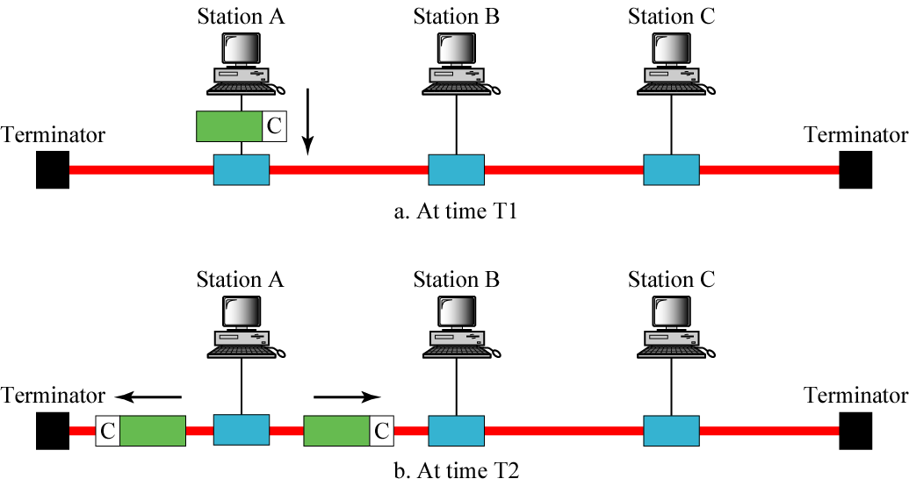
Bus Topology Operation
Notes:
匹配电阻(用来吸收总线上传播的信号)
网卡有数据要发送时，将网络层交来的Packet封装进Frame中，在Frame的最前面填入目的网卡的MAC地址，然后发向网络。
如果网络采用了广播介质，一个节点发送的Frame会被所有节点收到。节点的网卡比较Frame的目的MAC地址是否与自己的MAC地址相同，如果是，则解析出Packet并转交给适当的协议处理；否则，丢弃Frame。

Slide 88
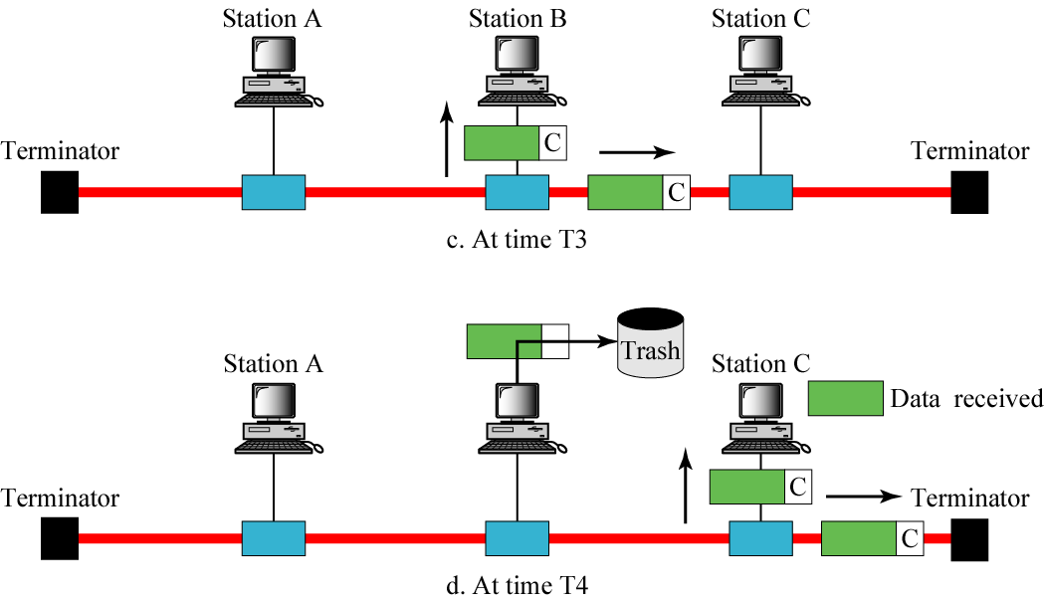
Bus Topology Operation
received and processed

Slide 89


2. 地址解析协议ARP
ARP表： LAN上的每个IP节点(主机、路由器)都有一个表
某个局域网中节点的IP/MAC地址映射:
< IP address; MAC address; TTL>
TTL (Time To Live): 地址映射将被遗忘的时间(通常为20分钟)
Question: 知道某接口的IP地址，如何确定该接口的MAC地址?
137.196.7.78
1A-2F-BB-76-09-AD
137.196.7.23
137.196.7.14
LAN
71-65-F7-2B-08-53
58-23-D7-FA-20-B0
0C-C4-11-6F-E3-98
137.196.7.88
Notes:
Because there are both network-layer addresses (for example, Internet IP addresses) and link-layer addresses (that is, MAC addresses), there is a need to translate between them.
For the Internet, this is the job of the Address Resolution Protocol (ARP) [RFC 826].
To understand the need for a protocol such as ARP, consider the network shown in Figure 6.17.
In this simple example, each host and router has a single IP address and single MAC address.
As usual, IP addresses are shown in dotted-decimal notation and MAC addresses are shown in hexadecimal notation.
For the purposes of this discussion, we will assume in this section that the switch broadcasts all frames; that is, whenever a switch receives a frame on one interface, it forwards the frame on all of its other interfaces.
In the next section, we will provide a more accurate explanation of how switches operate.
Now suppose that the host with IP address 222.222.222.220 wants to send an IP datagram to host 222.222.222.222.
In this example, both the source and destination are in the same subnet, in the addressing sense of Section 4.4.2.
To send a datagram, the source must give its adapter not only the IP datagram but also the MAC address for destination 222.222.222.222.
The sending adapter will then construct a link layer frame containing the destination’s MAC address and send the frame into the LAN.
The important question addressed in this section is, How does the sending host determine the MAC address for the destination host with IP address 222.222.222.222?
As you might have guessed, it uses ARP.
An ARP module in the sending host takes any IP address on the same LAN as input, and returns the corresponding MAC address.
In the example at hand, sending host 222.222.222.220 provides its ARP module the IP address 222.222.222.222, and the ARP module returns the corresponding MAC address 49-BD-D2-C7-56-2A.
So we see that ARP resolves an IP address to a MAC address.
In many ways it is analogous to DNS (studied in Section 2.5), which resolves host names to IP addresses.
However, one important difference between the two resolvers is that DNS resolves host names for hosts anywhere in the Internet, whereas ARP resolves IP addresses only for hosts and router interfaces on the same subnet.
If a node in California were to try to use ARP to resolve the IP address for a node in Mississippi, ARP would return with an error.
Now that we have explained what ARP does, let’s look at how it works.
Each host and router has an ARP table in its memory, which contains mappings of IP addresses to MAC addresses.
Figure 6.18 shows what an ARP table in host 222.222.222.220 might look like.
The ARP table also contains a time-to-live (TTL) value, which indicates when each mapping will be deleted from the table.
Note that a table does not necessarily contain an entry for every host and router on the subnet; some may have never been entered into the table, and others may have expired.
A typical expiration time for an entry is 20 minutes from when an entry is placed in an ARP table.

Slide 90
ARP protocol: same LAN
A wants to send datagram to B
B’s MAC address not in A’s ARP table.
A broadcasts ARP query packet, containing B's IP address
dest MAC address = FF-FF-FF-FF-FF-FF
all nodes on LAN receive ARP query
B receives ARP packet, replies to A with its (B's) MAC address
frame sent to A’s MAC address (unicast)
A caches (saves) IP-to-MAC address pair in its ARP table until information becomes old (times out)
soft state: information that times out (goes away) unless refreshed
ARP is “plug-and-play”:
nodes create their ARP tables without intervention from net administrator
Notes:
Now suppose that host 222.222.222.220 wants to send a datagram that is IP addressed to another host or router on that subnet.
The sending host needs to obtain the MAC address of the destination given the IP address.
This task is easy if the sender’s ARP table has an entry for the destination node.
But what if the ARP table doesn’t currently have an entry for the destination?
In particular, suppose 222.222.222.220 wants to send a datagram to 222.222.222.222.
In this case, the sender uses the ARP protocol to resolve the address.
First, the sender constructs a special packet called an ARP packet.
An ARP packet has several fields, including the sending and receiving IP and MAC addresses.
Both ARP query and response packets have the same format.
The purpose of the ARP query packet is to query all the other hosts and routers on the subnet to determine the MAC address corresponding to the IP address that is being resolved.
Returning to our example, 222.222.222.220 passes an ARP query packet to the adapter along with an indication that the adapter should send the packet to the MAC broadcast address, namely, FF-FF-FF-FF-FF-FF.
The adapter encapsulates the ARP packet in a link-layer frame, uses the broadcast address for the frame’s destination address, and transmits the frame into the subnet.
Recalling our social security number/postal address analogy, an ARP query is equivalent to a person shouting out in a crowded room of cubicles in some company (say, AnyCorp): “What is the social security number of the person whose postal address is Cubicle 13, Room 112, Any Corp, Palo Alto, California?”
The frame containing the ARP query is received by all the other adapters on the subnet, and (because of the
broadcast address) each adapter passes the ARP packet within the frame up to its ARP module.
Each of these ARP modules checks to see if its IP address matches the destination IP address in the ARP packet.
The one with a match sends back to the querying host a response ARP packet with the desired mapping.
The querying host 222.222.222.220 can then update its ARP table and send its IP datagram, encapsulated in a link-layer frame whose destination MAC is that of the host or router responding to the earlier ARP query.
There are a couple of interesting things to note about the ARP protocol.
First, the query ARP message is sent within a broadcast frame, whereas the response ARP message is sent within a standard frame.
Before reading on you should think about why this is so.
Second, ARP is plug-and-play; that is, an ARP table gets built automatically — it doesn’t have to be configured by a system administrator.
And if a host becomes disconnected from the subnet, its entry is eventually deleted from the other ARP tables in the subnet.
Students often wonder if ARP is a link-layer protocol or a network-layer protocol.
As we’ve seen, an ARP packet is encapsulated within a link-layer frame and thus lies architecturally above the link layer.
However, an ARP packet has fields containing link-layer addresses and thus is arguably a link-layer protocol, but it also contains network-layer addresses and thus is also arguably a network layer protocol.
In the end, ARP is probably best considered a protocol that straddles the boundary between the link and network layers — not fitting neatly into the simple layered protocol stack we studied in Chapter 1.
Such are the complexities of real-world protocols!

Slide 91
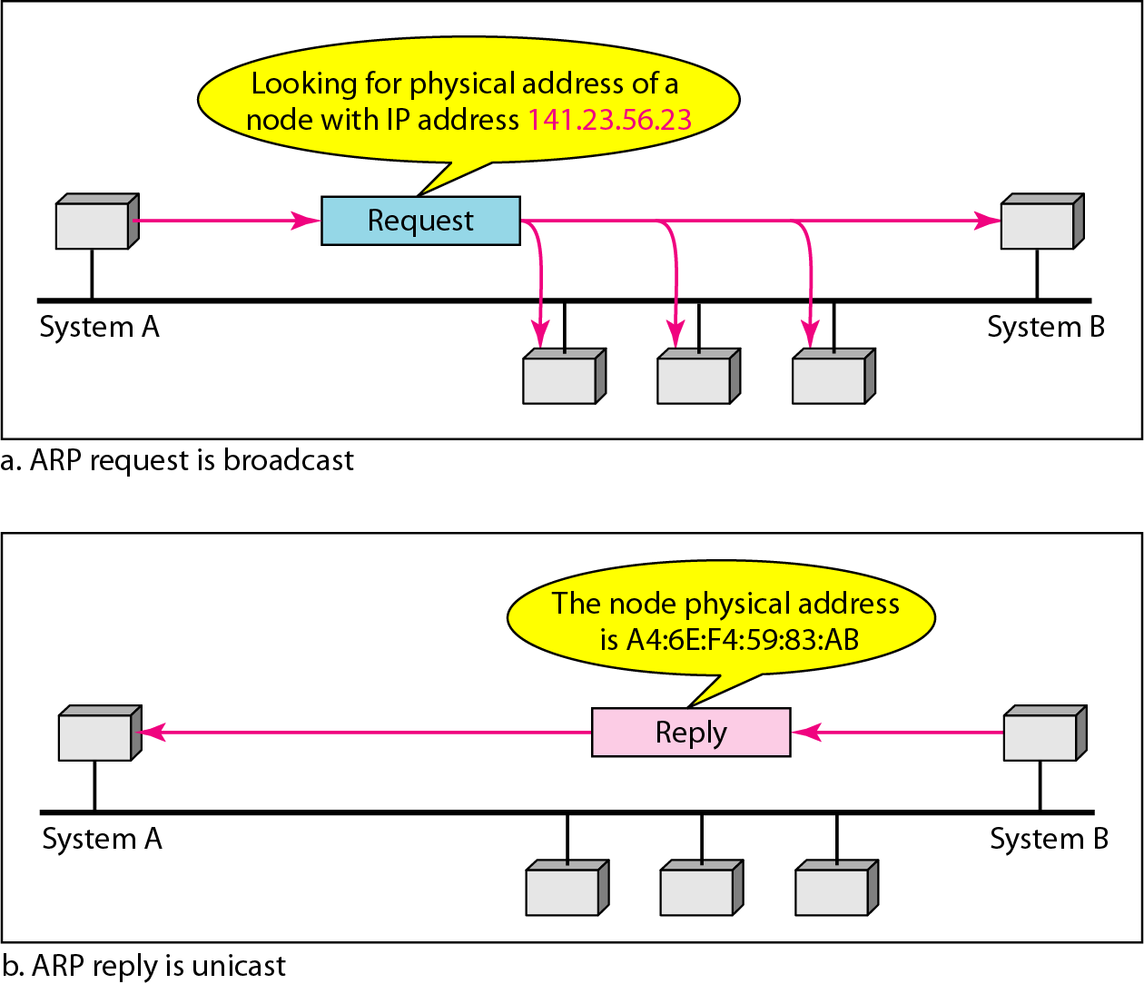
地址解析协议

Slide 92
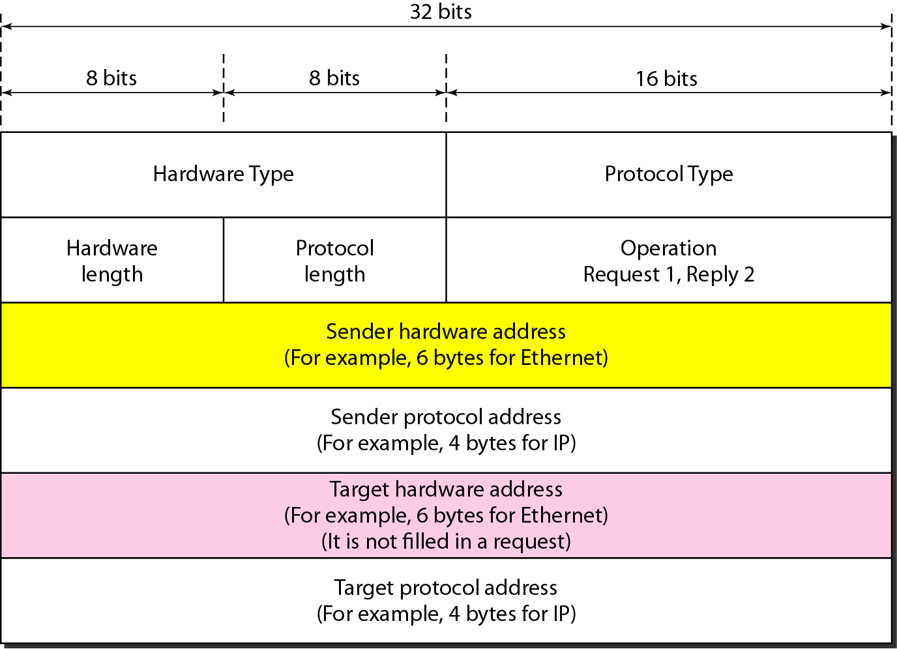
ARP 报文格式
1
0X0800
Notes:
如同多数协议一样，ARP和RARP协议报文也无固定的头部，IP将它设计成一种能适应各种物理网络地址和协议地址的格式。
(1) 硬件类型: 指出发送者本机网络接口类型 (值“1”代表以太网)。
(2) 协议类型: 指出发送者所提供/请求的高级协议地址类型(“0X0800”代表 IP协议)。
(3) 长度字段：分别指出以后各相应字段的长度。
(4) 操作：指出本报文的类型：“1”为ARP请求，“2”为ARP响应，“3”为RARP请求，“4”为RARP响应。
提示：从报文格式可见，除IP地址外，ARP还可用于解析其他协议地址；进行ARP请求时，发送者在“发送者硬件地址”字段和“发送者协议地址”字段分别填入本机物理地址和IP地址；并在“目标协议地址”字段填入欲解析的目标机IP地址，在“操作”字段填入“1”(ARP请求)；目标机(主机或路由器)处理请求时，在所缺字段中填入相应数据，交换发送者字段和目标字段的位置(交换的目的在于统一“发送者”与“目标”的概念，以便进行一致处理)，将“操作”字段改为“2”(ARP响应)。
ARP报文的传输: ARP报文是作为一般数据放入物理网络帧的数据区中传输的。

Slide 93
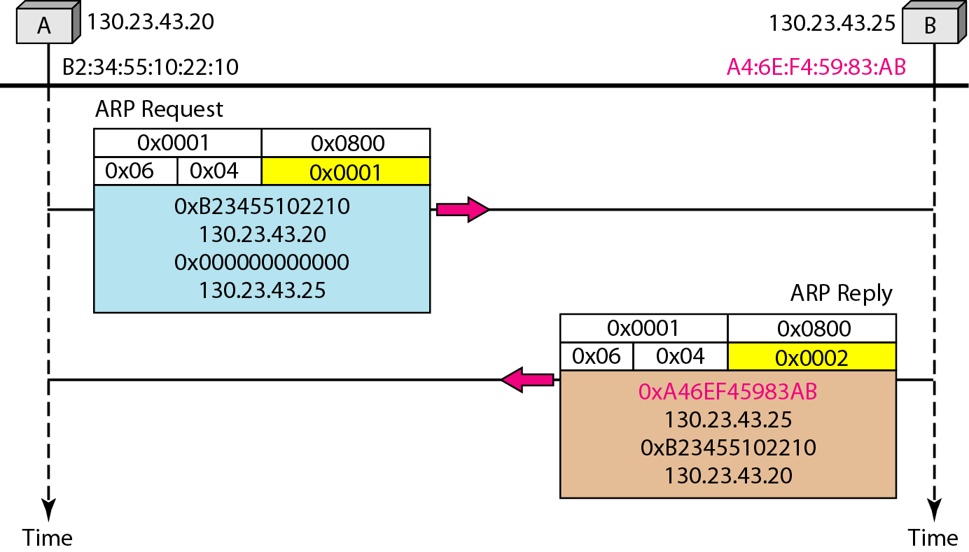
示例：ARP请求和响应
Notes:
93

Slide 94
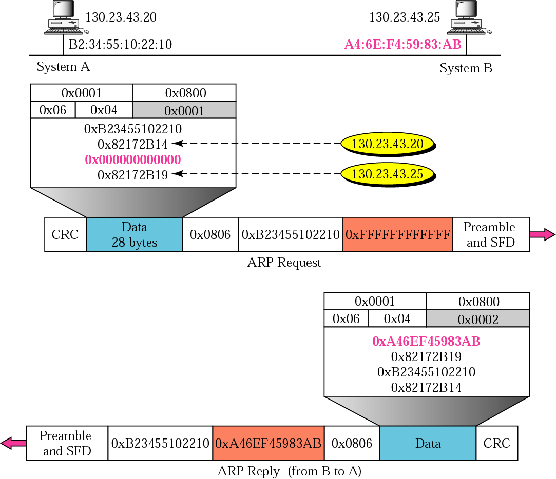

Slide 95
寻址: 路由到另一个局域网
预排工作：通过R将数据报从A发送到B
关注地址--- IP(数据报)地址和MAC层(帧)地址
假设A知道B的IP地址
假设A知道第一跳路由器R的IP地址，(怎么知道?)
假设A知道R的MAC地址，(怎么知道?)
A
B
R
111.111.111.111
222.222.222.222
74-29-9C-E8-FF-55
49-BD-D2-C7-56-2A
222.222.222.220
1A-23-F9-CD-06-9B
111.111.111.112
111.111.111.110
222.222.222.221
CC-49-DE-D0-AB-7D
E6-E9-00-17-BB-4B
88-B2-2F-54-1A-0F
Notes:
It should now be clear how ARP operates when a node wants to send a datagram to another node on the same subnet.
But now let’s look at the more complicated situation when a node on a subnet wants to send a network-layer datagram to a node off the subnet (that is, across a router onto another subnet).
Let’s discuss this issue in the context of Figure 6.19, which shows a simple network consisting of two subnets interconnected by a router.
There are several interesting things to note about Figure 6.19.
Each host has exactly one IP address and one adapter. But, as discussed in Chapter 4, a router has an IP address for each of its interfaces.
For each router interface there is also an ARP module (in the router) and an adapter.
Because the router in Figure 6.19 has two interfaces, it has two IP addresses, two ARP modules, and two adapters.
Of course, each adapter in the network has its own MAC address.
Also note that Subnet 1 has the network address 111.111.111/24 and that Subnet 2 has the network address 222.222.222/24.
Thus all of the interfaces connected to Subnet 1 have addresses of the form 111.111.111.xxx and all of the interfaces connected to Subnet 2 have addresses of the form 222.222.222.xxx.
Now let’s examine how a host on Subnet 1 would send a datagram to a host on Subnet 2.
Specifically, suppose that host 111.111.111.111 wants to send an IP datagram to a host 222.222.222.222.
The sending host passes the datagram to its adapter, as usual. But the sending host must also indicate to its adapter an appropriate destination MAC address. What MAC address should the adapter use?
One might be tempted to guess that the appropriate MAC address is that of the adapter for host 222.222.222.222, namely, 49-BD-D2-C7-56-2A. This guess, however, would be wrong!
If the sending adapter were to use that MAC address, then none of the adapters on Subnet 1 would bother to pass the IP datagram up to its network layer, since the frame’s destination address would not match the MAC address of any adapter on Subnet 1. The datagram would just die and go to datagram heaven.
If we look carefully at Figure 6.19, we see that in order for a datagram to go from 111.111.111.111 to a host on Subnet 2, the datagram must first be sent to the router interface 111.111.111.110, which is the IP address of the first-hop router on the path to the final destination.
Thus, the appropriate MAC address for the frame is the address of the adapter for router interface 111.111.111.110, namely, E6-E9-00-17-BB-4B.
How does the sending host acquire the MAC address for 111.111.111.110? By using ARP, of course!
Once the sending adapter has this MAC address, it creates a frame (containing the datagram addressed to 222.222.222.222) and sends the frame into Subnet 1.
The router adapter on Subnet 1 sees that the link-layer frame is addressed to it, and therefore passes the frame to the network layer of the router.
Hooray — the IP datagram has successfully been moved from source host to the router!
But we are not finished.
We still have to move the datagram from the router to the destination.
The router now has to determine the correct interface on which the datagram is to be forwarded.
As discussed in Chapter 4, this is done by consulting a forwarding table in the router.
The forwarding table tells the router that the datagram is to be forwarded via router interface 222.222.222.220.
This interface then passes the datagram to its adapter, which encapsulates the datagram in a new frame and sends the frame into Subnet 2.
This time, the destination MAC address of the frame is indeed the MAC address of the ultimate destination.
And how does the router obtain this destination MAC address?
From ARP, of course!
ARP for Ethernet is defined in RFC 826. A nice introduction to ARP is given in the TCP/IP tutorial, RFC 1180.
We’ll explore ARP in more detail in the homework problems.

Slide 96
寻址: 路由到另一个局域网
A creates IP datagram with IP source A, destination B
A creates link-layer frame with R's MAC address as destination address, frame contains A-to-B IP datagram
MAC src: 74-29-9C-E8-FF-55
MAC dest: E6-E9-00-17-BB-4B
IP
Eth
Phy
IP src: 111.111.111.111
IP dest: 222.222.222.222
A
B
R
111.111.111.111
222.222.222.222
74-29-9C-E8-FF-55
49-BD-D2-C7-56-2A
222.222.222.220
1A-23-F9-CD-06-9B
111.111.111.112
111.111.111.110
222.222.222.221
CC-49-DE-D0-AB-7D
E6-E9-00-17-BB-4B
88-B2-2F-54-1A-0F

Slide 97
寻址: 路由到另一个局域网
frame sent from A to R
frame received at R, datagram removed, passed up to IP
MAC src: 74-29-9C-E8-FF-55
MAC dest: E6-E9-00-17-BB-4B
IP src: 111.111.111.111
IP dest: 222.222.222.222
IP
Eth
Phy
IP src: 111.111.111.111
IP dest: 222.222.222.222
IP
Eth
Phy
A
B
R
111.111.111.111
222.222.222.222
74-29-9C-E8-FF-55
49-BD-D2-C7-56-2A
222.222.222.220
1A-23-F9-CD-06-9B
111.111.111.112
111.111.111.110
222.222.222.221
CC-49-DE-D0-AB-7D
E6-E9-00-17-BB-4B
88-B2-2F-54-1A-0F

Slide 98
寻址: 路由到另一个局域网
R forwards datagram with IP source A, destination B
R creates link-layer frame with B's MAC address as destination address, frame contains A-to-B IP datagram
MAC src: 1A-23-F9-CD-06-9B
MAC dest: 49-BD-D2-C7-56-2A
IP
Eth
Phy
IP
Eth
Phy
IP src: 111.111.111.111
IP dest: 222.222.222.222
A
B
R
111.111.111.111
222.222.222.222
74-29-9C-E8-FF-55
49-BD-D2-C7-56-2A
222.222.222.220
1A-23-F9-CD-06-9B
111.111.111.112
111.111.111.110
222.222.222.221
CC-49-DE-D0-AB-7D
E6-E9-00-17-BB-4B
88-B2-2F-54-1A-0F

Slide 99
寻址: 路由到另一个局域网
R forwards datagram with IP source A, destination B
R creates link-layer frame with B's MAC address as dest, frame contains A-to-B IP datagram
MAC src: 1A-23-F9-CD-06-9B
MAC dest: 49-BD-D2-C7-56-2A
IP src: 111.111.111.111
IP dest: 222.222.222.222
IP
Eth
Phy
A
B
R
111.111.111.111
222.222.222.222
74-29-9C-E8-FF-55
49-BD-D2-C7-56-2A
222.222.222.220
1A-23-F9-CD-06-9B
111.111.111.112
111.111.111.110
222.222.222.221
CC-49-DE-D0-AB-7D
E6-E9-00-17-BB-4B
88-B2-2F-54-1A-0F

Slide 100
A creates IP datagram with source A, destination B
A uses ARP to get R’s MAC address for 111.111.111.110
A creates link-layer frame with R's MAC address as dest, frame contains A-to-B IP datagram
A’s NIC sends frame
R’s NIC receives frame
R removes IP datagram from Ethernet frame, sees it’s destined to B
R uses ARP to get B’s MAC address
R creates frame containing A-to-B IP datagram sends to B
This is a really important
example – make sure you
understand!
A
B
R
111.111.111.111
222.222.222.222
74-29-9C-E8-FF-55
49-BD-D2-C7-56-2A
222.222.222.220
1A-23-F9-CD-06-9B
111.111.111.112
111.111.111.110
222.222.222.221
CC-49-DE-D0-AB-7D
E6-E9-00-17-BB-4B
88-B2-2F-54-1A-0F

Slide 101
链路层寻址和ARP
互联网环境下的ARP
主机Y
主机Z
主机Y
主机Z
路由器1
路由器2
网络1
网络2
网络3
MAC报头 IP报头
目标MAC地址 目标IP地址
路由器1 主机Z
源MAC地址 源IP地址
主机Y 主机Y
MAC报头 IP报头
目标MAC地址 目标IP地址
路由器2 主机Z
源MAC地址 源IP地址
路由器1 主机Y
MAC报头 IP报头
目标MAC地址 目标IP地址
主机Z 主机Z
源MAC地址 源IP地址
路由器2 主机Y

Slide 102
第 6 章 链路层和局域网
6.1 链路层概述
链路层提供的服务
链路层在何处实现
6.2 差错检测和纠正技术
奇偶校验
校验和方法
循环冗余检测
6.3 多路访问链路和协议
信道划分协议
随机接入协议
轮流协议
DOCSIS: 用于电缆互联网接入的链路层协议
6.4 交换局域网
链路层寻址和 ARP
以太网
链路层交换机
虚拟局域网 (VLANs)
6.5 链路虚拟化：网络作为链路层
多协议标签交换 (MPLS)
6.6 数据中心网络
6.7 回顾：Web页面请求的历程
准备：DHCP、UDP、IP和以太网
仍在准备：DNS 和 ARP
仍在准备：域内路由选择到DNS服务器
Web 客户 — 服务器交互：TCP 和 HTTP
6.8 小结

Slide 103
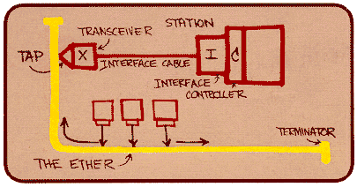
以太网
以太网概述
20世纪70年代由Bob Matcalfe和David Boggs发明
最先被广泛应用的局域网技术
便宜
速度：10Mbps->100Mbps->1Gbps->10Gbps
Metcalfe’s Ethernet sketch

Slide 104
什么是以太？
What is meant by Ether?
a medium that was once supposed to fill all space and to support the propagation of electromagnetic waves.

Slide 105

Ethernet: 物理拓扑结构
bus: popular through mid 90s
all nodes in same collision domain (can collide with each other)
star: prevails today
active switch in center
each “spoke” runs a (separate) Ethernet protocol (nodes do not collide with each other)
switch
star
bus: coaxial cable
Notes:
Ethernet has pretty much taken over the wired LAN market.
In the 1980s and the early 1990s, Ethernet faced many challenges from other LAN technologies, including token ring, FDDI, and ATM.
Some of these other technologies succeeded in capturing a part of the LAN market for a few years.
But since its invention in the mid-1970s, Ethernet has continued to evolve and grow and has held on to its dominant position.
Today, Ethernet is by far the most prevalent wired LAN technology, and it is likely to remain so for the foreseeable future.
One might say that Ethernet has been to local area networking what the Internet has been to global networking.
There are many reasons for Ethernet’s success.
First, Ethernet was the first widely deployed high-speed LAN.
Because it was deployed early, network administrators became intimately familiar with Ethernet — its wonders and its quirks — and were reluctant to switch over to other LAN technologies when they came on the scene.
Second, token ring, FDDI, and ATM were more complex and expensive than Ethernet, which further discouraged network administrators from switching over.
Third, the most compelling reason to switch to another LAN technology (such as FDDI or ATM) was usually the higher data rate of the new technology; however, Ethernet always fought back, producing versions that operated at equal data rates or higher.
Switched Ethernet was also introduced in the early 1990s, which further increased its effective data rates.
Finally, because Ethernet has been so popular, Ethernet hardware (in particular, adapters and switches) has become a commodity and is remarkably cheap.
The original Ethernet LAN was invented in the mid-1970s by Bob Metcalfe and David Boggs.
The original Ethernet LAN used a coaxial bus to interconnect the nodes.
Bus topologies for Ethernet actually persisted throughout the 1980s and into the mid-1990s.
Ethernet with a bus topology is a broadcast LAN — all transmitted frames travel to and are processed by all adapters connected to the bus.
Recall that we covered Ethernet’s CSMA/CD multiple access protocol with binary exponential backoff in Section 6.3.2.

Slide 106
Hub’s characteristics
LED:发光二级管 (light-emitting diode)
MDIX： Auto-Crossover MDI

Slide 107
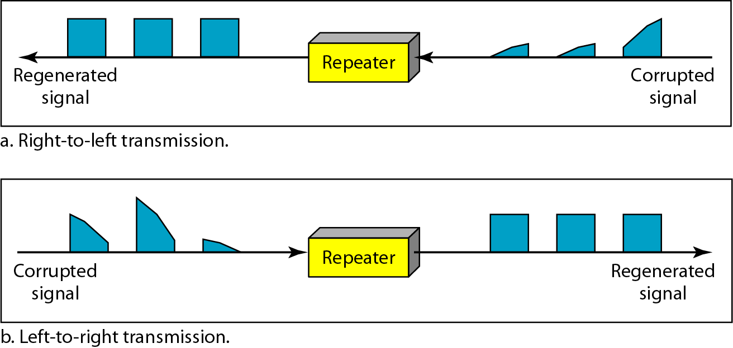
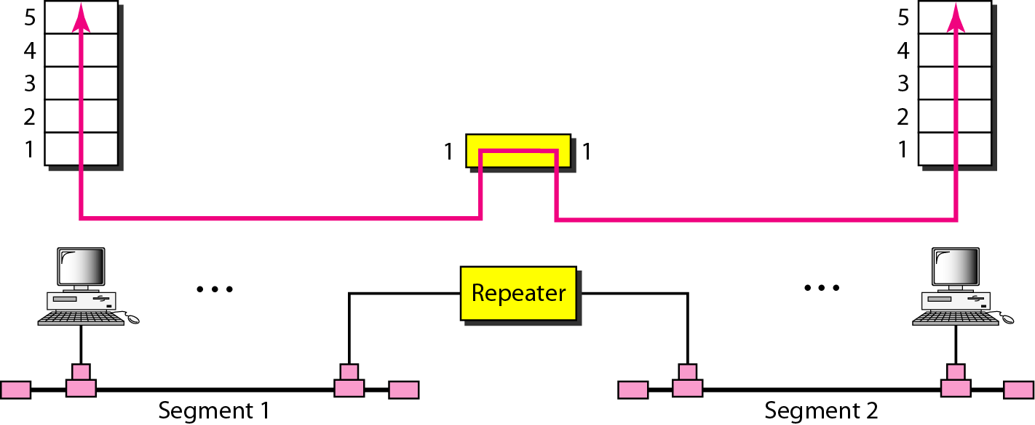
Hub is a multi-port repeater

Slide 108
Ethernet: 物理拓扑结构
hub
switch
传统的以太网
交换式的以太网
Notes:
By the late 1990s, most companies and universities had replaced their LANs with Ethernet installations using a hub-based star topology.
In such an installation the hosts (and routers) are directly connected to a hub with twisted-pair copper wire.
A hub is a physical-layer device that acts on individual bits rather than frames.
When a bit, representing a zero or a one, arrives from one interface, the hub simply recreates the bit, boosts its energy strength, and transmits the bit onto all the other interfaces.
Thus, Ethernet with a hub-based star topology is also a broadcast LAN — whenever a hub receives a bit from
one of its interfaces, it sends a copy out on all of its other interfaces.
In particular, if a hub receives frames from two different interfaces at the same time, a collision occurs and the nodes that created the frames must retransmit.
In the early 2000s Ethernet experienced yet another major evolutionary change.
Ethernet installations continued to use a star topology, but the hub at the center was replaced with a switch.
We’ll be examining switched Ethernet in depth later in this chapter.
For now, we only mention that a switch is not only “collision-less” but is also a bona-fide store-and-forward packet switch; but unlike routers, which operate up through layer 3, a switch operates only up through layer 2.

Slide 109
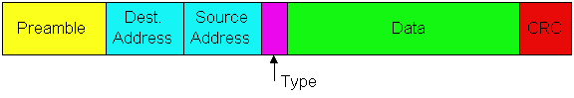
1. 以太网的帧结构
数据字段:（46字节，1500字节）
前同步码:
总共8字节，前7 字节的格式为 10101010，最后一个字节格式为10101011。
用于同步发送方与接收方时钟。
前同步码
目的地址
源地址
数据
类型
type
preamble
dest.
address
source
address
data (payload)
CRC
Notes:
Ethernet的帧有6部份：
1、Preamble：前导符(前同步码)，8个字节，其中前7个字节为10101010，第8个字节为10101011。
前同步码的作用是将接收方和发送方的时钟同步。
前7字节用于唤醒接收器，并且将他们的时钟与发送方的时钟进行同步。
由于发送方的时钟可能出现偏移，不可能总是以额定速率发送数据。
这个偏移对于网络中的其他节点来说无法预先获知，利用preamble的前7个字节，接收方就可以锁定发送方的时钟。
第8字节的最后两个为1的bit告诉接收方“重要的数据到来”。
接收方可以根据对电缆信号电流的检测得知Frame的结束。
2. 目的地址：6字节
3. 源地址：6字节
4. 类型(type)：2字节，即Frame中data部分采用的协议。Ethernet II (DIX的10M以太网)中为Type, IEEE 802.3中为Length.
5. Data: 可变长度，但大于等于46字节，且<=1500字节。
6. CRC：循环冗余校验, 4字节。CRC计算中不包括Preamble部分。
Ethernet利用基带传输，即网络适配器将数字信号直接发送到广播信道上，网络适配器不会像ADSL和Cable Modem那样将信号迁移(调制)到其他频带。

Slide 110
1. 以太网的帧结构
Addresses: 6 bytes
如果适配器接收到与目的地址或与广播地址(例如ARP包)匹配的帧，它将帧中的数据传递到网络层协议；
否则，适配器丢弃该帧。
Type: 指示更高的层协议(主要是IP，但其他可能，如Novell IPX, AppleTalk)
CRC: 接收方的循环冗余校验
检测到差误：帧被丢弃。
Notes:
We can learn a lot about Ethernet by examining the Ethernet frame, which is shown in Figure 6.20. To
give this discussion about Ethernet frames a tangible context, let’s consider sending an IP datagram
from one host to another host, with both hosts on the same Ethernet LAN (for example, the Ethernet
LAN in Figure 6.17.) (Although the payload of our Ethernet frame is an IP datagram, we note that an
Ethernet frame can carry other network-layer packets as well.) Let the sending adapter, adapter A, have
the MAC address AA-AA-AA-AA-AA-AA and the receiving adapter, adapter B, have the MAC address
BB-BB-BB-BB-BB-BB. The sending adapter encapsulates the IP datagram within an Ethernet frame and
passes the frame to the physical layer. The receiving adapter receives the frame from the physical layer,
extracts the IP datagram, and passes the IP datagram to the network layer. In this context, let’s now
examine the six fields of the Ethernet frame, as shown in Figure 6.20.
Data field (46 to 1,500 bytes). This field carries the IP datagram. The maximum transmission unit
(MTU) of Ethernet is 1,500 bytes. This means that if the IP datagram exceeds 1,500 bytes, then the
host has to fragment the datagram, as discussed in Section 4.3.2. The minimum size of the data
field is 46 bytes. This means that if the IP datagram is less than 46 bytes, the data field has to be
“stuffed” to fill it out to 46 bytes. When stuffing is used, the data passed to the network layer contains
the stuffing as well as an IP datagram. The network layer uses the length field in the IP datagram
header to remove the stuffing.
Destination address (6 bytes). This field contains the MAC address of the destination adapter, BBBB-
BB-BB-BB-BB. When adapter B receives an Ethernet frame whose destination address is either
BB-BB-BB-BB-BB-BB or the MAC broadcast address, it passes the contents of the frame’s data field
to the network layer; if it receives a frame with any other MAC address, it discards the frame.
Source address (6 bytes). This field contains the MAC address of the adapter that transmits the
frame onto the LAN, in this example, AA-AA-AA-AA-AA-AA.
Type field (2 bytes). The type field permits Ethernet to multiplex network-layer protocols. To
understand this, we need to keep in mind that hosts can use other network-layer protocols besides
IP. In fact, a given host may support multiple network-layer protocols using different protocols for
different applications. For this reason, when the Ethernet frame arrives at adapter B, adapter B
needs to know to which network-layer protocol it should pass (that is, demultiplex) the contents of
the data field. IP and other network-layer protocols (for example, Novell IPX or AppleTalk) each have
their own, standardized type number. Furthermore, the ARP protocol (discussed in the previous section) has its own type number, and if the arriving frame contains an ARP packet (i.e., has a type
field of 0806 hexadecimal), the ARP packet will be demultiplexed up to the ARP protocol. Note that
the type field is analogous to the protocol field in the network-layer datagram and the port-number
fields in the transport-layer segment; all of these fields serve to glue a protocol at one layer to a
protocol at the layer above.
Cyclic redundancy check (CRC) (4 bytes). As discussed in Section 6.2.3, the purpose of the CRC
field is to allow the receiving adapter, adapter B, to detect bit errors in the frame.
Preamble (8 bytes). The Ethernet frame begins with an 8-byte preamble field. Each of the first 7
bytes of the preamble has a value of 10101010; the last byte is 10101011. The first 7 bytes of the
preamble serve to “wake up” the receiving adapters and to synchronize their clocks to that of the
sender’s clock. Why should the clocks be out of synchronization? Keep in mind that adapter A aims
to transmit the frame at 10 Mbps, 100 Mbps, or 1 Gbps, depending on the type of Ethernet LAN.
However, because nothing is absolutely perfect, adapter A will not transmit the frame at exactly the
target rate; there will always be some drift from the target rate, a drift which is not known a priori by
the other adapters on the LAN. A receiving adapter can lock onto adapter A’s clock simply by locking
onto the bits in the first 7 bytes of the preamble. The last 2 bits of the eighth byte of the preamble
(the first two consecutive 1s) alert adapter B that the “important stuff” is about to come.

Slide 111
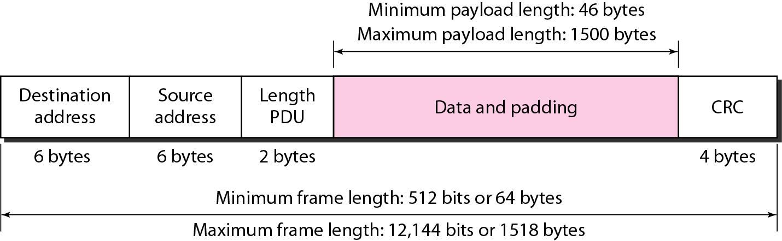
1. 以太网的帧结构
以太网对帧的最小和最大长度都施加了限制，如下图所示。
Notes:
Ethernet has imposed restrictions on both the minimum and maximum lengths of a frame, as shown in the following Figure.

Slide 112
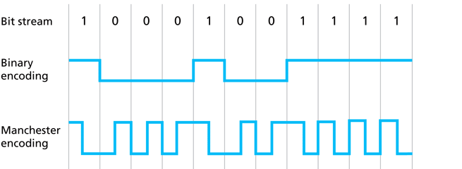
曼彻斯特编码
许多以太网技术(例如10BASE-T)也使用曼彻斯特编码。
通过在每个位的中间包含一个跳变(transition)，接收主机可以使它的时钟与发送主机的时钟同步。
不需要在节点之间建立一个集中式的全局时钟 !
嘿，这是物理层的东西 !

Slide 113
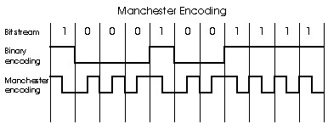
Manchester encoding
Used in 10BaseT
Each bit has a transition
Allows clocks in sending and receiving nodes to synchronize to each other
no need for a centralized, global clock among nodes!
Hey, this is physical-layer stuff!
Notes:
10Base-T采用了曼彻斯特编码。

Slide 114
An Unreliable Connectionless Service
Connectionless service:
All of the Ethernet technologies provide connectionless service to the network layer.
No handshaking between sending and receiving adapter.
This layer-2 connectionless service is analogous to IP’s layer-3 datagram service and UDP’s layer-4 connectionless service.
Notes:
所有的Ethernet技术均向网络层提供无连接服务(connectionless service)。
两个网络适配器传输Frame之前并没有握手过程。
同时，Ethernet向网络层提供不可靠的服务，虽然接收方收到Frame后会利用CRC检测Frame中是否出现错误，但无论如何也不会给发送方网络适配器发送确认/否定确认。
发送方网络适配器并不知道所发送的Frame是否通过了CRC校验过程。

Slide 115
An Unreliable Connectionless Service
Unreliable service:
receiving adapter doesn’t send ACKs or NAKs to sending adapter.
When a frame fails the CRC check, the adapter simply discards the frame.
Thus, adapter A has no idea whether its transmitted frame reached adapter B and passed the CRC check.
This lack of reliable transport (at the link layer) helps to make Ethernet simple and cheap.
Notes:
所有的Ethernet技术均向网络层提供无连接服务(connectionless service)。
两个网络适配器传输Frame之前并没有握手过程。
同时，Ethernet向网络层提供不可靠的服务，虽然接收方收到Frame后会利用CRC检测Frame中是否出现错误，但无论如何也不会给发送方网络适配器发送确认/否定确认。
发送方网络适配器并不知道所发送的Frame是否通过了CRC校验过程。

Slide 116
An Unreliable Connectionless Service
But it also means that the stream of datagrams passed to network layer can have gaps due to discarded Ethernet Frames.
Gaps will be filled if application is using TCP, otherwise app will see the gaps.
Note that when TCP retransmits data, the data will eventually return to the Ethernet adapter at which it was discarded.

Slide 117
An Unreliable Connectionless Service
Thus, in this sense, Ethernet does retransmit data, although Ethernet is unaware of
whether it is transmitting a brand-new datagram with brand-new data,
or a datagram that contains data that has already been transmitted at least once.

Slide 118
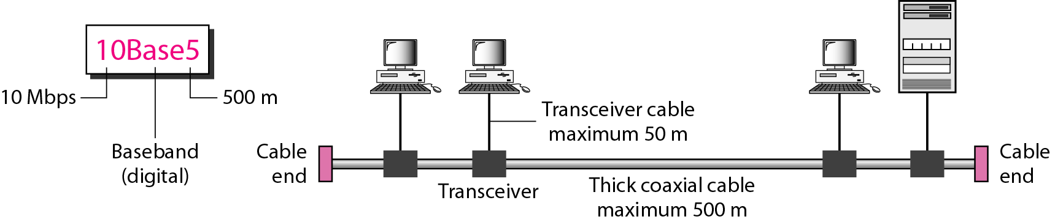
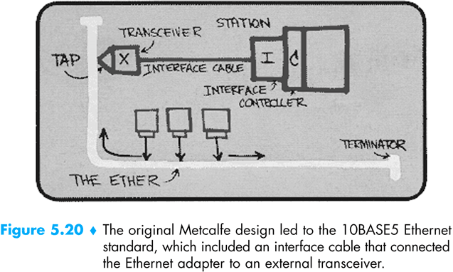
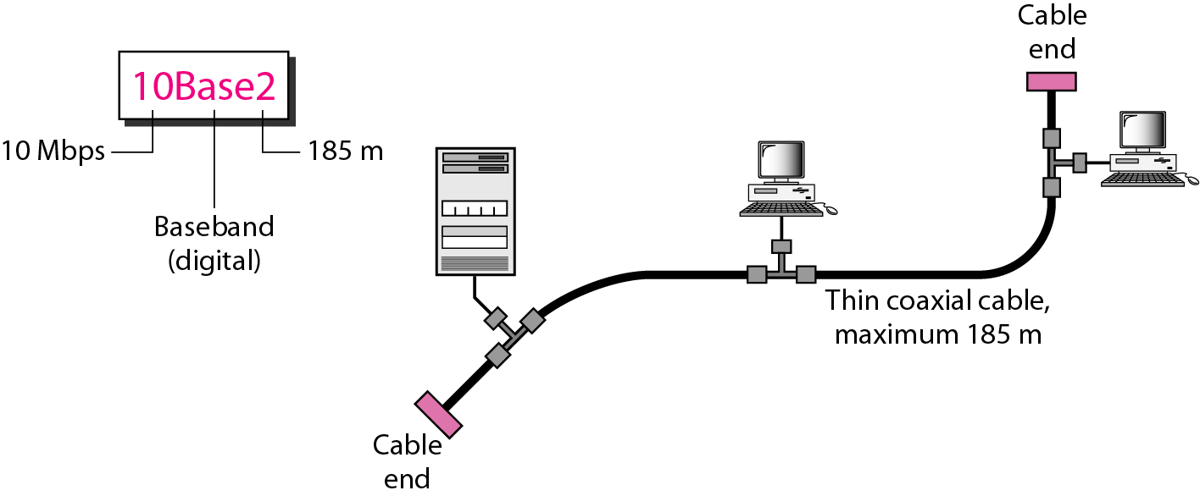
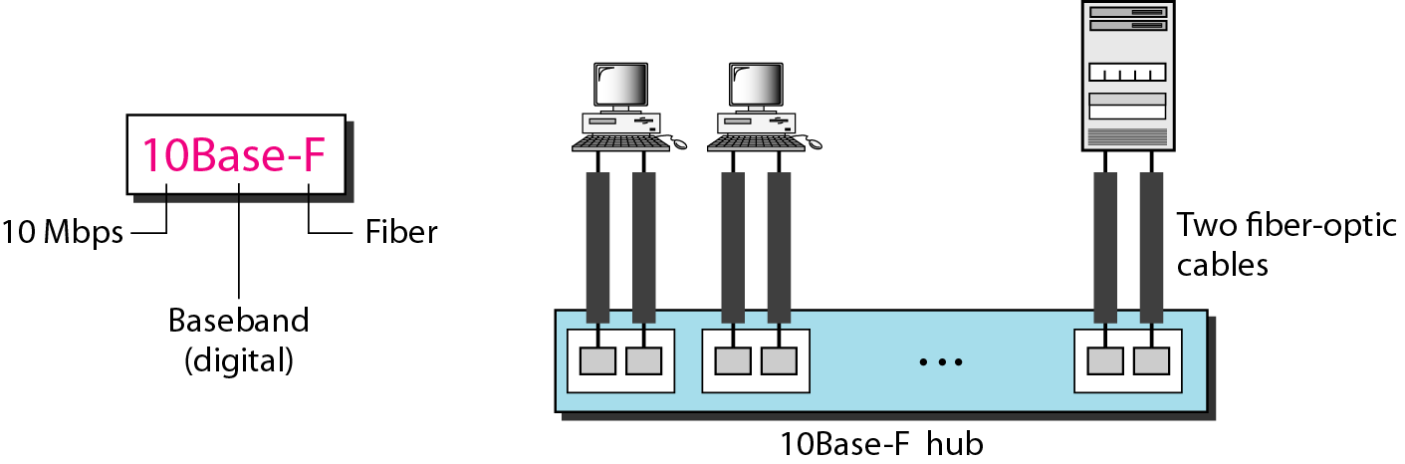

5.3 Ethernet Technologies

Slide 119

Ethernet Technologies
Ethernet has passed through a series of evolutionary steps over the years.
today’s Ethernet is very different from the original bus-topology designs using coaxial cable.
In most installations today, nodes are connected to a switch via point-to-point segments of twisted-pair copper wires or fiber-optic cables.
Notes:
Ethernet has passed through a series of evolutionary steps over the years, and today’s Ethernet is very different from the original bus-topology designs using coaxial cable.
In most installations today, nodes are connected to a switch via point-to-point segments of twisted-pair copper wires or fiber-optic cables.

Slide 120
802.3 Ethernet Standards
many different Ethernet standards
common MAC protocol and frame format
different speeds: 2 Mbps, 10 Mbps, 100 Mbps, 1Gbps, 10G bps
different physical layer media: fiber, cable
application
transport
network
link
physical
MAC protocol
and frame format
100BASE-TX
100BASE-T2
100BASE-FX
100BASE-T4
100BASE-SX
100BASE-BX
copper (twister
pair) physical layer
fiber physical layer

Slide 121
10BaseT and 100BaseT
In 2004 the most common Ethernet technologies are 10BaseT and 100BaseT, which uses twisted-pair copper wire in a star topology and have transmission rates of 10Mbps and 100Mbps, respectively.
100BaseT is also called “fast Ethernet”.
10BaseT is also called traditional Ethernet .
T stands for Twisted Pair
Nodes connect to a hub: “star topology”; 100m maximum distance between nodes and hub.
twisted pair
Hub or switch
Notes:
在2004年，通用的Ethernet技术是100Base-Tx和1000Base-T
Ethernet的标准化由IEEE的802.3工作组负责，因此，Ethernet LAN也叫802.3 LAN。
现在比较常用的桌面接入技术包括10Base-T、100Base-T。10/100指的是10/100Mbps，T指Twist Pair。每个节点上的网络适配器利用直接的点到点链路连接到Hub上，使用到的传输介质是双绞线。节点到Hub的最大距离为100米。

Slide 122

Encoding for Fast Ethernet implementation

Slide 123
GE (IEEE 802.3z)
Gigabit Ethernet is an extension to the highly successful 10 Mbps and 100 Mbps Ethernet standards.
(1) Gigabit Ethernet uses standard Ethernet frame format and is backward compatible with 10BaseT and 100BaseT technologies.
(2) Gigabit Ethernet allows for point-to-point links as well as shared broadcast channels.
(3) In shared mode, CSMA/CD is used; short distances between nodes required for efficiency; uses hubs, called here “Buffered Distributors”
Notes:
GE和10GE是对取得巨大成功的10//100Base Ethernet的扩充。

Slide 124
GE (IEEE 802.3z)
(4) Full-Duplex at 1 Gbps for point-to-point links
Gigabit Ethernet has a star topology with a hub or switch at its center.
Notes:
GE和10GE是对取得巨大成功的10//100Base Ethernet的扩充。

Slide 125
10G Ethernet (IEEE 802.3ae)
10 Gbps (IEEE 802.3ae) now !
With products that emerged in 2001, 10G Ethernet extended the popular Ethernet technology.
Additionally, the 10G Ethernet standard, 802.3ae, extends technology to point-to-point WAN links.
Notes:
GE和10GE是对取得巨大成功的10//100Base Ethernet的扩充。

Slide 126
LAN technologies
Categories of Networks
LAN — Local Area Network
WAN — Wide Area Network
MAN — Metropolitan Area Network
Data Link layer so far:
Services, error detection/correction, multiple access.
Next: LAN technologies
addressing
Ethernet
hubs, switches
PPP
Notes:
数据链路层的主要功能是提供错误校验、多路访问等服务。本站的后面章节我们将学习LAN技术。
LAN局域网是一种集中在一个较小地理区域的计算机网络，如一个建筑物、一个校园等。
Ethernet是目前最最主流的LAN技术，包括Fast Ethernet、GE、10GE等。其他LAN包括FDDI、Token Ring等。

Slide 127
第 6 章 链路层和局域网
6.1 链路层概述
链路层提供的服务
链路层在何处实现
6.2 差错检测和纠正技术
奇偶校验
校验和方法
循环冗余检测
6.3 多路访问链路和协议
信道划分协议
随机接入协议
轮流协议
DOCSIS: 用于电缆互联网接入的链路层协议
6.4 交换局域网
链路层寻址和 ARP
以太网
链路层交换机
虚拟局域网 (VLANs)
6.5 链路虚拟化：网络作为链路层
多协议标签交换 (MPLS)
6.6 数据中心网络
6.7 回顾：Web页面请求的历程
准备：DHCP、UDP、IP和以太网
仍在准备：DNS 和 ARP
仍在准备：域内路由选择到DNS服务器
Web 客户 — 服务器交互：TCP 和 HTTP
6.8 小结

Slide 128

Link-layer Switches
Notes:
The switch itself is transparent to the nodes; that is, a node addresses (寻址) a frames to another node (rather than addressing the frame to the switch) and happily sends the frame into the LAN, unaware that a switch will be receiving the frame and forwarding it to other nodes.
The rate at which frames arrive to any one of the switch’s output interfaces may temporarily exceed the link capacity of that interface.
To accommodate this problem, switch output interfaces have buffers, in much the same way that router output interfaces have buffers for datagrams.

Slide 129
Link-layer Switches
The switch itself is transparent to the nodes; that is,
a node addresses a frames to another node and happily sends the frame into the LAN,
unaware that a switch will be receiving the frame and forwarding it to other nodes.
The rate at which frames arrive to any one of the switch’s output interfaces may temporarily exceed the link capacity of that interface.
To accommodate this problem, switch output interfaces have buffers, in much the same way that router output interfaces have buffers for datagrams.
Notes:
The switch itself is transparent to the nodes; that is, a node addresses (寻址) a frames to another node (rather than addressing the frame to the switch) and happily sends the frame into the LAN, unaware that a switch will be receiving the frame and forwarding it to other nodes.
The rate at which frames arrive to any one of the switch’s output interfaces may temporarily exceed the link capacity of that interface.
To accommodate this problem, switch output interfaces have buffers, in much the same way that router output interfaces have buffers for datagrams.

Slide 130
1 Forwarding and Filtering
Filtering is the switch function that determines whether a frame should be forwarded to some interface or should just be dropped.
Forwarding is the switch function that determines the interfaces to which a frame should be directed, and then moves the frame to those interfaces.
Switch filtering and forwarding are done with a switch table.
A switch has a switch table, entry in switch table:
(MAC Address, Interface, Time Stamp)
stale entries in table dropped (TTL can be 60 min).

Slide 131

1. Forwarding and Filtering
There are important differences between switch table and router forwarding table.
(1) One importance difference is that switches forward packets based on MAC addresses rather than IP address.
(2) A switch table is constructed in a very different manner from routing table.

Slide 132
Switch
link-layer device: smarter than hubs, take active role
store, forward Ethernet frames
examine incoming frame’s MAC address, selectively forward frame to one-or-more outgoing links when frame is to be forwarded on segment, uses CSMA/CD to access segment.
transparent
hosts are unaware of presence of switches
plug-and-play, self-learning
switches do not need to be configured

Slide 133
allows multiple simultaneous transmissions
hosts have dedicated, direct connection to switch
switches buffer packets
Ethernet protocol used on each incoming link, but no collisions; full duplex
each link is its own collision domain
switching: A-to-A’ and B-to-B’ simultaneously, without collisions
not possible with dumb hub
A
C’
B
1
2
6
3
5
4
C
B’
A’
switch with six interfaces
(1,2,3,4,5,6)

Slide 134
Switch Table
Q: how does switch know that A’ reachable via interface 4, B’ reachable via interface 5?
A: each switch has a switch table, each entry:
(MAC address of host, interface to reach host, time stamp)
looks like a routing table!
Q: how are entries created, maintained in switch table?
something like a routing protocol?
A
C’
B
1
2
6
3
5
4
C
B’
A’
switch with six interfaces
(1,2,3,4,5,6)

Slide 135
(2) Self-Learning
A switch has the wonderful property that its table is built automatically, dynamically, and autonomously
— without any intervention from a network administrator or from a configured protocol.
In other words, switches are self-learning.
This capability is accomplished as follows.
Notes:
A switch has the wonderful property (particularly for the already-overworked network administrator) that its table is built automatically, dynamically, and autonomously — without any intervention from a network administrator or from a configured protocol.
In other words, switches are self-learning.
This capability is accomplished as follows.

Slide 136
Self-Learning
switch learns which hosts can be reached through which interfaces
when frame received, switch “learns” location of sender: incoming LAN segment
records sender/location pair in switch table
Source: A
Dest: A’
A
A A’
C’
B
1
2
6
3
5
4
C
MAC addr interface TTL
B’
A’
A
1
60
Switch table
(initially empty)

Slide 137
Switch: frame filtering / forwarding
When frame received:
1. record link associated with sending host
2. index switch table using MAC dest address
3. if entry found for destination then {
if dest on segment from which frame arrived then drop the frame
else forward the frame on interface indicated
}
else flood
forward on all but the interface
on which the frame arrived

Slide 138
Self-learning, forwarding: example
Source: A
Dest: A’
frame destination unknown:
A
A A’
flood
C’
B
1
2
destination A location known:
6
3
A A’
A A’
A A’
A A’
A A’
5
4
selective send
C
A’ A
B’
A’
MAC addr interface TTL
A
1
60
Switch table
(initially empty)
A’
4
60

Slide 139
Interconnecting switches
switches can be connected together
S₄
S₁
S₃
A
S₂
F
I
B
C
D
E
G
H
Q: sending from A to G — how does S₁ know to forward frame destined to G via S₄ and S₃?
A: self learning! (works exactly the same as in single-switch case!)

Slide 140
Self-learning multi-switch example
Suppose C sends frame to I, I responds to C
1
S₄
S₁
2
S₃
A
S₂
F
I
B
C
D
E
G
H
Q: show switch tables and packet forwarding in S₁, S₂, S₃, S₄

Slide 141
Self-Learning
A switch has the wonderful property that its table is built automatically, dynamically, and autonomously
without any intervention from a network administrator or from a configuration protocol.
switch learns which hosts can be reached through which interface
when frame received, switch “learns” location of sender: incoming LAN segment.
records sender/location pair in switch table

Slide 142

A learning bridge and the process of learning

Slide 143
Switch example
Suppose C sends frame to D
switch
address
interface
1
A
B
E
G
1
1
2
3
2
3
hub
hub
hub
A
I
C 1
D
F
B
C
G
H
E
Switch receives frame from from C
notes in bridge table that C is on interface 1
because D is not in table, switch forwards frame into interfaces 2 and 3 (flooding)
frame received by D

Slide 144
Switch example
Suppose D replies back with frame to C.
address
interface
1
switch
A
B
E
G
C
1
1
2
3
1
2
3
hub
hub
hub
A
I
D
F
D 2
B
C
G
H
E
Switch receives frame from D
notes in bridge table that D is on interface 2
because C is in table, switch forwards frame only to interface 1
frame received by C

Slide 145
Self-Learning
self learning is accomplished as follows:
Switch table is initially empty
If frame’s dest address is not in the switch table, switch forwards frame to all other interfaces, otherwise, the frame is forwarded to the interface
For each incoming frame, switch stores in its table
MAC address in frame’s source address field
interface that the frame comes from and arrival time

Slide 146
Self-Learning
Switch deletes an address in the table if no frames are received with that address as the source address after a period of time (the aging time).
A network administrator wanting to install a switch need do nothing more than connect the LAN segments to the switch interfaces.

Slide 147

Institutional network
mail server
to external
network
router
web server
IP subnet

Slide 148
(3) Properties of Link-Layer Switching
Having described the basic operation of a link-layer switch, let’s now consider their features and properties.
We can identify several advantages of using switches, rather than broadcast links such as buses or hub-based star topologies.
(1) Elimination of collisions
(2) Heterogeneous links
(3) Management
Notes:
Having described the basic operation of a link-layer switch, let’s now consider their features and properties.
We can identify several advantages of using switches, rather than broadcast links such as buses or hub-based star topologies.
Elimination of collisions. In a LAN built from switches (and without hubs), there is no wasted bandwidth due to collisions!
As with a router, the maximum aggregate throughput of a switch is the sum of all the switch interface rates.
Thus, switches provide a significant performance improvement over LANs with broadcast links.
Heterogeneous links. Because a switch isolates one link from another, the different links in the LAN can operate at different speeds and can run over different media.
Thus, a switch is ideal for mixing legacy equipment with new equipment.
Management. In addition to providing enhanced security (see sidebar on Focus on Security), a switch also eases network management.
For example, if an adapter malfunctions and continually sends Ethernet frames (called a jabbering adapter), a switch can detect the problem and internally disconnect the malfunctioning adapter.
With this feature, the network administrator need not get out of bed and drive back to work in order to correct the problem.
Similarly, a cable cut disconnects only that host that was using the cut cable to connect to the switch.
In the days of coaxial cable, many a network manager spent hours “walking the line” (or more accurately, “crawling the floor”) to find the cable break that brought down the entire network.
As discussed in Chapter 9 (Network Management), switches also gather statistics on bandwidth usage, collision
rates, and traffic types, and make this information available to the network manager.
This information can be used to debug and correct problems, and to plan how the LAN should evolve in the future.
Researchers are exploring adding yet more management functionality into Ethernet LANs in prototype deployments [Casado 2007; Koponen 2011].

Slide 149
(4) Switches vs. routers
application
transport
network
link
physical
both are store-and-forward:
routers: network-layer devices (examine network-layer headers)
switches: link-layer devices (examine link-layer headers)
both have forwarding tables:
routers: compute tables using routing algorithms, IP addresses
switches: learn forwarding table using flooding, learning, MAC addresses
datagram
frame
link
physical
frame
switch
network
link
physical
datagram
frame
application
transport
network
link
physical
Notes:
As we learned in Chapter 4, routers are store-and-forward packet switches that forward packets using network-layer addresses.
Although a switch is also a store-and-forward packet switch, it is fundamentally different from a router in that it forwards packets using MAC addresses.
Whereas a router is a layer-3 packet switch, a switch is a layer-2 packet switch.
Even though switches and routers are fundamentally different, network administrators must often choose between them when installing an interconnection device.
For example, for the network in Figure 6.15, the network administrator could just as easily have used a router instead of a switch to connect the department LANs, servers, and internet gateway router.
Indeed, a router would permit interdepartmental communication without creating collisions.
Given that both switches and routers are candidates for interconnection devices, what are the pros and cons of the two approaches?
First consider the pros and cons of switches.
As mentioned above, switches are plug-and-play, a property that is cherished by all the overworked network administrators of the world.
Switches can also have relatively high filtering and forwarding rates — as shown in Figure 6.24, switches have to process frames only up through layer 2, whereas routers have to process datagrams up through layer 3.
On the other hand, to prevent the cycling of broadcast frames, the active topology of a switched network is restricted to a spanning tree.
Also, a large switched network would require large ARP tables in the hosts and routers and would generate substantial ARP traffic and processing.
Furthermore, switches are susceptible to broadcast storms — if one host goes haywire and transmits an endless stream of Ethernet broadcast frames, the switches will forward all of these frames, causing the entire network to collapse.
Now consider the pros and cons of routers.
Because network addressing is often hierarchical (and not flat, as is MAC addressing), packets do not normally
cycle through routers even when the network has redundant paths.
(However, packets can cycle when router tables are misconfigured; but as we learned in Chapter 4, IP uses a special datagram header field to limit the cycling.)
Thus, packets are not restricted to a spanning tree and can use the best path between source and destination.
Because routers do not have the spanning tree restriction, they have allowed the Internet to be built with a rich topology that includes, for example, multiple active links between Europe and North America.
Another feature of routers is that they provide firewall protection against layer-2 broadcast storms.
Perhaps the most significant drawback of routers, though, is that they are not plug-and-play — they and the hosts that connect to them need their IP addresses to be configured.
Also, routers often have a larger per-packet processing time than switches, because they have to process up through the layer-3 fields.
Finally, there are two different ways to pronounce the word router, either as “rootor” or as “rowter,” and people waste a lot of time arguing over the proper pronunciation [Perlman 1999].
Given that both switches and routers have their pros and cons (as summarized in Table 5.1), when should an institutional network (for example, a university campus network or a corporate campus network) use switches, and when should it use routers?
Typically, small networks consisting of a few hundred hosts have a few LAN segments.
Switches suffice for these small networks, as they localize traffic and increase aggregate throughput without requiring any configuration of IP addresses.
But larger networks consisting of thousands of hosts typically include routers within the network (in addition to switches).
The routers provide a more robust isolation of traffic, control broadcast storms, and use more “intelligent” routes among the hosts in the network.
For more discussion of the pros and cons of switched versus routed networks, as well as a discussion of how switched LAN technology can be extended to accommodate two orders of magnitude more hosts than today’s Ethernets, see [Meyers 2004; Kim 2008].

Slide 150
Comparison of the typical features of popular interconnection devices
Notes:
A Top-Down Approach 3rd
(1) Hubs versus Switches
Recall that when a hub forwards a frame onto a link, it just sends the bits onto the link without bothering to sense whether another transmission is currently taking place on the link.
In contrast, when a switch wants to forward a frame onto a link, it runs CSMA/CD algorithm.
In particular, the switch refrains from transmitting if it senses that some other node on the LAN segment into which it wants to send a frame is transmitting; furthermore, the switch uses a exponential backoff when one of its transmissions results in a collision.
Thus switch interfaces behave very much like node adapters.
But, technically speaking, they are not node adapters because neither a switch nor its interfaces have MAC addresses.
A switch does not change the source address of the frame.
One significant feature of switches is that they can be used to combine Ethernet segments using different Ethernet technologies.
This feature of being able to interconnect different link rates is not available with hubs.
Also, when switches are used as interconnection devices, there is no theoretical limit to the geographical reach of a LAN.
(2) Dedicated Access and Full Duplex A switch with a large number of interfaces facilitates direct connections between hosts and the switch.
When a host has a direct connection to a switch (rather than a shared LAN connection), the host is said to have dedicated access.
A switch and the hosts directly connected to the switch can operate in the full-duplex mode.
Because of the dedicated access, when Host A transmits a frame on its upstream wire pair, there is no possibility that the frame will collide with a transmission from some other host or from the switch.
Thus, by disabling in each adapter the carrier sensing, the collision detection, and the looping back of transmitted data onto the receiver input, a full-duplex channel is created between each host and the switch.
For example, A-to-A’, C-to-C’ and B-to-B’ simultaneously, no collisions.
If A and A’ have 100 Mbps adapters and the remaining hosts have 10 Mbps adapters, then the aggregate throughput during the three simultaneous file transfers is 120 Mbps.
(2) Cut-Through Switching
cut-through switching: frame forwarded from input to output port without first collecting entire frame
slight reduction in latency
With cut-through switching, if the buffer becomes empty before the entire packet has arrived, the switch can start to transmit the front of the packet while the back of the packet continues to arrive.
Of course, before the packet on the outbound link is transmitted, the portion of the packet that contains the destination address must first arrive.
If the output link is a multiple access network that is shared with other hosts (e.g., the output link connects to a hub), the switch must also sense the link as idle before it can cut-through a packet.
A cut-through switch can reduce a packets end-to-end delay, but how much?
The maximum store–and-forward delay is L/R, where L is the packet size and R is the rate of the inbound link.
The maximum delay is approximately 1.2 msec for 10 Mbps Ethernet and 0.12 msec for 100Mbps Ethernet (corresponding to a maximum-size Ethernet packet.)
This reduction occurs only when the outbound link is lightly loaded.
How significant is this delay? — Probably not very much in most practical applications.

Slide 151
第 6 章 链路层和局域网
6.1 链路层概述
链路层提供的服务
链路层在何处实现
6.2 差错检测和纠正技术
奇偶校验
校验和方法
循环冗余检测
6.3 多路访问链路和协议
信道划分协议
随机接入协议
轮流协议
DOCSIS: 用于电缆互联网接入的链路层协议
6.4 交换局域网
链路层寻址和 ARP
以太网
链路层交换机
虚拟局域网 (VLANs)
6.5 链路虚拟化：网络作为链路层
多协议标签交换 (MPLS)
6.6 数据中心网络
6.7 回顾：Web页面请求的历程
准备：DHCP、UDP、IP和以太网
仍在准备：DNS 和 ARP
仍在准备：域内路由选择到DNS服务器
Web 客户 — 服务器交互：TCP 和 HTTP
6.8 小结

Slide 152


VLANs: motivation
consider:
CS user moves office to EE, but wants connect to CS switch?
single broadcast domain:
all layer-2 broadcast traffic (ARP, DHCP, unknown location of destination MAC address) must cross entire LAN
security/privacy, efficiency issues
Computer
Science
Computer
Engineering
Electrical
Engineering
Notes:
In our earlier discussion of Figure 6.15, we noted that modern institutional LANs are often configured hierarchically, with each workgroup (department) having its own switched LAN connected to the switched LANs of other groups via a switched hierarchy.
While such a configuration works well in an ideal world, the real world is often far from ideal.
Three drawbacks can be identified in the configuration in Figure 6.15.
• Lack of traffic isolation. Although the hierarchy localizes group traffic to within a single switch, broadcast traffic (e.g., frames carrying ARP and DHCP messages or frames whose destination has not yet been learned by a self-learning switch) must still traverse the entire institutional network.
Limiting the scope of such broadcast traffic would improve LAN performance.
Perhaps more importantly, it also may be desirable to limit LAN broadcast traffic for security/privacy reasons.
For example, if one group contains the company’s executive management team and another group contains disgruntled employees running Wireshark packet sniffers, the network manager may well prefer that the executives’ traffic never even reaches employee hosts.
This type of isolation could be provided by replacing the center switch in Figure 6.15 with a router.
We’ll see shortly that this isolation also can be achieved via a switched (layer 2) solution.
• Inefficient use of switches. If instead of three groups, the institution had 10 groups, then 10 first-level switches would be required.
If each group were small, say less than 10 people, then a single 96-port switch would likely be large enough to accommodate everyone, but this single switch would not provide traffic isolation.
• Managing users. If an employee moves between groups, the physical cabling must be changed to connect the employee to a different switch in Figure 6.15.
Employees belonging to two groups make the problem even harder.

Slide 153
VLANs
port-based VLAN: switch ports grouped (by switch management software) so that single physical switch ……
Virtual Local
Area Network
1
7
9
15
2
8
10
16
switch(es) supporting VLAN capabilities can be configured to define multiple virtual LANS over single physical LAN infrastructure.
…
…
Electrical Engineering
(VLAN ports 1-8)
Computer Science
(VLAN ports 9-15)
… operates as multiple virtual switches
1
7
9
15
2
8
10
16
…
…
Electrical Engineering
(VLAN ports 1-8)
Computer Science
(VLAN ports 9-16)
Notes:
Fortunately, each of these difficulties can be handled by a switch that supports virtual local area networks (VLANs).
As the name suggests, a switch that supports VLANs allows multiple virtual local area networks to be defined over a single physical local area network infrastructure.
Hosts within a VLAN communicate with each other as if they (and no other hosts) were connected to the switch.
In a port-based VLAN, the switch’s ports (interfaces) are divided into groups by the network manager.
Each group constitutes a VLAN, with the ports in each VLAN forming a broadcast domain (i.e., broadcast traffic from one port can only reach other ports in the group).
Figure 6.25 shows a single switch with 16 ports.
Ports 2 to 8 belong to the EE VLAN, while ports 9 to 15 belong to the CS VLAN (ports 1 and 16 are unassigned).
This VLAN solves all of the difficulties noted above — EE and CS VLAN frames are isolated from each other, the two switches in the Figure 6.15 have been replaced by a simple switch, and if the user at switch port 8 joins the CS Department, the network operator simply reconfigures the VLAN software so that port 8 is now associated with the CS VLAN.
One can easily imagine how the VLAN switch is configured and operates — the network manager declares a port to belong to a given VLAN (with undeclared ports belonging to a default VLAN) using switch management software, a table of port-to-VLAN mappings is maintained within the switch; and switch hardware only delivers frames between ports belonging to the same VLAN.
But by completely isolating the two VLANs, we have introduced a new difficulty!
How can traffic from the EE Department be sent to the CS Department?
One way to handle this would be to connect a VLAN switch port (e.g., port 1 in Figure 6.25) to an external router and configure that port to belong both the EE and CS VLANs.
In this case, even though the EE and CS departments share the same physical switch, the logical configuration would look as if the EE and CS departments had separate switches connected via router.
An IP datagram going from the EE to the CS department would first cross the EE VLAN to reach the router and then be forwarded by the router back over the CS VLAN to the CS host.
Fortunately, switch vendors make such configurations easy for the network manager by building a single device that contains both a VLAN switch and a router, so a separate external router is not needed.
A homework problem at the end of the chapter explores this scenario in more detail.

Slide 154

Port-based VLAN
traffic isolation: frames to/from ports 1-8 can only reach ports 1-8
can also define VLAN based on MAC addresses of endpoints, rather than switch port
router
1
7
9
15
2
8
10
16
dynamic membership: ports can be dynamically assigned among VLANs
…
…
Electrical Engineering
(VLAN ports 1-8)
Computer Science
(VLAN ports 9-15)
forwarding between VLANS: done via routing (just as with separate switches)
in practice vendors sell combined switches plus routers

Slide 155
VLANS spanning multiple switches
1
7
9
15
1
3
5
7
2
8
10
16
2
4
6
8
…
…
Electrical Engineering
(VLAN ports 1-8)
Computer Science
(VLAN ports 9-15)
Ports 2,3,5 belong to EE VLAN
Ports 4,6,7,8 belong to CS VLAN
trunk port: carries frames between VLANS defined over multiple physical switches
frames forwarded within VLAN between switches can’t be vanilla 802.1 frames (must carry VLAN ID info)
802.1q protocol adds/removed additional header fields for frames forwarded between trunk ports
Notes:
Returning again to Figure 6.15, let’s now suppose that rather than having a separate Computer Engineering department, some EE and CS faculty are housed in a separate building, where (of course!) they need network access, and (of course!) they’d like to be part of their department’s VLAN.
Figure 6.26 shows a second 8-port switch, where the switch ports have been defined as belonging to the EE or the CS VLAN, as needed.
But how should these two switches be interconnected?
One easy solution would be to define a port belonging to the CS VLAN on each switch (similarly for the EE VLAN) and to connect these ports to each other, as shown in Figure 6.26 (a).
This solution doesn’t scale, however, since N VLANS would require N ports on each switch simply to interconnect the two switches.
A more scalable approach to interconnecting VLAN switches is known as VLAN trunking.
In the VLAN trunking approach shown in Figure 6.26(b), a special port on each switch (port 16 on the left switch and port 1 on the right switch) is configured as a trunk port to interconnect the two VLAN switches.
The trunk port belongs to all VLANs, and frames sent to any VLAN are forwarded over the trunk link to the other switch.
But this raises yet another question: How does a switch know that a frame arriving on a trunk port belongs to a particular VLAN?

Slide 156
802.1Q VLAN frame format
type
preamble
dest.
address
source
address
data (payload)
CRC
802.1 frame
type
preamble
dest.
address
source
address
data (payload)
CRC
802.1Q frame
2-byte Tag Protocol Identifier
(value: 0x8100)
Recomputed
CRC
Tag Control Information (12 bit VLAN ID field,
3 bit priority field like IP TOS)
Notes:
The IEEE has defined an extended frame format 802.1Q, for frames crossing a VLAN trunk.
As shown in Figure 6.27, the 802.1Q frame consists of the standard Ethernet frame with a four-byte VLAN tag added into the header that carries the identity of the VLAN to which the frame belongs.
The VLAN tag is added into a frame by the switch at the sending side of a VLAN trunk, parsed, and removed by the switch at the receiving side of the trunk.
The VLAN tag itself consists of a 2-byte Tag Protocol Identifier (TPID) field (with a fixed hexadecimal value of 0x8100), a 2-byte Tag Control Information field that contains 12-bit VLAN identifier field, and a 3-bit priority field that is similar in intent to the IP datagram TOS field.
In this discussion, we’ve only briefly touched on VLANs and have focused on port-based VLANs.
We should also mention that VLANs can be defined in several other ways.
In MAC-based VLANs, the network manager specifies the set of MAC address that belong to each VLAN; whenever a device attaches to a port, the port is connected into the appropriate VLAN based on the MAC address of the device.
VLANs can also be defined based on network-layer protocol (e.g., IPv4, IPv6, or AppleTalk) and other criteria.
See the 802.1Q standard for more details.

Slide 157
第 6 章 链路层和局域网
6.1 链路层概述
链路层提供的服务
链路层在何处实现
6.2 差错检测和纠正技术
奇偶校验
校验和方法
循环冗余检测
6.3 多路访问链路和协议
信道划分协议
随机接入协议
轮流协议
DOCSIS: 用于电缆互联网接入的链路层协议
6.4 交换局域网
链路层寻址和 ARP
Ethernet
链路层交换机
虚拟局域网 (VLANs)
5.5 PPP: The Point-to-Point Protocol
6.5 链路虚拟化：网络作为链路层
多协议标签交换 (MPLS)
6.6 数据中心网络
6.7 回顾：Web页面请求的历程
6.8 小结

Slide 158
PPP: The Point-to-Point Protocol
In this section we cover a link-layer protocol for point-to-point link — PPP, the point-to-point protocol.
The point-to-point link over which PPP operates might be a serial dial-up telephone line (for example, a 56k modem connection), a SONET/SDH link, an X.25 connection, or an ISDN circuit.
As noted above, PPP is often the protocol of choice for connecting home users to their ISPs over a dial-up connection.

Slide 159
(Remote Access Service server)
Fig. Access through a telephone network with analog local loops

Slide 160
Difference between the operation of ADSL modems and of traditional modems

Slide 161
ADSL应用方式
PPPoE (PPP over Ethernet)
以太网的HUB或交换机用双绞线连接到ATU-R (R代表远端Remote)
单机使用时，则用双绞线把网卡与ATU-R相连
加载PPPoE协议栈，使PPP协议工作在以太网上
多个用户可共享一条ADSL线路

Slide 162
Point to Point Data Link Control
one sender, one receiver, one link: easier than broadcast link:
no Media Access Control
no need for explicit MAC addressing
e.g., dial-up link, ISDN circuit, a SONET/SDH link
popular point-to-point DLC protocols:
PPP (point-to-point protocol)
HDLC: High level Data Link Control (Data link used to be considered “high layer” in protocol stack!)
Notes:
PPP(点到点协议)是工作在点到点链路上的链路层协议，这种点到点链路可以是拨号线路、SONET/SDH链路、X.25连接、或者是ISDN电路。，除了PPP外，HDLC( High-level Data Link Control)协议也是一种链路层协议。

Slide 163
PPP Design Requirements [RFC 1557]
packet framing: encapsulation of network-layer packet in data link frame
carry network layer data of any network layer protocol (not just IP) at the same time
ability to demultiplex upwards
bit transparency: must carry any bit pattern in the data field
error detection (no correction): A PPP receiver must be able to detect bit errors in the received frame.
connection liveness: must be able to detect a failure at the link level and signal this error condition to network layer.
Notes:
PPP的设计要求：
1、成帧：将上层的Packet封装进Frame中，以使得接收方可以分清帧、帧内Packet的起始和结束；
2、透明性：PPP必须对高层协议透明，不能对高层所传送的数据加以限制或约束；
3、多网络层协议支持：应允许在一条链路上同时运行多种网络层协议，因此需要在Frame头部有一个类似type/protocol的字段来指明其中的网络层协议类型；
4、多链路类型支持：PPP可以运行在多种不同的链路；
5、错误检测：接收方必须能够检测所接收Frame中是否出现错误；
6、连接活性检测：能够检测并向网络层报告链路的故障；
7、网络层地址协商：许多网络层协议在传输Packet之前必须知道一点到点链路两端设备的网络层地址，某些点到点链路可能是动态生成的，如拨号网络，路由器的地址可能在不同连接时是不同的，因此，PPP需要为网络层协议提供一种来获知或配置相互的网络层地址的机制；
8、简单性：PPP不应该提供比IP更复杂的功能，传输层提供的功能无需在PPP中实现。
由

Slide 164
PPP Design Requirements [RFC 1557]
network layer address negotiation: The PPP must provide a mechanism for the communicating network layers (for example, IP) to learn or configure each other’s network-layer address.
Multiple network-layer protocols. The PPP protocol must be able to support multiple network-layer protocols running the over same physical link at the same time.
Multiple types of links. The PPP must also be able to operate over a wide variety of link types.
Simplicity. On top of all of theses requirements listed above, first and foremost is simplicity.
Notes:
PPP的设计要求：
1、成帧：将上层的Packet封装进Frame中，以使得接收方可以分清帧、帧内Packet的起始和结束；
2、透明性：PPP必须对高层协议透明，不能对高层所传送的数据加以限制或约束；
3、多网络层协议支持：应允许在一条链路上同时运行多种网络层协议，因此需要在Frame头部有一个类似type/protocol的字段来指明其中的网络层协议类型；
4、多链路类型支持：PPP可以运行在多种不同的链路；
5、错误检测：接收方必须能够检测所接收Frame中是否出现错误；
6、连接活性检测：能够检测并向网络层报告链路的故障；
7、网络层地址协商：许多网络层协议在传输Packet之前必须知道一点到点链路两端设备的网络层地址，某些点到点链路可能是动态生成的，如拨号网络，路由器的地址可能在不同连接时是不同的，因此，PPP需要为网络层协议提供一种来获知或配置相互的网络层地址的机制；
8、简单性：PPP不应该提供比IP更复杂的功能，传输层提供的功能无需在PPP中实现。
由

Slide 165
PPP non-requirements
While it may appear that many requirements were placed on the design of PPP, the situation could actually have been much more difficult.
The design specifications for PPP also explicitly note protocol functionality that PPP was not required to implement.
no error correction / recovery
no flow control
out of order delivery OK
no need to support multipoint links (e.g., polling)
Error recovery, flow control, data re-ordering all relegated to higher layers !
Notes:
不要求PPP协议实现的功能：
1、错误纠正：检错就够了；
2、流量控制：PPP的接收方应该能够以最高链路速率接收Frame，如果高层协议跟不上，应该由高层协议抑制发送方高层协议的发送速率；
3、顺序递交：可以将收到的Frame乱序递交给接收方。
4、多点链路：PPP只是工作在point-to-point链路上，无须考虑多点链路情况。

Slide 166

PPP Data Framing
Flag: delimiter (framing)
Address: does nothing (only one option), the only possible value for this field is 11111111.
Control: does nothing; in the future possible multiple control fields.
Protocol: upper layer protocol to which frame delivered (e.g., PPP-LCP, IP, IPCP, etc)

Slide 167

PPP Data Framing

Slide 168
PPP Data Framing
info: upper layer data being carried.
The default maximum length of the information field is 1,500 bytes, although this can be changed when the link is first configured, as discussed below.
check: cyclic redundancy check for error detection

Slide 169
Byte Stuffing
“data transparency” requirement: data field must be allowed to include flag pattern <01111110>
Q: is received <01111110> data or flag?
Sender: adds (“stuffs”) an extra < 01111101> control escape byte before each < 01111110> and <01111101> data byte
single <01111101> indicates an stuff byte;
two <01111101> bytes in a row: discard first byte, continue data reception
single 01111110 and there is not a <01111101>: flag byte
Notes:
PPP的数据帧的标志(FLAG)字段的位模式为01111110，如果在info字段中有同样的位模式，如果不进行处理则会不适当地看作Frame已经结束。
PPP的透明性又要求不能限制高层协议数据的位模式，因此，需要PPP以某种机制来保证透明性。
常用方法叫做byte-stuffing (字节填充)，即定义一个特殊的控制转义字节：01111101，出现在帧中除Flag外任何地方的01111110，前面都要填充上转义字符01111101，以指示下一个01111110不是Flag，而是实际的数据部分。
接收方看到01111110前面有转移字符01111101，则将取出填充的转义字节以重构数据。
同样的，如果在实际数据中出现01111101(转义字符)，则在其前同样填充一个转义字符。
接收方只看到一个转义字符时，则知道这个字符是被填充进的；如果成对出现转义字符，则实际数据中有与转义字符相同的位模式，需要取出一个转移字符以还原初始的数据。

Slide 170

Byte Stuffing
flag byte
pattern
in data
to send
flag byte pattern plus
stuffed byte in transmitted data

Slide 171

PPP Data Control Protocol
Before exchanging network-layer data, data link peers must
configure PPP link (maximum frame length, authentication)
learn / configure network layer information
for IP: carry IP Control Protocol (IPCP) messages (protocol field: 8021) to configure/learn IP address
Notes:
PPP需要利用LCP (link control protocol)来初始化链路。除了初始化外，LCP还负责链路的维护、错误报告、关闭链路等。
在链路两端节点能够交换数据之前，两个节点需要做相当多关于链路配置的处理，这些处理有些类似于TCP的三次握手。
本页幻灯片给出了一个PPP链路的状态迁移图。PPP链路的状态迁移总是开始并且结束于dead状态，当检测到链路上有载波，或网络管理人员指示有物理层已经准备好时，PPP进入link establishment状态；在link establishment状态，链路一端节点使用LCP configure-request帧(本质上是PPP帧，其protocol字段为LCP，info中包含具体的配置请求)发送自己想要的链路配置选项；另一端节点可能发送configure-ACK帧来接受，或configure-NAK来拒绝其配置请求，或者configure-reject来进行应答。
LCP的配置选项包括链路最大帧长度，认证协议，是否跳过PPP帧中地址和控制字段的使用的选择；
链路建立起来后，可以进行认证，PPP链路两端会相互交换网络层特定的网络控制分组，如果网络层为IP,则IPCP(IP控制协议)数据将在Frame中携带，IPCP允许两个IP模块交换或者配置其IP地址并协商数据包是否已压缩的方式传输。
一旦网络层配置完成后，PPP就可以开始发送网络层的数据，链路进入了open状态，open状态中，双方可以进行数据传输，并且通过定时交换echo-request和echo-reply来检测链路状态。
当一方发送一个LCP terminate-request帧后，PPP进入terminating状态，收到对方的terminate-ack后，链路进入dead状态。

Slide 172

An example

Slide 173

An example(continued)

Slide 174
第 6 章 链路层和局域网
6.1 链路层概述
链路层提供的服务
链路层在何处实现
6.2 差错检测和纠正技术
奇偶校验
校验和方法
循环冗余检测
6.3 多路访问链路和协议
信道划分协议
随机接入协议
轮流协议
DOCSIS: 用于电缆互联网接入的链路层协议
6.4 交换局域网
链路层寻址和 ARP
以太网
链路层交换机
虚拟局域网 (VLANs)
6.5 链路虚拟化：网络作为链路层
多协议标签交换 (MPLS)
6.6 数据中心网络
6.7 回顾：Web页面请求的历程
准备：DHCP、UDP、IP和以太网
仍在准备：DNS 和 ARP
仍在准备：域内路由选择到DNS服务器
Web 客户 — 服务器交互：TCP 和 HTTP
6.8 小结

Slide 175
6.5 Link Virtualization
Given that we’re nearing the chapter’s end, let’s reflect on how our understanding of the term link has evolved.
We began this chapter by viewing the link as a physical wire ⁽¹⁾ connecting two communicating hosts.
In studying multiple access protocol, we saw that multiple hosts could be connected by a shared wire ⁽²⁾ and that the “wire” connecting the hosts could be radio spectra or other media.
This led us to consider the link a bit more abstractly as a channel, rather than as a wire.
Notes:
Because this chapter concerns link-layer protocols, and given that we’re now nearing the chapter’s end, let’s reflect on how our understanding of the term link has evolved.
We began this chapter by viewing the link as a physical wire connecting two communicating hosts.
In studying multiple access protocol, we saw that multiple hosts could be connected by a shared wire and that the “wire" connecting the hosts could be radio spectra or other media.
This led us to consider the link a bit more abstractly as a channel, rather than as a wire.

Slide 176
Link Virtualization
In our study of Ethernet LANs we saw that the interconnecting media could actually be a rather complex switched infrastructure.
Throughout this evolution, however, the hosts themselves maintained the view that the interconnecting medium ⁽³⁾ was simply a link-layer channel connecting two or more hosts.
For example, that an Ethernet host can be blissfully unaware of whether it is connected to other LAN hosts by a single short LAN segment or by a geographically dispersed switched or by a VLAN.
Notes:
In our study of Ethernet LANs we saw that the interconnecting media could actually be a rather complex switched infrastructure.
Throughout this evolution, however, the hosts themselves maintained the view that the interconnecting medium was simply a link-layer channel connecting two or more hosts.
For example, that an Ethernet host can be blissfully unaware of whether it is connected to other LAN hosts by a single short LAN segment (Figure 6.17) or by a geographically dispersed switched LAN (Figure 6.15) or by a VLAN (Figure 6.26).

Slide 177
Link Virtualization
In the case of a dialup modem connection between two hosts, the link connecting the two hosts is actually the telephone network ⁽⁴⁾.
— a logically separate, global telecommunications network with its own switches, links, and protocol stacks for data transfer and signaling.
From the Internet link-layer point of view, however, the dial-up connection through the telephone network is viewed as a simple “wire”.
Notes:
In the case of a dialup modem connection between two hosts, the link connecting the two hosts is actually the telephone network — a logically separate, global telecommunications network with its own switches, links, and protocol stacks for data transfer and signaling.
From the Internet link-layer point of view, however, the dial-up connection through the telephone network is viewed as a simple “wire.”

Slide 178
Link Virtualization
In this sense, the Internet virtualizes the telephone network, viewing the telephone network as a link-layer technology providing link-layer connectivity between two Internet hosts.
An overlay network similarly views the Internet ⁽⁵⁾ as a means for providing connectivity between overlay nodes, seeking to overlay the Internet
in the same way that the Internet overlays the telephone network.
Notes:
In this sense, the Internet virtualizes the telephone network, viewing the telephone network as a link — a layer technology providing link-layer connectivity between two Internet hosts.
We may recall from our discussion of overlay networks in chapter 2 that an overlay network similarly views the Internet as a means for providing connectivity between overlay nodes, seeking to overlay the Internet in the same way that the Internet overlays the telephone network.

Slide 179
Link Virtualization
In this section, we’ll consider multiprotocol Label Switching (MPLS) networks.
Unlike the circuit-switched telephone network, MPLS is a packet-switched, virtual-circuit networks in their own right.
It has its own packet formats and forwarding behaviors.
Thus, from a pedagogical viewpoint, a discussion of MPLS fits well into a study of either the network layer or the link layer.
Notes:
In this section, we’ll consider multiprotocol Label Switching (MPLS) networks.
Unlike the circuit-switched telephone network, MPLS is a packet-switched, virtual-circuit networks in their own right.
It has its own packet formats and forwarding behaviors.
Thus, from a pedagogical viewpoint, a discussion of MPLS fits well into a study of either the network layer or the link layer.

Slide 180
Link Virtualization
From an Internet viewpoint, however, we can consider MPLS, like the telephone network and switched-Ethernets, as link-layer technologies that serve to interconnect IP devices.
Thus, we’ll consider MPLS in our discussion of the link layer.
Frame Relay and ATM networks can also be used to interconnect IP devices,
though they represent a slightly older technology and will not be covered here.
Notes:
From an Internet viewpoint, however, we can consider MPLS, like the telephone network and switched-Ethernets, as link-layer technologies that serve to interconnect IP devices.
Thus, we’ll consider MPLS in our discussion of the link layer.
Frame Relay and ATM networks can also be used to interconnect IP devices, though they represent a slightly older (but still deployed) technology and will not be covered here; see the very readable book [Goralski 1999] for details.

Slide 181
Link Virtualization
Our treatment of MPLS will be necessarily brief, as entire books could be (and have been) written on these networks.
We’ll focus here primarily on how MPLS servers interconnect to IP devices,
although we’ll dive a bit deeper into the underlying technologies as well.
Notes:
Our treatment of MPLS will be necessarily brief, as entire books could be (and have been) written on these networks.
We’ll focus here primarily on how MPLS servers interconnect to IP devices, although we’ll dive a bit deeper into the underlying technologies as well.

Slide 182
第 6 章 链路层和局域网
6.1 链路层概述
链路层提供的服务
链路层在何处实现
6.2 差错检测和纠正技术
奇偶校验
校验和方法
循环冗余检测
6.3 多路访问链路和协议
信道划分协议
随机接入协议
轮流协议
DOCSIS: 用于电缆互联网接入的链路层协议
6.4 交换局域网
链路层寻址和 ARP
以太网
链路层交换机
虚拟局域网 (VLANs)
6.5 链路虚拟化：网络作为链路层
多协议标签交换 (MPLS)
6.6 数据中心网络
6.7 回顾：Web页面请求的历程
准备：DHCP、UDP、IP和以太网
仍在准备：DNS 和 ARP
仍在准备：域内路由选择到DNS服务器
Web 客户 — 服务器交互：TCP 和 HTTP
6.8 小结

Slide 183
Multiprotocol label switching (MPLS)
MPLS evolved from a number of industry efforts to improve the forwarding speed of IP routers by adopting a key concept from the world of virtual-circuit networks: a fixed-length label.
The goal was
not to abandon the destination-based IP datagram-forwarding infrastructure for one based on fixed-length labels and virtual circuits,
but to augment it by selectively labeling datagrams and allowing routers to forward datagram based on fixed-length labels when possible.
Notes:
MPLS evolved from a number of industry efforts in the mid-to-late 1990s to improve the forwarding speed of IP routers by adopting a key concept from the world of virtual-circuit networks: a fixed-length label.
The goal was not to abandon the destination-based IP datagram-forwarding infrastructure for one based on fixed-length labels and virtual circuits, but to augment it by selectively labeling datagrams and allowing routers to forward datagram based on fixed-length labels (rather than destination IP addresses) when possible.
Importantly, these techniques work hand-in-hand with IP, using IP addressing and routing.
The IETF unified these efforts in the MPLS protocol, effectively blending VC techniques into a routed datagram network.

Slide 184
Multiprotocol label switching (MPLS)
Importantly, these techniques work hand-in-hand with IP, using IP addressing and routing.
The IETF unified these efforts in the MPLS protocol, effectively blending VC techniques into a routed datagram network.
Notes:
MPLS evolved from a number of industry efforts in the mid-to-late 1990s to improve the forwarding speed of IP routers by adopting a key concept from the world of virtual-circuit networks: a fixed-length label.
The goal was not to abandon the destination-based IP datagram-forwarding infrastructure for one based on fixed-length labels and virtual circuits, but to augment it by selectively labeling datagrams and allowing routers to forward datagram based on fixed-length labels (rather than destination IP addresses) when possible.
Importantly, these techniques work hand-in-hand with IP, using IP addressing and routing.
The IETF unified these efforts in the MPLS protocol [RFC 3031, RFC 3032], effectively blending VC techniques into a routed datagram network.

Slide 185
Multiprotocol label switching (MPLS)
initial goal: high-speed IP forwarding using fixed length label (instead of IP address)
fast lookup using fixed length identifier (rather than shortest prefix matching)
borrowing ideas from Virtual Circuit (VC) approach
but IP datagram still keeps IP address!
PPP or Ethernet
header
IP header
remainder of link-layer frame
MPLS header
label
Exp
S
TTL
20
3
1
5
Notes:
Let’s begin our study of MPLS by considering the format of a link-layer frame that is handled by an MPLS-capable router.
Figure 6.28 shows that a link-layer frame transmitted between MPLS-capable devices has a small MPLS header added between the layer-2 (e.g., Ethernet) header and layer-3 (i.e., IP) header.
RFC 3032 defines the format of the MPLS header for such links; headers are defined for ATM and frame-relayed networks as well in other RFCs.
Among the fields in the MPLS header are the label (which serves the role of the virtual-circuit identifier that we
encountered back in Section 4.2.1), 3 bits reserved for experimental use, a single S bit, which is used to indicate the end of a series of “stacked” MPLS headers (an advanced topic that we’ll not cover here), and a time-to-live field.
It’s immediately evident from Figure 6.28 that an MPLS-enhanced frame can only be sent between routers that are both MPLS capable (since a non-MPLS-capable router would be quite confused when it found an MPLS header where it had expected to find the IP header!).
An MPLS-capable router is often referred to as a label-switched router, since it forwards an MPLS frame by looking up the MPLS label in its forwarding table and then immediately passing the datagram to the
appropriate output interface.
Thus, the MPLS-capable router need not extract the destination IP address and perform a lookup of the longest prefix match in the forwarding table.
But how does a router know if its neighbor is indeed MPLS capable, and how does a router know what label to associate with the given IP destination?
To answer these questions, we’ll need to take a look at the interaction among a group of MPLS-capable routers.

Slide 186
MPLS 协议的基本原理
MPLS
MPLS 域
打上标记
B
去除标记
LDP
LDP
A
C
LDP
D
标记交换
标记交换
标记交换
MPLS
entry router
MPLS
exit router
普通 IP 分组
打上标记的分组
普通路由器
标记交换路由器 LSR
Notes:
(1) MPLS 域中的各LSR (Label Switching Router) 使用专门的标记分配协议LDP (Label Distribution Protocol) 交换报文，并找出标记交换路径LSP (Label Switching Path)。各 LSR 根据这些路径构造出分组转发表。
(2) 分组进入到 MPLS 域时， MPLS 入口结点把分组打上标记，并按照转发表将分组转发给下一个 LSR。
(3) 以后的所有LSR都按照标记进行转发。每经过一个 LSR，要换一个新的标记。
(4) 当分组离开 MPLS 域时，MPLS 出口结点把分组的标记去除。再以后就按照一般分组的转发方法进行转发。

Slide 187
MPLS capable routers
a.k.a. label-switched router
forward packets to outgoing interface based only on label value (don’t inspect IP address)
MPLS forwarding table distinct from IP forwarding tables
flexibility: MPLS forwarding decisions can differ from those of IP
use destination and source addresses to route flows to same destination differently (traffic engineering)
re-route flows quickly if link fails: pre-computed backup paths (useful for VoIP)

Slide 188
MPLS versus IP paths
R6
D
R4
R3
R5
A
R2
IP routing: path to destination determined by destination address alone
IP router

Slide 189
MPLS versus IP paths
entry router (R4) can use different MPLS routes to A based, e.g., on source address
R6
D
R4
R3
R5
A
R2
IP routing: path to destination determined by destination address alone
IP-only
router
MPLS routing: path to destination can be based on source and dest. address
fast reroute: precompute backup routes in case of link failure
MPLS and
IP router

Slide 190
MPLS signaling
modify OSPF, IS-IS link-state flooding protocols to carry info used by MPLS routing,
e.g., link bandwidth, amount of “reserved” link bandwidth
entry MPLS router uses RSVP-TE signaling protocol to set up MPLS forwarding at downstream routers
R6
RSVP-TE
D
R4
R5
modified
link state
flooding
A

Slide 191
MPLS forwarding tables
in out out
label label dest interface
10 A 0
in out out
label label dest interface
12 D 0
8 A 1
10 6 A 1
12 9 D 0
R6
0
10
0
D
1
1
R4
8
R3
6
R5
0
6
0
A
R2
R1
in out out
label label dest interface
in out out
label label dest interface
8 6 A 0
6 - A 0
Notes:
In the example in Figure 6.36, routers R1 through R4 are MPLS capable. R5 and R6 are standard IP routers.
R1 has advertised to R2 and R3 that it (R1) can route to destination A, and that a received frame with MPLS label 6 will be forwarded to destination A.
Router R3 has advertised to router R4 that it can route to destinations A and D, and that incoming frames with MPLS labels 10 and 12, respectively, will be switched toward those destinations.
Router R2 has also advertised to router R4 that it (R2) can reach destination A, and that a received frame with MPLS label 8 will be switched toward A.
Note that router R4 is now in the interesting position of have two MPLS paths to reach A: via interface 0 with outbound MPLS label 10, and via interface 1 with an MPLS label of 8.
The broad picture painted in Figure 6.36 is that IP devices R5, R6, A and D are connected together via an MPLS infrastructure (MPLS-capable routers R1, R2, R3, and R4) in much the same way that a switched LAN or an ATM network can connect together IP devices.
And like a switched LAN or ATM network, the MPLS-capable routers R1 through R4 do so without ever touching the IP header of a packet.
In our discussion above, we’ve not specified the specific protocol used to distribute labels among the MPLS-capable routers, as the details of this signaling are well beyond the scope of this book.
We note, however, that the IETF working group on MPLS has specified in [RFC 3468] that an extension of the RSVP protocol, known as RSVP-TE [RFC 3209], will be the focus of its efforts for MPLS signaling.
We’ve also not discussed how MPLS actually computes the paths for packets among MPLS capable routers, nor how it gathers link-state information (e.g., amount of link bandwidth unreserved by MPLS) to use in these path computations.
Existing link-state routing algorithms (e.g., OSPF) have been extended to flood this information to MPLS-capable routers.
Interestingly, the actual path computation algorithms are not standardized, and are currently vendor-specific.
Thus far, the emphasis of our discussion of MPLS has been on the fact that MPLS performs switching based on labels, without needing to consider the IP address of a packet.
The true advantages of MPLS and the reason for current interest in MPLS, however, lie not in the potential increases in switching speeds, but rather in the new traffic management capabilities that MPLS enables.
As noted above, R4 has two MPLS paths to A.
If forwarding were performed up at the IP layer on the basis of IP address, the IP routing protocols we studied in Chapter 4 would specify only a single, least-cost path to A.
Thus, MPLS provides the ability to forward packets along routes that would not be possible using standard IP routing protocols.
This is one simple form of traffic engineering using MPLS [RFC 3346; RFC 3272; RFC 2702; Xiao 2000], in which a network operator can override normal IP routing and force some of the traffic headed toward a given destination along one path, and other traffic destined toward the same destination along another path (whether for policy, performance, or some other reason).
It is also possible to use MPLS for many other purposes as well.
It can be used to perform fast restoration of MPLS forwarding paths, e.g., to reroute traffic over a precomputed failover path in response to link failure [Kar 2000; Huang 2002; RFC 3469].
Finally, we note that MPLS can, and has, been used to implement so-called virtual private networks (VPNs).
In implementing a VPN for a customer, an ISP uses its MPLS-enabled network to connect together the customer’s various networks.
MPLS can be used to isolate both the resources and addressing used by the customer’s VPN from that of other users crossing the ISP’s network; see [DeClercq 2002] for details.
Our discussion of MPLS has been brief, and we encourage you to consult the references we’ve mentioned.
We note that with so many possible uses for MPLS, it appears that it is rapidly becoming the Swiss Army knife of Internet traffic engineering!

Slide 192
第 6 章 链路层和局域网
6.1 链路层概述
链路层提供的服务
链路层在何处实现
6.2 差错检测和纠正技术
奇偶校验
校验和方法
循环冗余检测
6.3 多路访问链路和协议
信道划分协议
随机接入协议
轮流协议
DOCSIS: 用于电缆互联网接入的链路层协议
6.4 交换局域网
链路层寻址和 ARP
以太网
链路层交换机
虚拟局域网 (VLANs)
6.5 链路虚拟化：网络作为链路层
多协议标签交换 (MPLS)
6.6 数据中心网络
6.7 回顾：Web页面请求的历程
准备：DHCP、UDP、IP和以太网
仍在准备：DNS 和 ARP
仍在准备：域内路由选择到DNS服务器
Web 客户 — 服务器交互：TCP 和 HTTP
6.8 小结

Slide 193

Data center networks
10’s to 100’s of thousands of hosts, often closely coupled, in close proximity:
e-business (e.g. Amazon)
content-servers (e.g., YouTube, Akamai, Apple, Microsoft)
search engines, data mining (e.g., Google)
challenges:
multiple applications, each serving massive numbers of clients
managing / balancing load, avoiding processing, networking, data bottlenecks
Inside a 40-ft Microsoft container,
Chicago data center
Notes:
In recent years, Internet companies such as Google, Microsoft, Facebook, and Amazon (as well as their counterparts in Asia and Europe) have built massive data centers, each housing tens to hundreds of thousands of hosts, and concurrently supporting many distinct cloud applications (e.g., search, email, social networking, and e-commerce).
Each data center has its own data center network that interconnects its hosts with each other and interconnects the data center with the Internet.
In this section, we provide a brief introduction to data center networking for cloud applications.
The cost of a large data center is huge, exceeding $12 million per month for a 100,000 host data center [Greenberg 2009a].
Of these costs, about 45 percent can be attributed to the hosts themselves (which need to be replaced every 3–4 years); 25 percent to infrastructure, including transformers, uninterruptable power supplies (UPS) systems, generators for long-term outages, and cooling systems; 15 percent for electric utility costs for the power draw; and 15 percent for networking, including network gear (齿轮；装置) (switches, routers and load balancers), external links, and transit traffic costs.
( In these percentages, costs for equipment are amortized so that a common cost metric is applied for one-time purchases and ongoing expenses such as power. )
While networking is not the largest cost, networking innovation is the key to reducing overall cost and maximizing performance [Greenberg 2009a].
The worker bees in a data center are the hosts: They serve content (e.g., Web pages and videos), store emails and documents, and collectively perform massively distributed computations (e.g., distributed index computations for search engines).
The hosts in data centers, called blades and resembling pizza boxes, are generally commodity hosts that include CPU, memory, and disk storage.
The hosts are stacked in racks, with each rack typically having 20 to 40 blades.
At the top of each rack there is a switch, aptly named the Top of Rack (TOR) switch, that interconnects the hosts in the rack with each other and with other switches in the data center.
Specifically, each host in the rack has a network interface card that connects to its TOR switch, and each TOR switch has additional ports that can be connected to other switches.
Although today hosts typically have 1 Gbps Ethernet connections to their TOR switches, 10 Gbps connections may become the norm.
Each host is also assigned its own data-center-internal IP address.
The data center network supports two types of traffic: traffic flowing between external clients and internal hosts and traffic flowing between internal hosts.
To handle flows between external clients and internal hosts, the data center network includes one or more border routers, connecting the data center network to the public Internet.
The data center network therefore interconnects the racks with each other and connects the racks to the border routers.
Figure 6.30 shows an example of a data center network.
Data center network design, the art of designing the interconnection network and protocols that connect the racks with each other and with the border routers, has become an important branch of computer networking research in recent years [Al-Fares 2008; Greenberg 2009a; Greenberg 2009b; Mydotr 2009; Guo 2009; Chen 2010; Abu-Libdeh 2010; Alizadeh 2010; Wang 2010; Farrington 2010; Halperin 2011; Wilson 2011; Mudigonda 2011; Ballani 2011; Curtis 2011; Raiciu 2011].

Slide 194
Data center networks
load balancer: application-layer routing
receives external client requests
directs workload within data center
returns results to external client (hiding data center internals from client)
Internet
Access router
Border router
Load
balancer
Load
balancer
B
Tier-1 switches
A
C
Tier-2 switches
TOR switches
Server racks
1
2
3
4
5
6
7
8
Notes:
Load Balancing
A cloud data center, such as a Google or Microsoft data center, provides many applications concurrently, such as search, email, and video applications.
To support requests from external clients, each application is associated with a publicly visible IP address to which clients send their requests and from which they receive responses.
Inside the data center, the external requests are first directed to a load balancer whose job it is to distribute requests to the hosts, balancing the load across the hosts as a function of their current load.
A large data center will often have several load balancers, each one devoted to a set of specific cloud applications.
Such a load balancer is sometimes referred to as a “layer-4 switch” since it makes decisions based on the destination port number (layer 4) as well as destination IP address in the packet.
Upon receiving a request for a particular application, the load balancer forwards it to one of the hosts that handles the application.
( A host may then invoke the services of other hosts to help process the request. )
When the host finishes processing the request, it sends its response back to the load balancer, which in turn relays the response back to the external client.
The load balancer not only balances the work load across hosts, but also provides a NAT-like function, translating the public external IP address to the internal IP address of the appropriate host, and then translating back for packets traveling in the reverse direction back to the clients.
This prevents clients from contacting hosts directly, which has the security benefit of hiding the internal network structure and preventing clients from directly interacting with the hosts.
Hierarchical Architecture
For a small data center housing only a few thousand hosts, a simple network consisting of a border router, a load balancer, and a few tens of racks all interconnected by a single Ethernet switch could possibly suffice.
But to scale to tens to hundreds of thousands of (几万至几十万) hosts, a data center often employs a hierarchy of routers and switches, such as the topology shown in Figure 6.30.
At the top of the hierarchy, the border router connects to access routers (only two are shown in Figure 6.30, but there can be many more).
Below each access router there are three tiers of switches.
Each access router connects to a top-tier switch, and each top-tier switch connects to multiple second-tier switches and a load balancer.
Each second-tier switch in turn connects to multiple racks via the racks’ TOR switches (third-tier switches).
All links typically use Ethernet for their link-layer and physical-layer protocols, with a mix of copper and fiber cabling.
With such a hierarchical design, it is possible to scale a data center to hundreds of thousands of hosts.
Because it is critical for a cloud application provider to continually provide applications with high availability, data centers also include redundant network equipment and redundant links in their designs (not shown in Figure 6.30).
For example, each TOR switch can connect to two tier-2 switches, and each access router, tier-1 switch, and tier-2 switch can be duplicated and integrated into the design [Cisco 2012; Greenberg 2009b].
In the hierarchical design in Figure 6.30, observe that the hosts below each access router form a single subnet.
In order to localize ARP broadcast traffic, each of these subnets is further partitioned into smaller VLAN subnets, each comprising a few hundred hosts [Greenberg 2009a].
Although the conventional hierarchical architecture just described solves the problem of scale, it suffers from limited host-to-host capacity [Greenberg 2009b].
To understand this limitation, consider again Figure 6.30, and suppose each host connects to its TOR switch with a 1 Gbps link, whereas the links between switches are 10 Gbps Ethernet links.
Two hosts in the same rack can always communicate at a full 1 Gbps, limited only by the rate of the hosts’ network interface cards.
However, if there are many simultaneous flows in the data center network, the maximum rate between two hosts in different racks can be much less.
To gain insight into this issue, consider a traffic pattern consisting of 40 simultaneous flows between 40 pairs of hosts in different racks.
Specifically, suppose each of 10 hosts in rack 1 in Figure 6.30 sends a flow to a corresponding host in rack 5.
Similarly, there are ten simultaneous flows between pairs of hosts in racks 2 and 6, ten simultaneous flows between racks 3 and 7, and ten simultaneous flows between racks 4 and 8.
If each flow evenly shares a link’s capacity with other flows traversing that link, then the 40 flows crossing the 10 Gbps A-to-B link (as well as the 10 Gbps B-to-C link) will each only receive 10 Gbps / 40 = 250 Mbps, which is significantly less than the 1 Gbps network interface card rate.
The problem becomes even more acute for flows between hosts that need to travel higher up the hierarchy.
One possible solution to this limitation is to deploy higher-rate switches and routers.
But this would significantly increase the cost of the data center, because switches and routers with high port speeds are very expensive.
Supporting high-bandwidth host-to-host communication is important because a key requirement in data centers is flexibility in placement of computation and services [Greenberg 2009b; Farrington 2010].
For example, a large-scale Internet search engine may run on thousands of hosts spread across multiple racks with significant
bandwidth requirements between all pairs of hosts.
Similarly, a cloud computing service such as EC2 may wish to place the multiple virtual machines comprising a customer’s service on the physical hosts with the most capacity irrespective of their location in the data center.
If these physical hosts are spread across multiple racks, network bottlenecks as described above may result in poor performance.

Slide 195
Data center networks
rich interconnection among switches, racks:
increased throughput between racks (multiple routing paths possible)
increased reliability via redundancy
Tier-1 switches
Tier-2 switches
TOR switches
Server racks
1
2
3
4
5
6
7
8
Notes:
Trends in Data Center Networking
In order to reduce the cost of data centers, and at the same time improve their delay and throughput performance, Internet cloud giants such as Google, Facebook, Amazon, and Microsoft are continually deploying new data center network designs.
Although these designs are proprietary, many important trends can nevertheless be identified.
One such trend is to deploy new interconnection architectures and network protocols that overcome the drawbacks of the traditional hierarchical designs.
One such approach is to replace the hierarchy of switches and routers with a fully connected topology [Al-Fares 2008; Greenberg 2009b; Guo 2009], such as the topology shown in Figure 6.31.
In this design, each tier-1 switch connects to all of the tier-2 switches so that (1) host-to-host traffic never has to rise above the switch tiers, and (2) with n tier-1 switches, between any two tier-2 switches there are n disjoint paths.
Such a design can significantly improve the host-to-host capacity. To see this, consider again our example of 40 flows.
The topology in Figure 6.31 can handle such a flow pattern since there are four distinct paths between the first tier-2 switch and the second tier-2 switch, together

Slide 196
第 6 章 链路层和局域网
6.1 链路层概述
链路层提供的服务
链路层在何处实现
6.2 差错检测和纠正技术
奇偶校验
校验和方法
循环冗余检测
6.3 多路访问链路和协议
信道划分协议
随机接入协议
轮流协议
DOCSIS: 用于电缆互联网接入的链路层协议
6.4 交换局域网
链路层寻址和 ARP
以太网
链路层交换机
虚拟局域网 (VLANs)
6.5 链路虚拟化：网络作为链路层
多协议标签交换 (MPLS)
6.6 数据中心网络
6.7 回顾：Web页面请求的历程
准备：DHCP、UDP、IP和以太网
仍在准备：DNS 和 ARP
仍在准备：域内路由选择到DNS服务器
Web 客户 — 服务器交互：TCP 和 HTTP
6.8 小结

Slide 197
Synthesis: a day in the life of a web request
journey down protocol stack complete!
application, transport, network, link
putting-it-all-together: synthesis!
goal: identify, review, understand protocols (at all layers) involved in seemingly simple scenario: requesting www page
scenario: student attaches laptop to campus network, requests/receives www.google.com
Notes:
Now that we’ve covered the link layer in this chapter, and the network, transport and application layers in earlier chapters, our journey down the protocol stack is complete!
In the very beginning of this book, we wrote “much of this book is concerned with computer network protocols,” and in the first five chapters, we’ve certainly seen that this is indeed the case!
Before heading into the topical chapters in second part of this book, we’d like to wrap up our journey down the protocol stack by taking an integrated, holistic view of the protocols we’ve learned about so far.
One way then to take this “big picture” view is to identify the many (many!) protocols that are involved in satisfying even the simplest request: downloading a web page.
Figure 6.32 illustrates our setting: a student, Bob, connects a laptop to his school’s Ethernet Switch and downloads a web page (say the home page of www.google.com).
As we now know, there’s a lot going on “under the hood” to satisfy this seemingly simple request.
A Wireshark lab at the end of this chapter examines trace files containing a number of the packets involved in similar scenarios in more detail.

Slide 198




A day in the life: scenario
browser
DNS server
Comcast network
68.80.0.0/13
school network
68.80.2.0/24
DHCP server
web page
web server
Google’s network
64.233.160.0/19
64.233.169.105
Notes:
5.7.1 Getting Started: DHCP, UDP, IP, and Ethernet
Let’s suppose that Bob boots up his laptop and then connects it to an Ethernet cable connected to the school’s Ethernet switch, which in turn is connected to the school’s router, as shown in Figure 6.32.
The school’s router is connected to an ISP, in this example, comcast.net.
In this example, comcast.net is providing the DNS service for the school; thus, the DNS server resides in the comcast network rather than the school network. (学校没有实现它自己的DNS服务器)
We’ll assume that the DHCP server is running within the router, as is often the case.

Slide 199
A day in the life… connecting to the Internet
DHCP
UDP
IP
Eth
Phy
connecting laptop needs to get its own IP address, addr of first-hop router, addr of DNS server: use DHCP
DHCP
DHCP
DHCP
DHCP
DHCP
DHCP request encapsulated in UDP, encapsulated in IP, encapsulated in 802.3 Ethernet
DHCP
DHCP
UDP
IP
Eth
Phy
DHCP
DHCP
DHCP
Ethernet frame broadcast (dest: FFFFFFFFFFFF) on LAN, received at router running DHCP server
DHCP
router
(runs DHCP)
Ethernet demuxed to IP demuxed, UDP demuxed to DHCP
Notes:
When Bob first connects his laptop to the network, he can’t do anything (e.g., download a Web page) without an IP address.
Thus, the first network-related action taken by Bob’s laptop is to run the DHCP protocol to obtain an IP address, as well as other information, from the local DHCP server:
1. The operating system on Bob’s laptop creates a DHCP request message (Section 4.4.2) and puts this message within a UDP segment (Section 3.3) with destination port 67 (DHCP server) and source port 68 (DHCP client).
The UDP segment is then placed within an IP datagram (Section 4.4.1) with a broadcast IP destination address (255.255.255.255) and a source IP address of 0.0.0.0, since Bob’s laptop doesn’t yet have an IP address.
2. The IP datagram containing the DHCP request message is then placed within an Ethernet frame (Section 5.4.2).
The Ethernet frame has a destination MAC addresses of FF:FF:FF:FF:FF:FF so that the frame will be broadcast to all devices connected to the switch (hopefully including a DHCP server); the frame’s source MAC address is that of Bob’s laptop, 00:16:D3:23:68:8A.
3. The broadcast Ethernet frame containing the DHCP request is the first frame sent by Bob’s laptop to the Ethernet switch.
The switch broadcasts the incoming frame on all outgoing ports, including the port connected to the router.

Slide 200
A day in the life… connecting to the Internet
DHCP
DHCP
UDP
IP
Eth
Phy
DHCP server formulates DHCP ACK containing client’s IP address, IP address of first-hop router for client, name & IP address of DNS server
DHCP
DHCP
DHCP
encapsulation at DHCP server, frame forwarded (switch learning) through LAN, demultiplexing at client
DHCP
DHCP
UDP
IP
Eth
Phy
DHCP
DHCP
DHCP
router
(runs DHCP)
DHCP client receives DHCP ACK reply
DHCP
Client now has IP address, knows name & addr of DNS
server, IP address of its first-hop router
Notes:
4. The router receives the broadcast Ethernet frame containing the DHCP request on its interface with MAC address 00:22:6B:45:1F:1B and the IP datagram is extracted from the Ethernet frame.
The datagram’s broadcast IP destination address indicates that this IP datagram should be processed by upper layer protocols at this node, so the datagram’s payload (a UDP segment) is thus demultiplexed (Section 3.2) up to UDP, and the DHCP request message is extracted from the UDP segment.
The DHCP server now has the DHCP request message.
5. Let’s suppose that the DHCP server running within the router can allocate IP addresses in the CIDR (Section 4.4.2) block 68.85.2.0/24.
In this example, all IP addresses used within the school are thus within Comcast’s address block.
Let’s suppose the DHCP server allocates address 68.85.2.101 to Bob’s laptop.
The DHCP server creates a DHCPACK message (Section 4.4.2) containing this IP address, as well as the IP address of the DNS server (68.87.71.226), the IP address for the default gateway router (68.85.2.1), and the subnet block (68.85.2.0/24) (equivalently, the “network mask”).
The DHCP message is put inside a UDP segment, which is put inside an IP datagram, which is put inside an Ethernet frame.
The Ethernet frame has a source MAC address of the router’s interface to the home network (00:22:6B:45:1F:1B) and a destination MAC address of Bob’s laptop (00:16:D3:23:68:8A).
6. The Ethernet frame containing the DHCP ACK is sent (unicast) by the router to the switch.
Because the switch is self-learning (Section 5.4.3) and previously received an Ethernet frame (containing the DHCP request) from Bob’s laptop, the switch knows to forward a frame addressed to 00:16:D3:23:68:8A only to the output port leading to Bob’s laptop.
7. Bob’s laptop receives the Ethernet frame containing the DHCP ACK, extracts the IP datagram from the Ethernet frame, extracts the UDP segment from the IP datagram, and extracts the DHCP ACK message from the UDP segment. Bob’s DHCP client then records its IP address and the IP address of its DNS server. It also installs the address of the default gateway into its IP forwarding table (Section 4.1). Bob’s laptop will send all datagrams with destination address outside of its subnet 68.85.2.0/24 to the default gateway. At this point, Bob’s laptop has initialized its networking components and is ready to begin processing the Web page fetch. (Note that only the last two DHCP steps of the four presented in Chapter 4 are actually necessary.)

Slide 201
A day in the life… ARP (before DNS, before HTTP)
DNS
UDP
IP
Eth
Phy
before sending HTTP request, need IP address of www.google.com: DNS
DNS
DNS
DNS
ARP
ARP query
DNS query created, encapsulated in UDP, encapsulated in IP, encapsulated in Eth. To send frame to router, need MAC address of router interface: ARP
ARP
ARP reply
Eth
Phy
ARP query broadcast, received by router, which replies with ARP reply giving MAC address of router interface
router
(runs DHCP)
client now knows MAC address of first hop router, so can now send frame containing DNS query

Slide 202
A day in the life… using DNS
DNS
UDP
IP
Eth
Phy
DNS
DNS server
DNS
UDP
IP
Eth
Phy
DNS
DNS
DNS
DNS
DNS
DNS
DNS
DNS
Comcast network
68.80.0.0/13
IP datagram forwarded from campus network into comcast network, routed (tables created by RIP, OSPF, IS-IS and/or BGP routing protocols) to DNS server
router
(runs DHCP)
IP datagram containing DNS query forwarded via LAN switch from client to 1st hop router
demux’ed to DNS server
DNS server replies to client with IP address of www.google.com

Slide 203
A day in the life…TCP connection carrying HTTP
HTTP
HTTP
TCP
IP
Eth
Phy
SYNACK
SYN
SYNACK
SYN
SYNACK
SYN
SYN
to send HTTP request, client first opens TCP socket to web server
router
(runs DHCP)
TCP SYN segment (step 1 in 3-way handshake) inter-domain routed to web server
TCP
IP
Eth
Phy
SYNACK
SYN
SYNACK
SYN
SYNACK
SYNACK
SYN
web server responds with TCP SYNACK (step 2 in 3-way handshake)
web server
64.233.169.105
TCP connection established!

Slide 204
A day in the life… HTTP request/reply
HTTP
HTTP
TCP
IP
Eth
Phy
web page finally (!!!) displayed
HTTP
HTTP
HTTP
HTTP
HTTP
HTTP
HTTP
HTTP
HTTP request sent into TCP socket
IP datagram containing HTTP request routed to www.google.com
router
(runs DHCP)
HTTP
HTTP
TCP
IP
Eth
Phy
HTTP
HTTP
web server responds with HTTP reply (containing web page)
HTTP
HTTP
web server
IP datagram containing HTTP reply routed back to client
64.233.169.105

Slide 205
第 6 章 链路层和局域网
6.1 链路层概述
链路层提供的服务
链路层在何处实现
6.2 差错检测和纠正技术
奇偶校验
校验和方法
循环冗余检测
6.3 多路访问链路和协议
信道划分协议
随机接入协议
轮流协议
DOCSIS: 用于电缆互联网接入的链路层协议
6.4 交换局域网
链路层寻址和 ARP
以太网
链路层交换机
虚拟局域网 (VLANs)
6.5 链路虚拟化：网络作为链路层
多协议标签交换 (MPLS)
6.6 数据中心网络
6.7 回顾：Web页面请求的历程
准备：DHCP、UDP、IP和以太网
仍在准备：DNS 和 ARP
仍在准备：域内路由选择到DNS服务器
Web 客户 — 服务器交互：TCP 和 HTTP
6.8 小结

Slide 206
6.8 小结
Principles behind data link layer services:
error detection, correction
sharing a broadcast channel: multiple access
link layer addressing
Instantiation and implementation of various link layer technologies
Ethernet
switched LANs
PPP
virtualized networks as a link layer: MPLS
Notes:
In this chapter, we've examined the data link layer — its services, the principles underlying its operation, and a number of important specific protocols that use these principles in implementing data link services.
We saw that the basic service of the data link layer is to move a network-layer datagram from one node (host, switch, router, WiFi access point) to an adjacent node.
We saw that all data link protocols operate by encapsulating a network-layer datagram within a link-layer frame before transmitting the frame over the link to the adjacent node.
Beyond this common framing function, however, we learned that different data link protocols can provide very different link access, delivery [reliability, error detection /correction] and transmission [e.g., full-duplex versus half-duplex] services.
These differences are due in part to the wide variety of link types over which data link protocols must operate.
A simple point-to-point link has a single sender and receiver communicating over a single "wire."
A multiple access link is shared among many senders and receivers; consequently the data link protocol for a multiple access channel has a protocol (its multiple access protocol) for coordinating link access.
In the cases of MPLS, the "link" connecting two adjacent nodes (e.g., two IP routers that are adjacent in an IP sense — that they are next-hop IP routers towards some destination) may actually be a network in and of itself.
In one sense, the idea of a network being considered as a link should not seem odd.
A telephone link connecting a home modem/computer to a remote modem/router, for example, is actually a path through a sophisticated and complex telephone network.
Among the principles underlying data link communication, we examined error detection and correction techniques, multiple access protocols, link-layer addressing, virtualization (VLANs) and the construction of extended local area networks via hubs and switches.
In the case of error detection/correction, we examined how it is possible to add additional bits to a frame's header that are used to detect, and in some cases correct, bit-flip errors that might occur when the frame is transmitted over the link.
We covered simple parity and checksumming schemes, as well as the more robust cyclic redundancy check.
We then moved on to the topic of multiple access protocols.
We identified and studied three broad approaches for coordinating access to a broadcast channel: channel partitioning approaches (TDM, FDM, CDMA), random access approaches (the ALOHA protocols, and CSMA protocols), and taking-turns approaches (polling and token passing).
We saw that a consequence of having multiple nodes share a single broadcast channel was the need to provide node address at the data link level.
We learned that physical addresses were quite different from network-layer addresses, and that, in the case of the Internet, a special protocol (ARP — the address resolution protocol) is used to translate between these two forms of addressing and studied the hugely
successful Ethernet protocol in detail.
We then examined how nodes sharing a broadcast channel form a LAN and how multiple LANs can be connected together to form larger LANs — all without the intervention of network-layer routing to interconnect these local nodes.
We also learned how multiple virtual LANs can be created on a single physical LAN infrastructure.

Slide 207
Chapter 6: Let’s take a breath
journey down protocol stack complete (except PHY)
solid understanding of networking principles, practice
….. could stop here …. but lots of interesting topics!
wireless
multimedia
security
network management
Notes:
We ended our study of the link layer by focusing on how MPLS networks provide link-layer services when they interconnect IP routers and an overview of the network designs for today’s massive data centers.
We wrapped up this chapter (and indeed the first five chapters) by identifying the many protocols that are needed to fetch a simple Web page.
Having covered the link layer, our journey down the protocol stack is now over!
Certainly, the physical layer lies below the link layer, but the details of the physical layer are probably best left for another course (for example, in communication theory, rather than computer networking).
We have, however, touched upon several aspects of the physical layer in this chapter and in Chapter 1 (our discussion of physical media in Section 1.2).
We’ll consider the physical layer again when we study wireless link characteristics in the next chapter.
Although our journey down the protocol stack is over, our study of computer networking is not yet over.
In the following three chapters we cover wireless networking, network security, and multimedia networking.
These three topics do not fit conveniently into any one layer; indeed, each topic crosscuts many layers.
Understanding these topics (billed as "advanced topics" in some networking texts) thus requires a firm foundation in all layers of the protocol stack — a foundation that our study of the data link layer has now completed!

